Slide 1
Chapter 1: Computer Abstractions and Technology
1.6 – 1.7: Performance and power
ITSC 3181 Introduction to Computer Architecture https://passlab.github.io/ITSC3181/
Department of Computer Science
Yonghong Yan
yyan7@uncc.edu
https://passlab.github.io/yanyh/

Slide 2
Lectures for Chapter 1 and C Basics
Computer Abstractions and Technology
Lecture 01: Chapter 1
  1.1 – 1.4: Introduction, great ideas, Moore’s law, abstraction, computer components, and program execution
Lecture 02: Chapter 1 and Memory/Binary System
  1.6 – 1.7: Performance, power and technology trends
  Memory and Binary Systems
Lecture 03: C Basics
Lecture 03/4: Number System, Compilation, Assembly, Linking and Program Execution
Lecture 05:
  1.8 - 1.9: Multiprocessing and benchmarking
☛

Slide 3
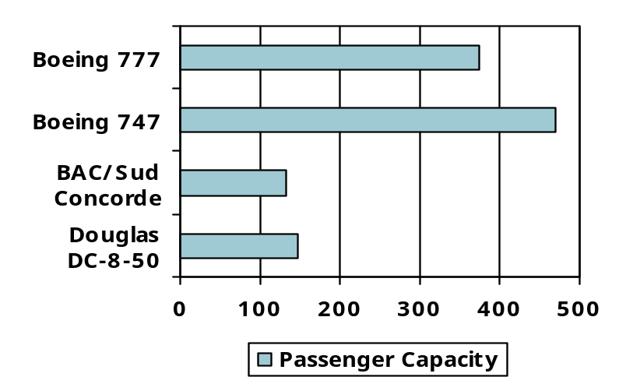
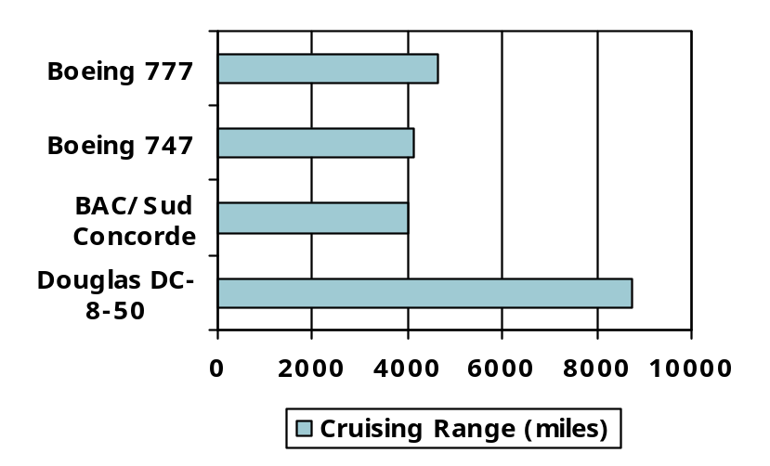
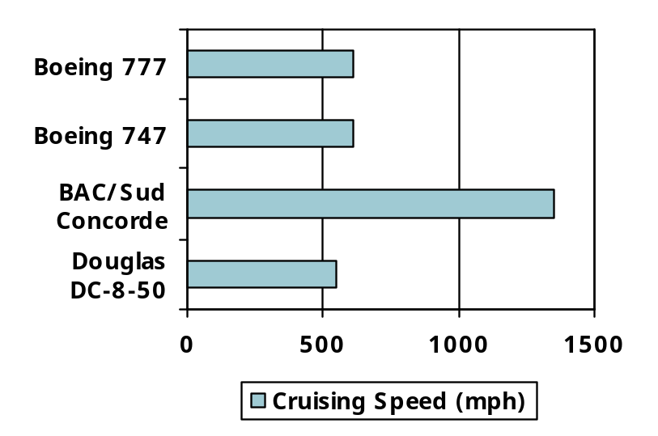
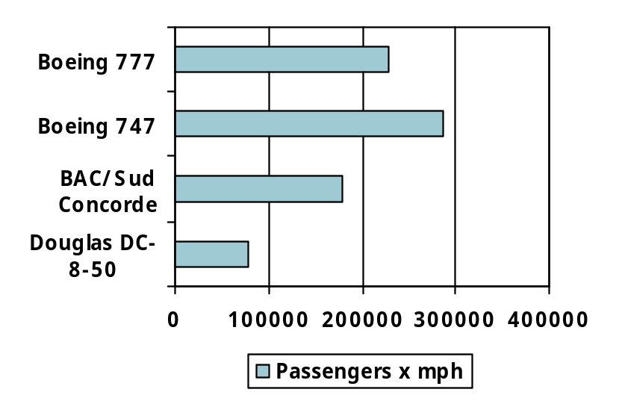
Defining Performance
§1.6 Performance
Which airplane has the best performance?

Slide 4
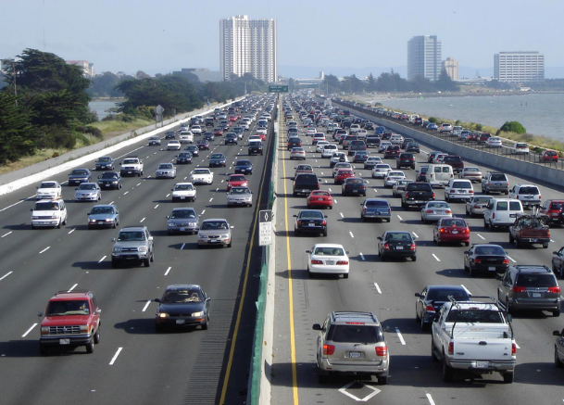
Response Time and Throughput
Response time ⬅➔ Latency
  How long it takes to do a task
Throughput ⬅➔ Bandwidth
  Total work done per unit time
    e.g., tasks/transactions/… per hour
How are response time and throughput affected by
  Replacing the processor with a faster version?
  Adding more processors?
We’ll focus on response time for now…

Slide 5
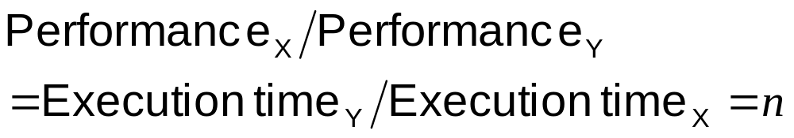
Relative Performance
Define Performance = 1/Execution Time
“X is n time faster than Y”, i.e. speedup
Example: time taken to run a program
  10s on A, 15s on B
  Execution Time_{B} / Execution Time_{A}
  = 15s / 10s = 1.5
  So A is 1.5 times faster than B

Slide 6
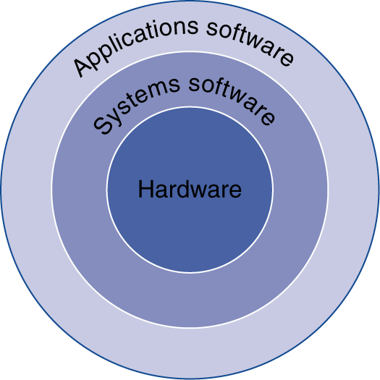
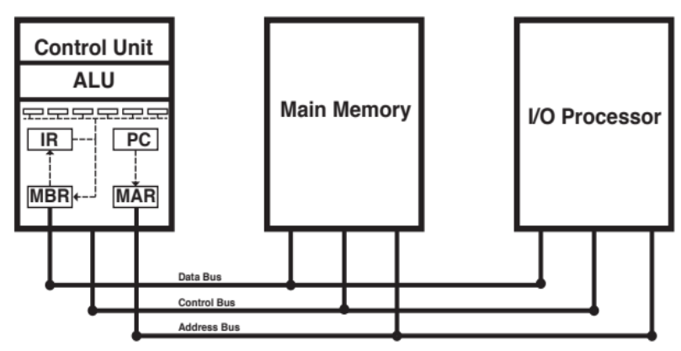
Below Your Program
Program Performance is impacted by many things
Program, i.e. Application software
  Written in high-level language
System software
  Compiler: translates HLL code to machine code
  Operating System: service code
    Handling input/output
    Managing memory and storage
    Scheduling tasks & sharing resources
Hardware
  Processor, memory, I/O controllers
CPU
Input
Output

Slide 7
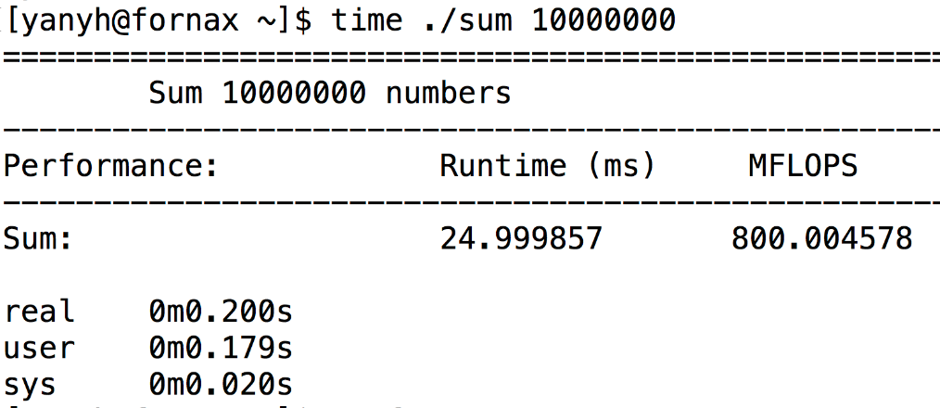
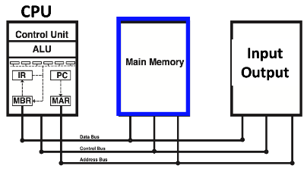
Measuring Execution Time 1/3
Wall clock time, response time, real time
  Total response time, including all aspects
    CPU Time + I/O + OS overhead + idle time
    printf consume OS/system and I/O time
Execution time (time cmd from terminal)
https://passlab.github.io/ITSC3181/exercises/sum/sum_full.c

Slide 8
Measuring Execution Time 2/3
Wall clock time, response time, real time (time cmd)
CPU time
  Time spent processing a given job
    Not including I/O time, other jobs’ shares
  Comprises user CPU time and system CPU time
  Different programs are affected differently by CPU and system
  “time” command in Linux
CPU
Input
Output
Notes:
Real is wall clock time - time from start to finish of the call. This is all elapsed time including time slices used by other processes and time the process spends blocked (for example if it is waiting for I/O to complete).
User is the amount of CPU time spent in user-mode code (outside the kernel) within the process. This is only actual CPU time used in executing the process. Other processes and time the process spends blocked do not count towards this figure.
Sys is the amount of CPU time spent in the kernel within the process. This means executing CPU time spent in system calls within the kernel, as opposed to library code, which is still running in user-space. Like 'user', this is only CPU time used by the process. See below for a brief description of kernel mode (also known as 'supervisor' mode) and the system call mechanism.

Slide 9
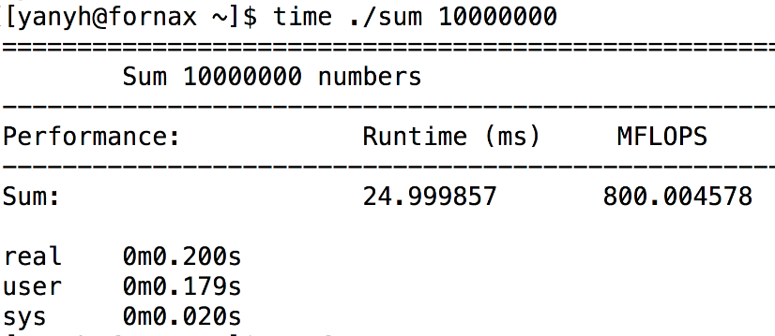
Understanding time command output
Real is wall clock time - time from start to finish of the call. This is all elapsed time including time slices used by other processes and time the process spends blocked (for example if it is waiting for I/O to complete).
User is the amount of CPU time spent in user-mode code (outside the kernel) within the process. This is only actual CPU time used in executing the process. Other processes and time the process spends blocked do not count towards this figure.
Sys is the amount of CPU time spent in the kernel within the process. This means executing CPU time spent in system calls within the kernel, as opposed to library code, which is still running in user-space. Like 'user', this is only CPU time used by the process. See below for a brief description of kernel mode (also known as 'supervisor' mode) and the system call mechanism.

Slide 10

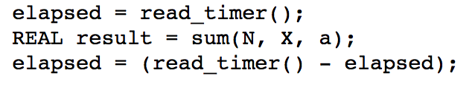
Measuring Execution Time of Specific Operations 3/3
Elapsed time of the sum function: use timer
https://passlab.github.io/ITSC3181/exercises/sum/sum_full.c

Slide 11
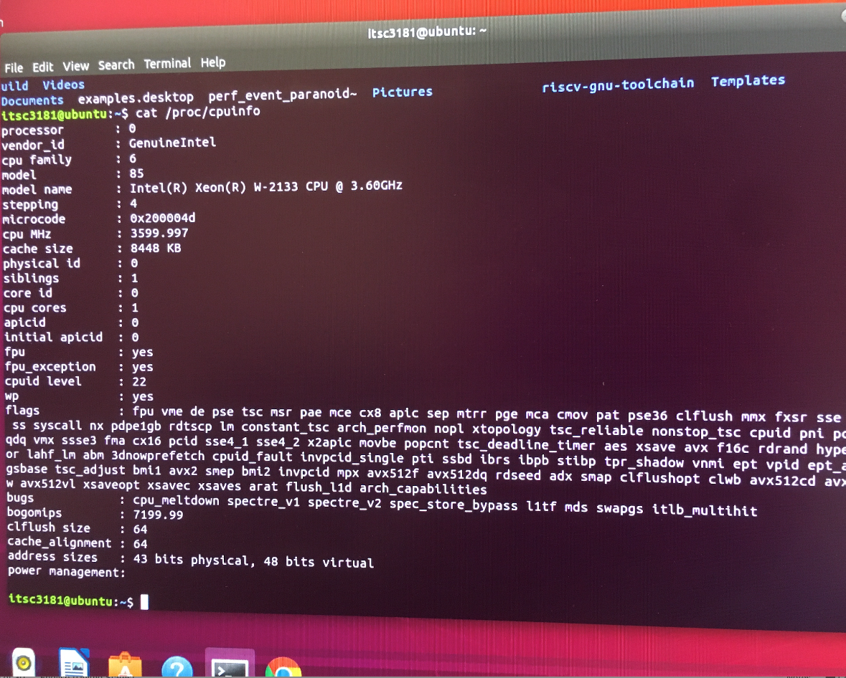
CPU Frequency and Clocking
CPU Frequency can be obtained by checking /proc/cpuinfo
  Intel Xeon ® W-2133 CPU @ 3.60 GHz
  From Intel official website: https://ark.intel.com/content/www/us/en/ark/products/125040/intel-xeon-w-2133-processor-8-25m-cache-3-60-ghz.html
Notes:
106

Slide 12
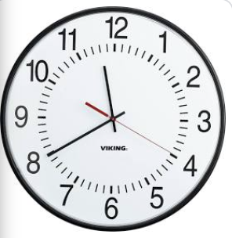
CPU Clocking
Operation of digital hardware governed by a constant-rate clock, alternating high-low voltage (0 and 1 binary state)
Clock period
Clock (cycles)
Data transfer
and computation
Update state
Clock period: duration of a clock cycle
  e.g., 250ps = 0.25ns = 250×10^{–12}s
Clock frequency (rate): cycles per second
  e.g., 4.0GHz = 4000MHz = 4.0×10⁹Hz
Clock period, or cycle time is 1/Frequency

Slide 13
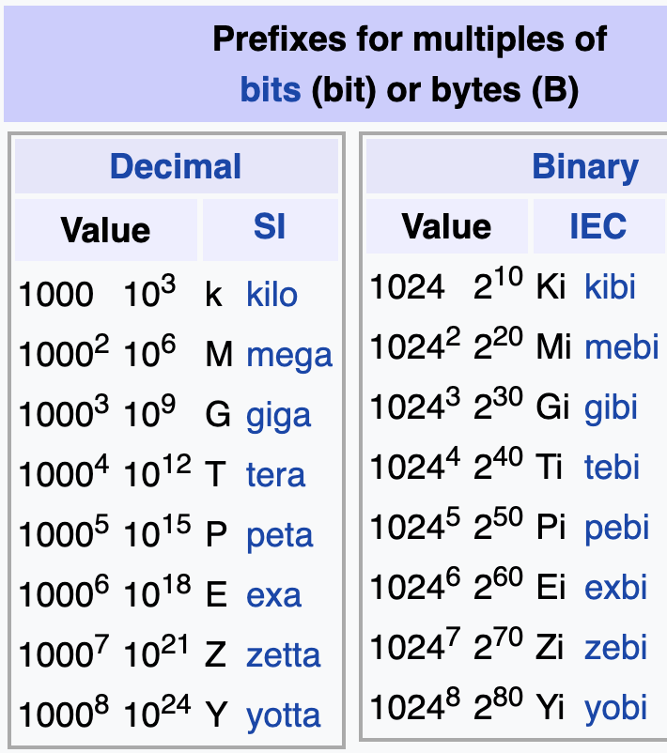
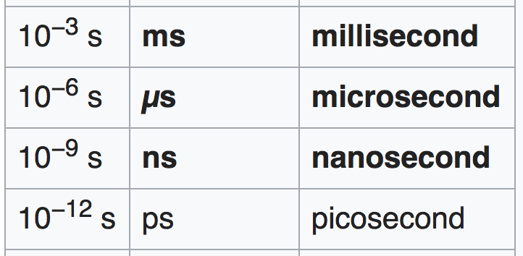
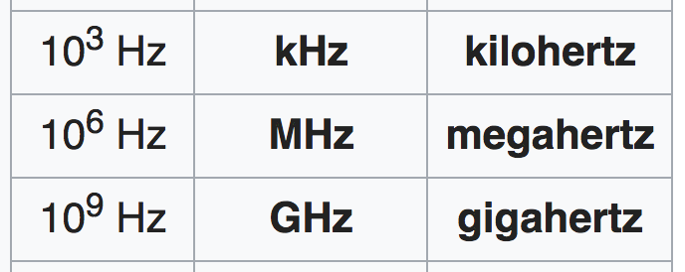
About the Unit
Notes:
Why we do not use billion-byte?

Slide 14
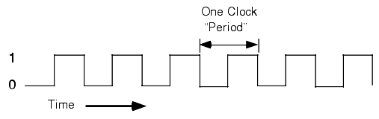
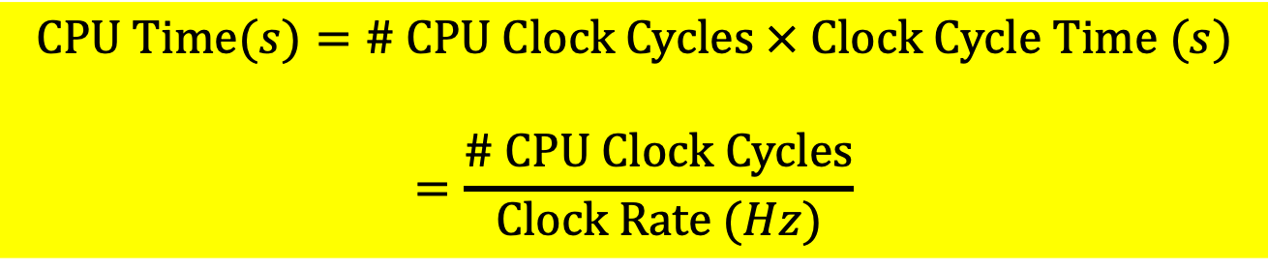
CPU Time
Performance improved by
  Reducing number of clock cycles
  Increasing clock rate
  Hardware designer must often trade off clock rate against cycle count
$$CPU Time(s)=\# CPU Clock Cycles × Clock Cycle Time (s)$$
$$=\frac{\# CPU Clock Cycles}{Clock Rate (Hz)}$$

Slide 15
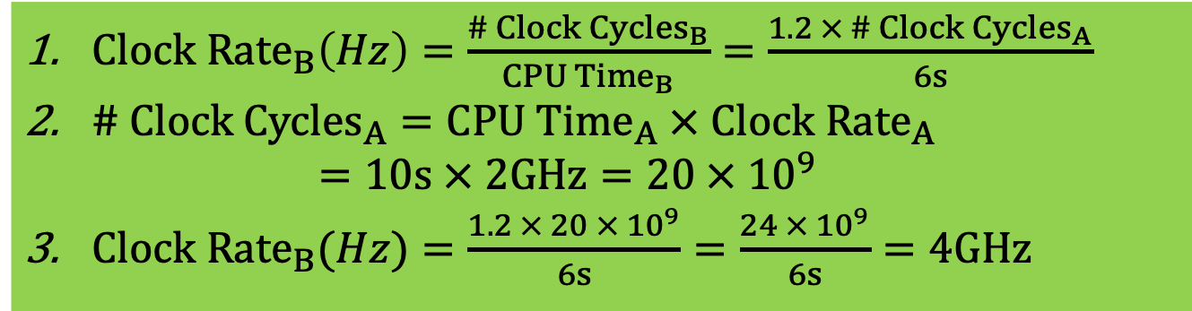
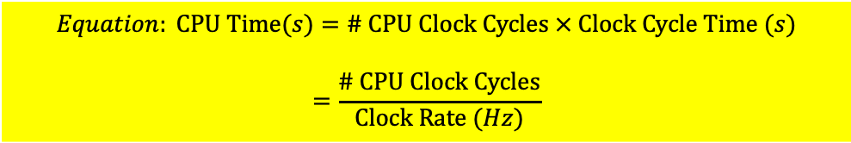
CPU Time Example
Computer A: 2GHz clock, 10s CPU time to execute a program
Designing Computer B
  Aim for 6s CPU time to execute the same program
  Can do faster clock, but causes to have 1.2 X of clock cycles of A
How fast must Computer B clock be?
$$Equation: CPU Time(s)=\# CPU Clock Cycles × Clock Cycle Time (s)$$
$$=\frac{\# CPU Clock Cycles}{Clock Rate (Hz)}$$
$Clock Rate_{B}\left(Hz\right)=\frac{\# Clock Cycles_{B}}{CPU Time_{B}}=\frac{1.2 × \# Clock Cycles_{A}}{6s}$
$\# Clock Cycles_{A}=CPU Time_{A} × Clock Rate_{A}$
$=10s × 2GHz=20 × 10^{9}$
$Clock Rate_{B}(Hz)=\frac{1.2 × 20 × 10^{9}}{6s}=\frac{24 × 10^{9}}{6s}=4GHz$

Slide 16
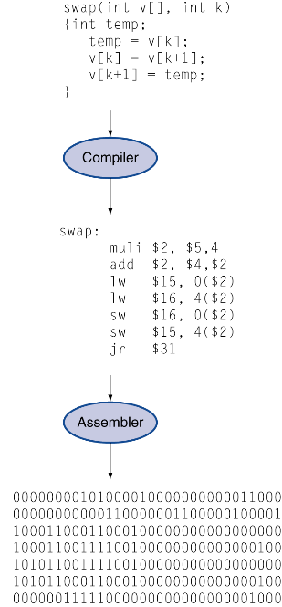
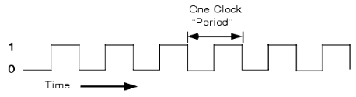
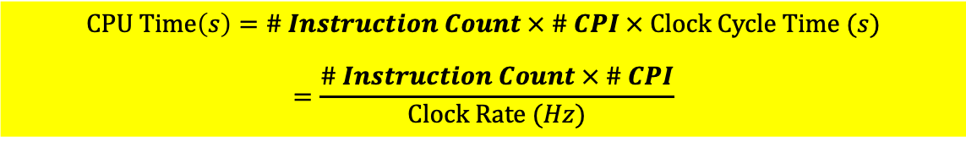
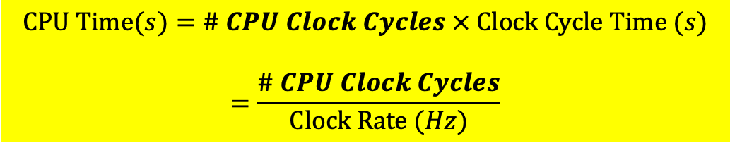
Instruction Count and CPI
Hardware/CPU executes a program instruction by instructions
Instruction Count for a program
  Determined by program, ISA and compiler
Average cycles per instruction (CPI)
  Determined by CPU hardware
  If different instructions have different CPI
    Average CPI affected by instruction mix
$$CPU Time(s)=\# CPU Clock Cycles × Clock Cycle Time (s)$$
$$=\frac{\# CPU Clock Cycles}{Clock Rate (Hz)}$$
$$\# CPU Clock Cycles=\# Instruction Count × \# Cycles per Instruction (CPI)$$
$$CPU Time\left(s\right)=\# Instruction Count × \# CPI × Clock Cycle Time (s)$$
$$=\frac{\# Instruction Count × \# CPI}{Clock Rate (Hz)}$$

Slide 17
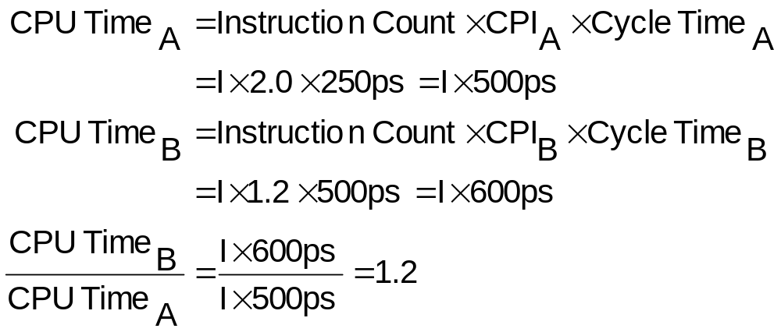

CPI Example
Computer A: Cycle Time = 250ps, CPI = 2.0
Computer B: Cycle Time = 500ps, CPI = 1.2
Same program and same set of instructions (ISA)
Which is faster, and by how much?
$$Equation: CPU Time(s)=\# CPU Clock Cycles × Clock Cycle Time (s)$$
$$=\frac{\# CPU Clock Cycles}{Clock Rate (Hz)}$$
A is faster…
…by this much

Slide 18
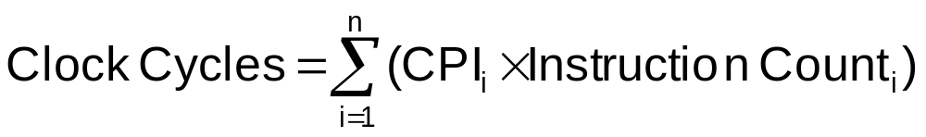
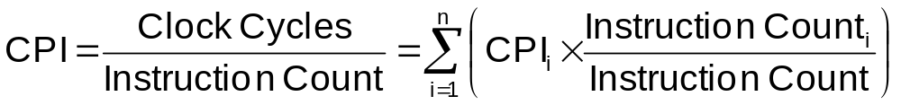
CPI in More Detail
If different instruction classes take different numbers of cycles
$$\# CPU Clock Cycles=\# Instruction Count × \# Cycles per Instruction (CPI)$$
Weighted average CPI
Relative frequency

Slide 19
CPI Example
Alternative compiled code sequences using instructions in classes A, B, C
Class | A | B | C
CPI for class | 1 | 2 | 3
IC in sequence 1 | 2 | 1 | 2
IC in sequence 2 | 4 | 1 | 1
Sequence 1: IC = 5
  Clock Cycles
  = 2×1 + 1×2 + 2×3
  = 10
  Avg. CPI = 10/5 = 2.0
Sequence 2: IC = 6
  Clock Cycles
  = 4×1 + 1×2 + 1×3
  = 9
  Avg. CPI = 9/6 = 1.5

Slide 20
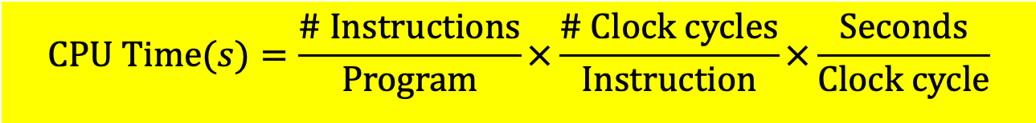
Performance Summary
The BIG Picture
$$CPU Time(s)=\frac{\# Instructions}{Program}×\frac{\# Clock cycles}{Instruction}×\frac{Seconds}{Clock cycle}$$
Performance depends on
  Algorithm: affects IC, possibly CPI
  Programming language: affects IC, CPI
  Compiler: affects IC, CPI
  Instruction set architecture: affects IC, CPI, T_{c}

Slide 21
Questions in HW and Tests
CPU Time = # Clock Cycles * Cycle Time (s) = # Clock Cycles/ClockRate (Hz)
# Clock Cycles = # Instruction Count * Cycles Per Instruction (CPI)
Most questions give you two cases (two computers, e.g.) and some known parameters, and you solve the unknown based on the questions

Slide 22
Download, Compile and Execute sum_full.c for Lab 03
wget https://passlab.github.io/ITSC3181/exercises/sum/sum_full.c
gcc sum_full.c
gcc -save-temps sum_full.c -o sum
./sum 100000
time ./sum 10000000
Checkout sum_full.c and sum_full.s
Generate assembly code by yourself
  X86 assembly code is generated using gcc
    gcc -c -save-temps sum.c
  https://godbolt.org/

Slide 23
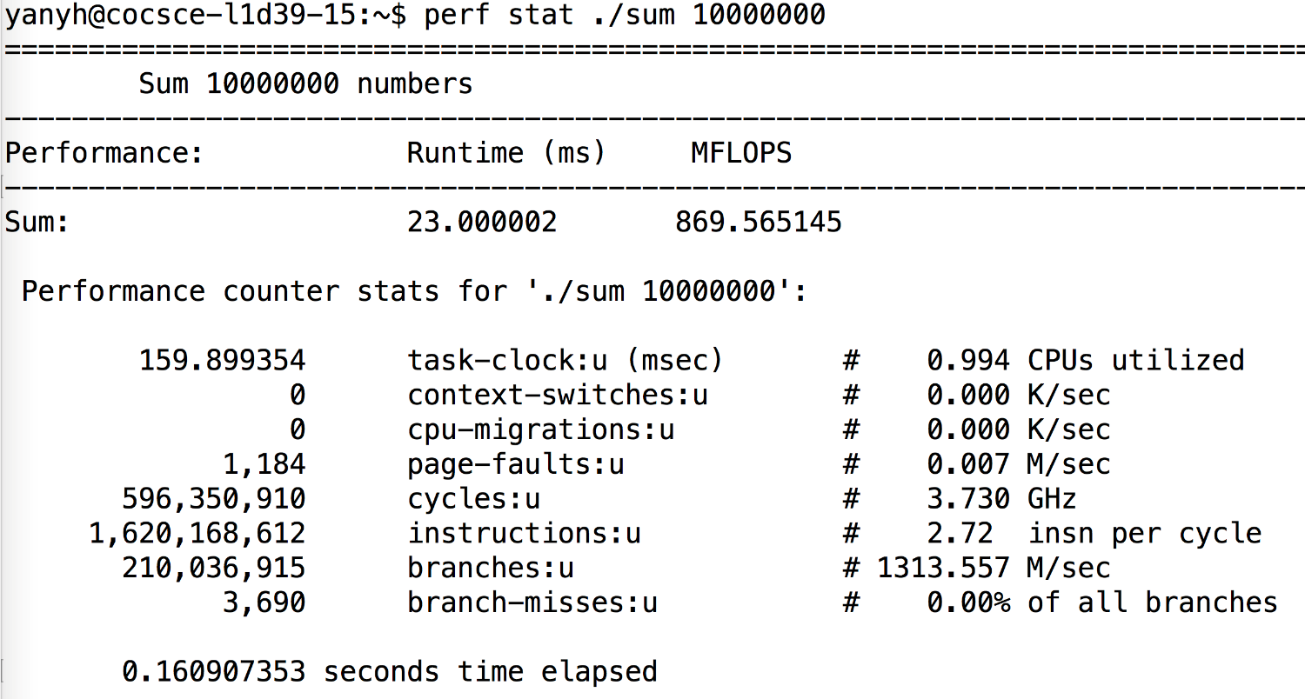
Using Perf for Lab 03
http://www.brendangregg.com/perf.html

Slide 24
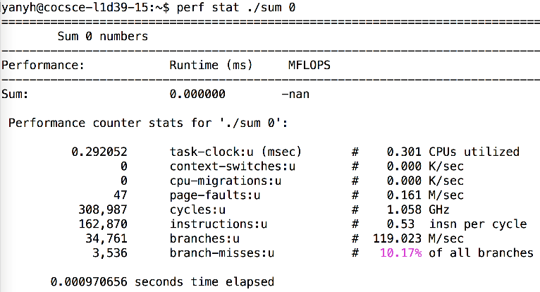
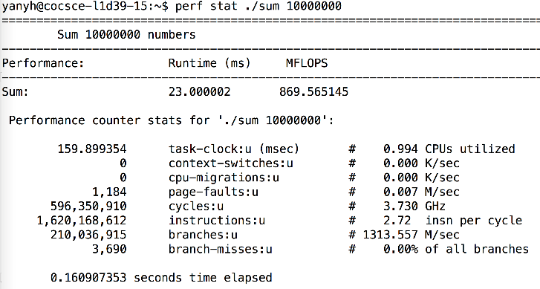
Use perf to collect cycle information for lab 03
perf stat ./sum 0
  To collect non-sum instructions profiles as baseline
perf stat ./sum 1000000
  To collect instruction profiles that include sum and non-sum ins
  Instructions and cycles each can be subtracted, but not CPI
  E.g. for sum 10000000
    Cycles = 596,350,910 – 308,987
    Instructions = 1,620,168,612 - 162,870
  If N=10000000 is huge, baseline can be ignored
  Notice the differences of CPU frequency (1.058 GHz vs 3.730 GHz)

Slide 25
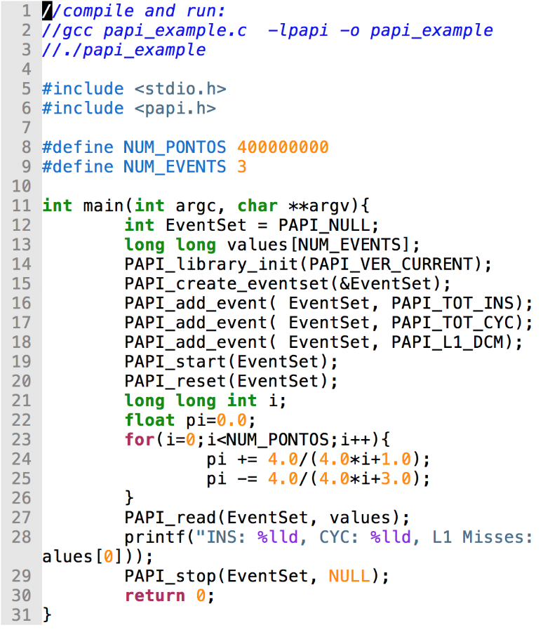
Using PAPI
perf only profiles the whole program execution
PAPI can read hardware counter of a specific part of a program
  Hardware counter records # cycles, # instructions, etc during program execution
https://passlab.github.io/ITSC3181/resources/#papi
https://passlab.github.io/ITSC3181/resources/papi_example.c

Slide 26
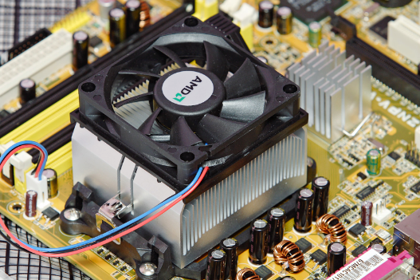
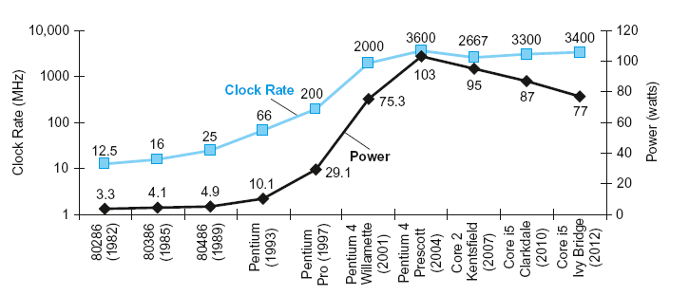
Power and Energy
§1.7 The Power Wall
Problem:
  Get power in and distribute around
  get power out: dissipate heat
Revisit Moore’s Law
  Transistor density double every 2 years
  Translate to frequency till ~2005

Slide 27
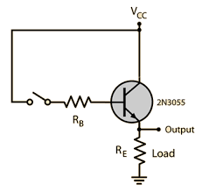
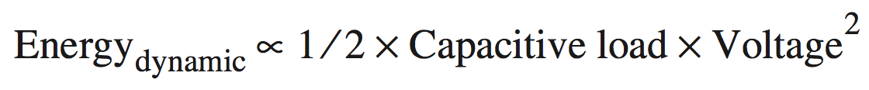
Dynamic Energy and Power
Dynamic energy
  Transistor switch from 0 -> 1 or 1 -> 0
Dynamic power
Reducing clock rate reduces power, not energy
The capacitive load:
  a function of the number of transistors connected to an output and the technology, which determines the capacitance of the wires and the transistors.

Slide 28
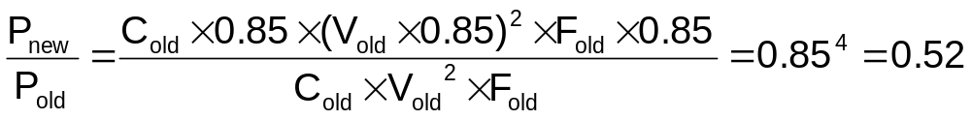
An Example from Textbook
Suppose a new CPU has
  85% of capacitive load of old CPU
  15% voltage and 15% frequency reduction

Slide 29
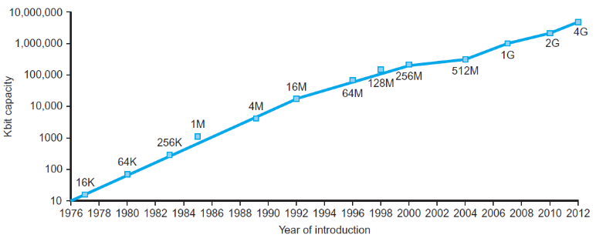
Technology Trends
Electronics technology continues to evolve
  Increased capacity and performance
  Reduced cost
§1.5 Technologies for Building Processors and Memory
DRAM capacity
Year | Technology | Relative performance/cost
1951 | Vacuum tube | 1
1965 | Transistor | 35
1975 | Integrated circuit (IC) | 900
1995 | Very large scale IC (VLSI) | 2,400,000
2013 | Ultra large scale IC | 250,000,000,000

Slide 30
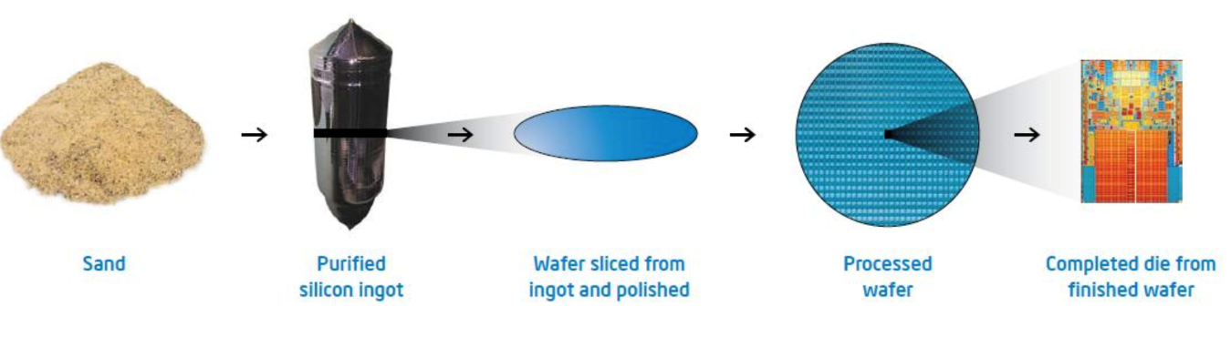
Semiconductor Technology
Silicon: semiconductor
  How to turn sand into gold
Add materials to transform properties:
  Conductors
  Insulators
  Switch

Slide 31
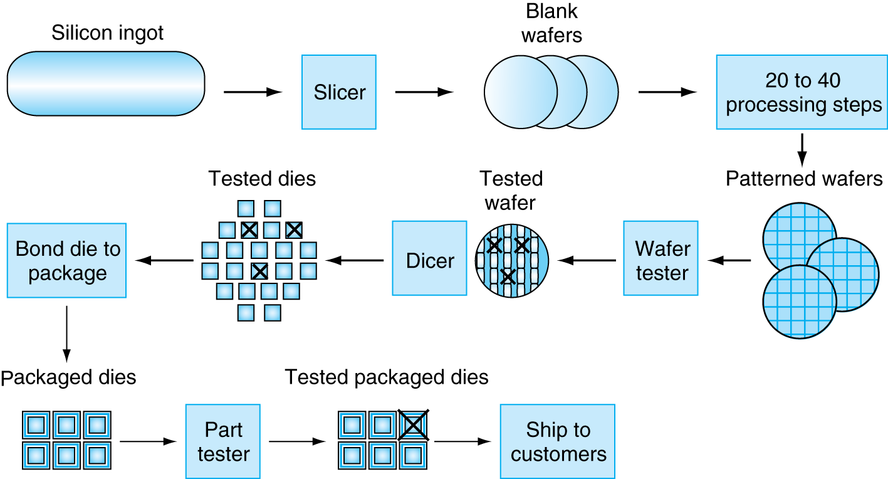
Manufacturing ICs
Yield: proportion of working dies per wafer

Slide 32
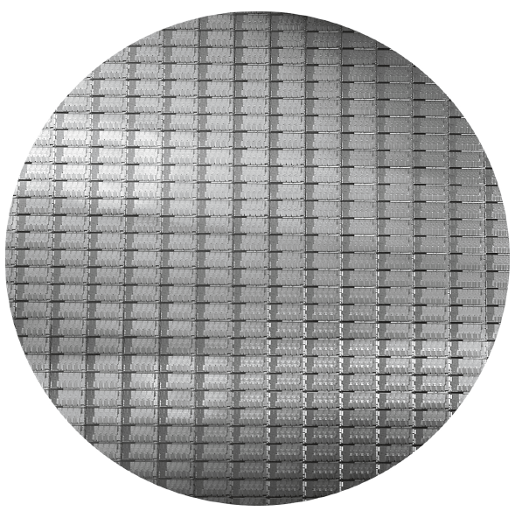
Intel Core i7 Wafer
300mm wafer, 280 chips, 32nm technology
Each chip is 20.7 x 10.5 mm

Slide 33
Silicon Valley

Slide 34
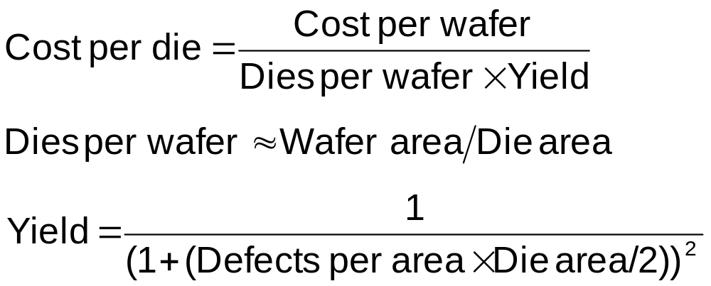
Integrated Circuit Cost
Nonlinear relation to area and defect rate
  Wafer cost and area are fixed
  Defect rate determined by manufacturing process
  Die area determined by architecture and circuit design
A key factor in determining the cost of an integrated circuit is the volume

