Slide 1
Chapter 2: Instructions: Language of the Computer
2.6 – 2.7 Logical Operations, and Branch Instructions
ITSC 3181 Introduction to Computer Architecture https://passlab.github.io/ITSC3181/
Department of Computer Science
Yonghong Yan
yyan7@uncc.edu
https://passlab.github.io/yanyh/

Slide 2
Chapter 2: Instructions: Language of the Computer
Lecture
  2.1 Introduction
  2.2 Operations of the Computer Hardware
  2.3 Operands of the Computer Hardware
Lecture
  2.4 Signed and Unsigned Numbers
  2.5 Representing Instructions in the Computer
Lecture
  2.6 Logical Operations
  2.7 Instructions for Making Decisions
Lecture
  2.8 Supporting Procedures in Computer Hardware
  2.9 Communicating with People
  2.10 RISC-V Addressing for Wide Immediate and Addresses
Lecture
  2.11 Parallelism and Instructions: Synchronization
  2.12 Translating and Starting a Program
    We covered before along with C Basics
  2.13 A C Sort Example to Put It All Together
  2.14 Arrays versus Pointers
    We covered most before along with C Basics
  2.15 Advanced Material: Compiling C and Interpreting Java
  2.16 Real Stuff: MIPS Instructions
  2.17 Real Stuff: x86 Instructions
  2.18 Real Stuff: The rest of RISC-V
  2.19 Fallacies and Pitfalls
  2.20 Concluding Remarks
  2.21 Historical Perspective and Further Reading
☛

Slide 3
Three Classes of Instructions We Will Focus On:
Arithmetic-logic instructions
  add, sub, addi, and, or, shift left|right, etc
Memory load and store instructions
  lw and sw: Load/store word
  ld and sd: Load/store doubleword
Control transfer instructions (changing sequence of instruction execution)
  Conditional branch: bne, beq
  Unconditional jump: j
  Procedure call and return: jal and jr

Slide 4
Logical Operations
§2.6 Logical Operations
Instructions for bitwise manipulation
Operation | C | Java | RISC-V
Shift left | << | << | Sll, slli
Shift right | >> | >>> | Srl, srli
Bit-by-bit AND | & | & | and, andi
Bit-by-bit OR | | | | | or, ori
Bit-by-bit XOR | ^ | ^ | xor, xori
Bit-by-bit NOT | ~ | ~
Useful for extracting and inserting groups of bits in a word

Slide 5
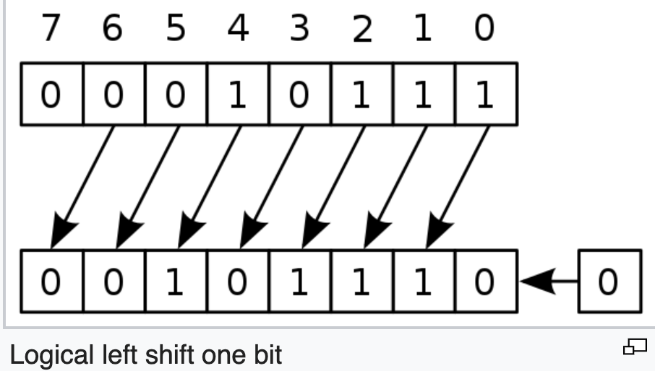
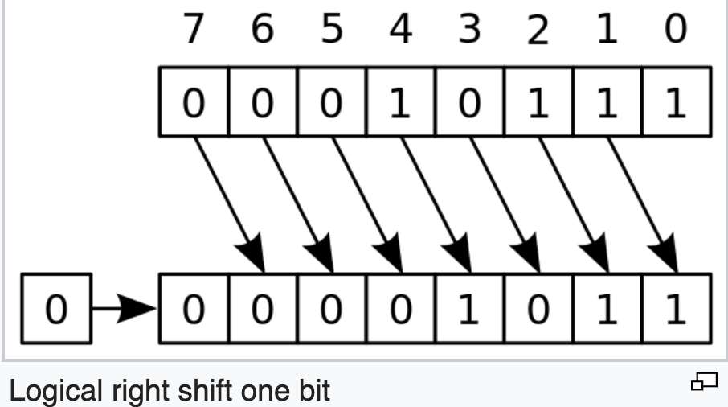
Shift Logic Operation Examples
Shift Left Logic: slli by i bits: multiplies by 2^{i}
  C/java: int i = 23; int j = i<<1; //46
  RISC-V: If i is in x5, and j is stored in x6:
    slliw x6, x5, 1
    slliw: shift left logic immediate word
Instruction name
  Carries the operand type it operates
    B: byte, H: half-word, W: word, D: double word
Shift Right Logic
  Java: int i = 23; int j = i >>> 1; //j=11
  C: int i = 23; int j = i >> 1; //j=11
  RISC-V: if i is in x5, j will be in x6:
    srliw x6, x5, 1
  Fill in 0, not much used for signed

Slide 6
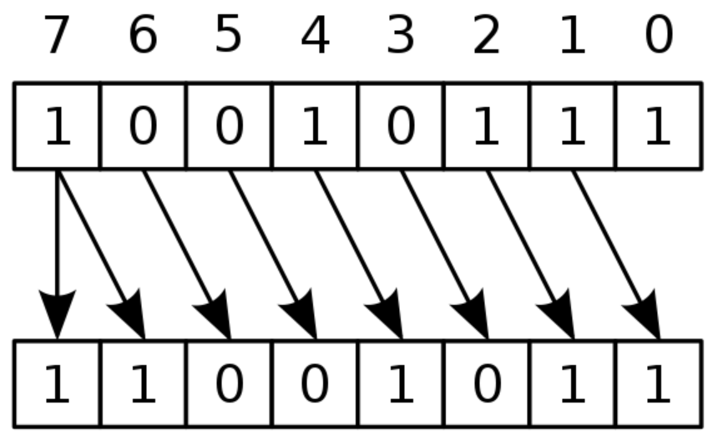
Shift Right Arithmetic
Shift right arithmetic (srai): Format: srai(w) rd, rs, #immediate
  Shift right and fill with sign bit
  srai by i bits: divides by 2^{i}
  Java: i=-105; int j=i>>1; //-53
  RISC-V: if i is in x5, j will be in x6:
    sraiw x6, x5, -1;
-105
-53

Slide 7
Summary of Shift Operations
immed: how many positions to shift
Shift left logical (sll): Format: slli(w) rd, rs, #immediate
  Shift left and fill with 0 bits
  slli by i bits: multiplies by 2^{i}
  E.g. int a = b<<2; //a = b * 4 (2²)
Shift right logical (srl): Format: srli(w) rd, rs, #immediate
  Shift right and fill with 0 bits
  srli by i bits: divides by 2^{i} (unsigned only)
  E.g. int a = b>>2; //a = b / 4 (2²)
Shift right arithmetic (sra): Format: srai(w) rd, rs, #immediate
  Shift right and fill with sign bit
  srai by i bits: divides by 2^{i}
funct6
immed
rs1
funct3
rd
opcode
6 bits
6 bits
5 bits
3 bits
5 bits
7 bits

Slide 8
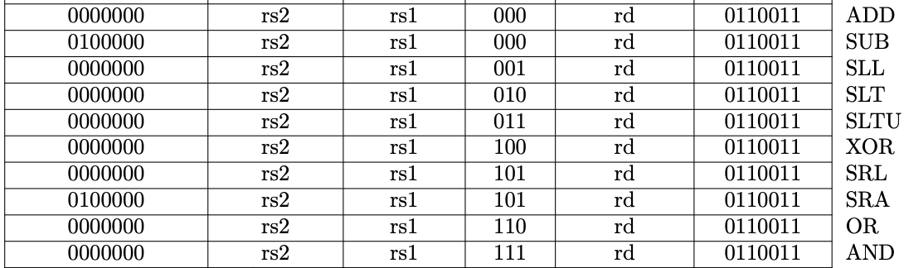
Shift Operation Encoding
Use immediate operands, I-Format
  Immediate: slli, sri, srai, etc
Can use registers for all operands, R-Format
  Sll, sri, sra
funct6
immed
rs1
funct3
rd
opcode
6 bits
6 bits
5 bits
3 bits
5 bits
7 bits
funct7
rs2
rs1
funct3
rd
opcode
7 bits
5 bits
5 bits
3 bits
5 bits
7 bits

Slide 9
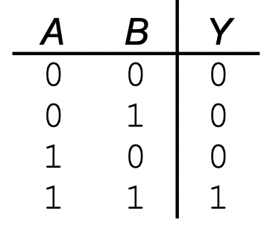
AND Operations
Useful to mask bits in a word
  Select only some bits, clear others to 0
and x9,x10,x11
  To only select 4 bits of x10 in the specific positions: Set the bits of x11 in the same positions 1, and the bits in other positions 0, and then perform AND and store the result in a new register x9
x10
00000000 00000000 00000000 00000000 00000000 00000000 00001101 11000000
x11
00000000 00000000 00000000 00000000 00000000 00000000 00111100 00000000
x9
00000000 00000000 00000000 00000000 00000000 00000000 00001100 00000000

Slide 10
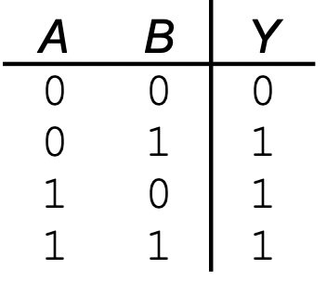
OR Operations
Useful to include bits in a word
  Set some bits to 1, leave others unchanged
or x9,x10,x11
  To only set 4 bits of x10 in the specific positions 1: Set the bits of x11 in the same positions 1, and the bits in other positions 0, and then perform OR and store the result in a new register x9
x10
00000000 00000000 00000000 00000000 00000000 00000000 00001101 11000000
x11
00000000 00000000 00000000 00000000 00000000 00000000 00111100 00000000
x9
00000000 00000000 00000000 00000000 00000000 00000000 00111101 11000000

Slide 11
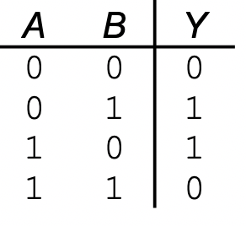
XOR Operations
Differencing operation
  E.g. NOT operation
xor x9,x10,x12 // NOT operation, invert bits
  To invert bit (logical NOT) of x10: set all bits of x12 as 1, do xor of x10 and x11, and store the result in x9
x10
00000000 00000000 00000000 00000000 00000000 00000000 00001101 11000000
x12
11111111 11111111 11111111 11111111 11111111 11111111 11111111 11111111
x9
11111111 11111111 11111111 11111111 11111111 11111111 11110010 00111111

Slide 12
Conditional Branch
Branch to the labeled instruction if a condition is true, otherwise continue
beq rs1, rs2, L1
  if (rs1 == rs2, i.e. true) branch to instruction labeled L1 (branch target);
  else continue the following instruction
  beq x1, x2, label1
  add x5, x6, x7
  …
  addi …
  label1: sub x5, x6, x7
  …
bne rs1, rs2, L1
  if (rs1 != rs2) branch to instruction labeled L1 (branch target);
  else continue the following instruction
J: unconditional jump (not an instruction)
  beq x0, x0, L1
§2.7 Instructions for Making Decisions
  beq x1, x2, label1
  add x5, x6, x7
  …
  addi …
  label1: sub x5, x6, x7
  …
False
True
True
Notes:
L2: addi x5, x5, 1 //L1 could be here
add x10, x5, x11
beq x5, x6, L1 //can branch backward
add x10, x10, x9
sub ….
…
L1: sub x10, x10, x9
add …
…
True

Slide 13
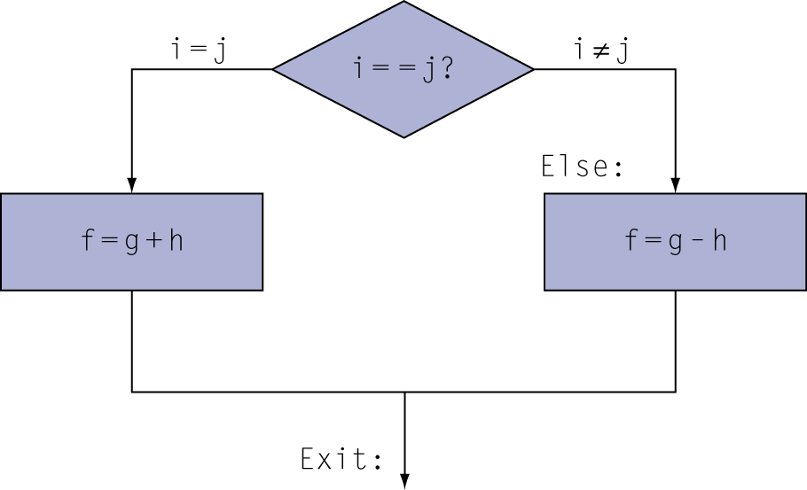
Translating If Statements 1/2
C code:
if (i==j) f = g+h;
else f = g-h;
Compiled RISC-V code:
bne x22, x23, Else //branch if not equal
add x19, x20, x21 //Then path
beq x0, x0, Exit //unconditional
Else: sub x19, x20, x21 //Else path
Exit: …
Variable | f | g | h | i | j
Register | x19 | x20 | x21 | x22 | x23
Using bne (reverse of if (==)) to branch to the Else path b.c. we want the code following the bne to be the code of the Then path
We need “beq x0 x0 Exit”, an unconditional jump, to let Then path terminate since CPU executes instruction in the sequence if not branching.

Slide 14
Translating If Statements 2/2
C code:
if (i==j) f = g+h;
else f = g-h;
Compiled RISC-V code:
beq x22, x23, Then //branch if equal
sub x19, x20, x21 //Else path
beq x0, x0, Exit //unconditional
Then: add x19, x20, x21 //Then path
Exit:
Variable | f | g | h | i | j
Register | x19 | x20 | x21 | x22 | x23
Using beq (for if (==)) to branch to the Then path
The instruction that follows the beq is the Else path
We need “beq x0 x0 Exit”, a unconditional jump, to let Else path terminate since CPU executes instruction in the sequence if not branching.
Notes:
beq x22 x23 then
F = g-h
Beq x0 x0 exit
Then: f=g+h
Exit

Slide 15
Translating Loop Statement
i = 0;
for (i=0; i<100; i++) { … }
while (i<100) { …; i++; }
Do the loop structure first
  Init condition
  Loop condition (using reverse relationship for branch instr)
  True path (the loop body)
  Loop back
  False path (break the loop)
Then translate the loop body
False
i < 100 ?
True
…
Exit
i ++
Loop: beq/bge x22, x23, Exit
… # loop body
addi x22, x22, 1
beq x0, x0, loop
Exit:
Using bge for (<) to branch to the false/exit path, which breaks the loop
The instruction(s) following bge are for the true path, which are for the loop body.
beq to jumping back to the beginning of the loop

Slide 16
Translating Loop Statement: for loop
i = 0;
C code:
for (i=0; i<100; i++) …
  i in x22
RISC-V code:
addi x22, x0, 0
li x23, 100
Loop: bge x22, x23, Exit //beq works
… …
addi x22, x22, 1 //true,the loop body,i++
beq x0, x0, Loop
Exit: …
False
i < 100 ?
True
…
Exit
i ++
Using bge for (<) to branch to the false/exit path, which breaks the loop
The instruction(s) following bge are for the true path, which are for the loop body.
beq to jumping back to the beginning of the loop

Slide 17
Translating Loop Statement: while loop (textbook 2.7)
C code:
while (save[i] == k) i += 1;
  i in x22, k in x24
  address of save in x25
RISC-V code: (save[i] is to be read/loaded)
Loop: slli x10, x22, 3 //x10 has i*8
add x10, x10, x25 //base+offset
ld x9, 0(x10)//save[i] in x9
bne x9, x24, Exit //false
addi x22, x22, 1 //true,the loop body,i=i+1
beq x0, x0, Loop
Exit: …
False
(save[i] == k) ?
True
Exit
i += 1
Using bne for (==) to branch to the false path, which breaks the loop by going to the Exit
The instruction(s) following bne are for the true path, which are for the loop body.
beq to jumping back to the beginning of the loop

Slide 18
More Conditional Operations
blt rs1, rs2, L1
  if (rs1 < rs2) branch to instruction labeled L1
bge rs1, rs2, L1
  if (rs1 >= rs2) branch to instruction labeled L1
Example:
if (a > b) a += 1; //a in x22, b in x23
  bge x23, x22, Exit // branch if b >= a
  addi x22, x22, 1
  Exit:

Slide 19
for (i=1; i<M-1; i++) B2[i] = B[i-1] + B[i] + B[i+1];
1-D stencil: B2[i] = B[i-1] + B[i] + B[i+1]; int type
  Representing a typical program pattern: Need to access a memory location and its surrounding area
Converting to assembly
  Similar to while loop
  Do the loop structure first (init, condition, loop back, etc)
  Then do the loop body
B[0]
B[1]
B[2]
B[3]
B[i-2]
B[i-1]
B[i]
B[i+1]
B[i+2]
B[N-4]
B[N-3]
B[N-2]
B[N-1]
B2[0]
B2[1]
B2[2]
B2[3]
B2[i-2]
B2[i-1]
B2[i]
B2[i+1]
B2[i+2]
B2[N-4]
B2[N-3]
B2[N-2]
B2[N-1]

Slide 20
for (i=1; i<M-1; i++) B2[i] = B[i-1] + B[i] + B[i+1];
Base address B and B2 are in register x22 and x23. i is stored in register x5, M is stored in x4.
  addi x5, x0, 1 // i=1
  addi x21, x4, -1 // loop bound x21 has M-1
  LOOP: bge x5, x21, Exit
  slliw x6, x5, 2 // x6 now store i*4, slliw is i<<2 (shift left logic)
  add x7, x22, x6 // x7 now stores address of B[i].
  lw x9, 0(x7) // load B[i] from memory location (x7+0) to x9
  lw x10, -4(x7) // load B[i-1] to x10
  add x9, x10, x9 // x9 = B[i] + B[i-1]
  lw x10, 4(x7) //load B[i+1] to x10
  add x9, x10, x9 // x9 = B[i-1] + B[i] + B[i+1]
  add x8, x23, x6 // x8 now stores the address of B2[i]
  sw x9, 0(x8) // store value for B2[i] from register x9 to memory (x8+0)
  addi x5, x5, 1 // i++
  beq x0, x0, LOOP
  Exit:
Using bge (>=) for <, i.e. reverse relationship, to exit

Slide 21
Why Use Reverse Relationship between High-level Language Code and instructions
L2: addi x5, x5, 1
add x10, x5, x11
beq x5, x6, L1
add x10, x10, x9
sub ….
…
L1: sub x10, x10, x9
add …
…
To keep the original code sequence
and structure as much as possible.
High level language
  If (==|>|<, …) true do the following things
  while (==|>|<, …) do the following things
  for (; i<M; …) do the following things
b* Instructions
  If (true), go to branch target,
    i.e. do NOT the following things of b*

Slide 22
Signed vs. Unsigned
Signed comparison: blt, bge
Unsigned comparison: bltu, bgeu
Example
  x22 = 1111 1111 1111 1111 1111 1111 1111 1111
  x23 = 0000 0000 0000 0000 0000 0000 0000 0001
  x22 < x23 // signed
    –1 < +1
    “blt x22 x23” true and branch to target
  x22 > x23 // unsigned
    +4,294,967,295 > +1
    “bltu x22 x23” false and not branch

Slide 23
Code Structure of A Program
.globl main #declare main function
.data # The .data section of the program is used to
# reserve memory to use for the variables/arrays
.text #The .text section is the actual code
main: #definition of main function

Slide 24
Declare An Array
.globl main #declare main function
.data #The .data section, for the variables/arrays
buffer: .space 8 #declare a symbol named "buffer" for
# 8 bytes of memory.
# For a word element, this correspond to "int buffer[2]"
#If you need to declare an array of 100 elements of int,
# use "myArray: .space 400
.text #The .text section of the program is the actual code
main: #definition of main function
la t0, buffer # set register t0 to have the address of the buffe[0]
li t1, 8 # Set register t1 to have immediate number 8

Slide 25
Random Number Generator
li a0, 0 # for random number seed
li a1, 100 # range of random number
li a7, 42 # rand code
ecall # call random number generator to generate a random number stored in a0
Check: https://github.com/TheThirdOne/rars/wiki/Environment-Calls

Slide 26
Memory.s file
.globl main #declare main function
.data #The .data section of the program is used to claim memory to use for the variables/arrays of the program
buffer: .space 8 #declare a symbol named "buffer" for 8 bytes of memory. For a word element, this coorespond to "int buffer[2]"
#This declaration claims 8 bytes of memory.
#If you need to declare an array of 100 elements of word, use "myArray: .space 400
.text #The .text section of the program is the actual code
main: #definition of main function
la t0, buffer # set register t0 to have the address of the buffer variable
li t1, 8 # Set register t1 to have immediate number 8
sw t1, 0(t0) # store a word (4 bytes) of what register t1 contains (8) to memory address 0(t0), which is buffer[0]
lw t2, 0(t0) # load a word from memory address 0(t0) to register t2, i.e. buffer[0] -> t2
bne t1, t2, failure # check whether register t1 and t2 contain the same value or not. If not, branch to failure, else continue the next instruction
li t3, 56 # set register t3 to have immediate 56
sw t3, 4(t0) # store a word of what register t3 contains (56) to memory address 4(t0), which is buffer[1]
addi t0, t0, 4 # increment register t0 (&buffer) by 4, t0 now contains buffer+4, which is &buffer[1]
lw t4, 0(t0) # load a word from memory 0(t0) (&buffer[1]) to register t4
bne t3, t4, failure # check whether register t3 and t4 contain the same value or not. If not, branch to failure, else continue.
lw t5, -4(t0) # load a word from memory -4(t0) to register t5. -4(t0) address is actually &buffer[0] since register t0 now contains the address of buffer[1]
bne t5,t1, failure # check whether register t5 and t1 contain the same value or not. They should both contain 8
li t1, 0xFF00F007 # set register t1 to have value 0xFF00F007
sw t1, 0(t0) # store a word of what register t1 contains to memory address 0(t0) (&buffer[1])
lb t2, 0(t0)

Slide 27
Example
Find the minimum of an array
    A is in t0, min is in t1, i is in t2, N is in t3
    # Init condition: i=0
    add t2, x0, x0 # li t2, 0
    lw t1, 0(t0)
Loop: bge t2, t3, Exit # (if i >= N) break the loop, the false path
    slli t6, t2, 2 #mul t6, t2, 4
    add t7, t0, t6
    lw t4, 0(t7)
    blt t4, t1, TRUE
    J FALSE
TRUE: add t1, x0, t4 # copy A[i] to min
FALSE:
    addi t2, t2, 1
    J loop #beq x0 x0 loop
Exit:
    int A[N];
    int min = A[0];
    for (i=0; i<N; i++) {
    if (A[i] < min) min = A[i]; //loop body
    }

Slide 28
Switch-case
int i;
switch (i) {
case 0:
a = 0;
break;
case 1:
a = 1;
break;
case 2:
a = 2;
break;
default:
a = i;
}

Slide 29
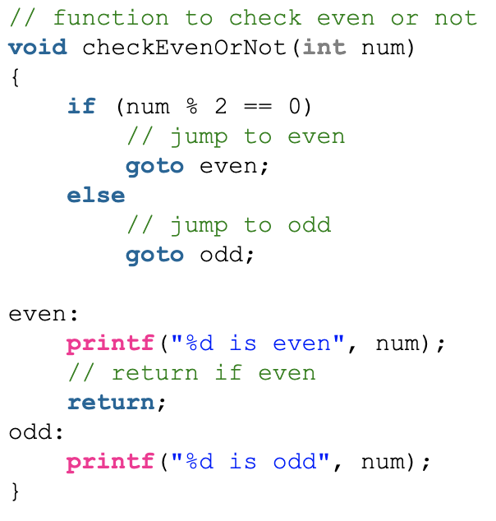
Branch is ”if ( … ) goto ” of high-level code
L2: addi x5, x5, 1
add x10, x5, x11
beq x5, x6, L1
add x10, x10, x9
sub ….
…
L1: sub x10, x10, x9
add …
…

Slide 30
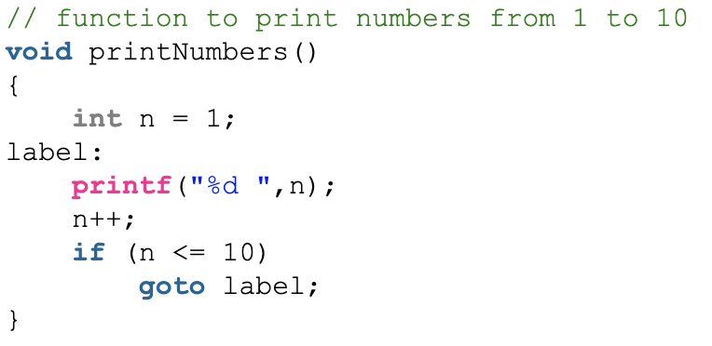
Branch is ”if ( … ) goto ” of high-level code
L2: addi x5, x5, 1
add x10, x5, x11
beq x5, x6, L1
add x10, x10, x9
sub ….
…
L1: sub x10, x10, x9
add …
…
Not directly
  If ( … ) {
  …
  } else {
  …
  }
With branch (if goto), we can implement:
  if … else
  for loop, while loop, do loop
  switch case

Slide 31
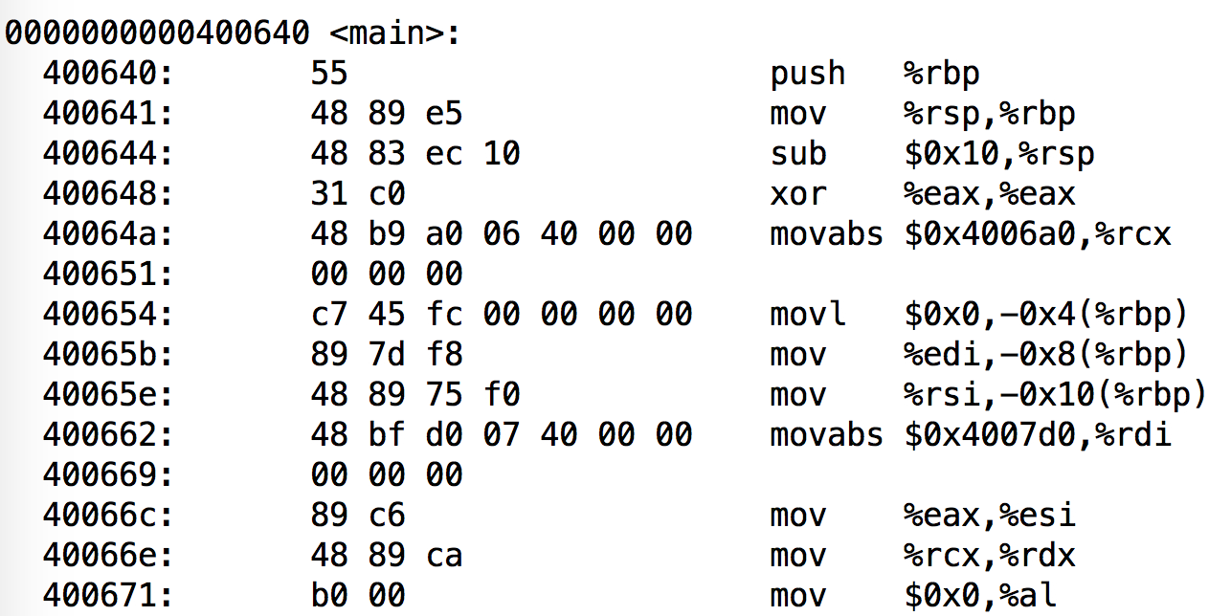
Label in C
Label (a program symbol) is the symbolic representation of the address of the memory that the instruction is stored in.

Slide 32
Compiling Loop Statements 2/3
C code:
while (save[i] == k) i += 1;
  i in x22, k in x24
  address of save in x25
RISC-V code: (save[i] is to be read/loaded)
Loop: slli x10, x22, 3 //x10 has i*8
add x10, x10, x25 //base+offset
ld x9, 0(x10)//newbase in x10
beq x9, x24, Body //True
beq x0, x0, Exit //False
Body: addi x22, x22, 1 //true,the loop body,i=i+1
beq x0, x0, Loop
Exit: …
False
(save[i] == k) ?
True
Exit
i += 1
Using beq for (==) to branch to the true path, which is the loop body
The instruction following beq is the false path, which breaks the loop by jumping to Exit
We need another beq to jumping back to the beginning of the loop, i.e. loop back
Not as elegant as the previous version, one more instruction in the code. But not necessary executing more instructions.

