Slide 1
Chapter 2: Instructions: Language of the Computer
2.1 – 2.3 Introduction, Operations and Operands,
2.4 – 2.5 Signed and Unsigned Numbers, Representing Instructions in the Computer
ITSC 3181, Introduction to Computer Architecture https://passlab.github.io/ITSC3181/
Department of Computer Science
Yonghong Yan
yyan7@uncc.edu
https://passlab.github.io/yanyh/

Slide 2
Chapter 2: Instructions: Language of the Computer
☛
Lecture
  2.8 Supporting Procedures in Computer Hardware
  2.9 Communicating with People
  2.10 RISC-V Addressing for Wide Immediate and Addresses
Lecture
  2.11 Parallelism and Instructions: Synchronization
  2.12 Translating and Starting a Program
    We covered before along with C Basics
  2.13 A C Sort Example to Put It All Together
  2.14 Arrays versus Pointers
    We covered most before along with C Basics
  2.15 Advanced Material: Compiling C and Interpreting Java
  2.16 Real Stuff: MIPS Instructions
  2.17 Real Stuff: x86 Instructions
  2.18 Real Stuff: The rest of RISC-V
  2.19 Fallacies and Pitfalls
  2.20 Concluding Remarks
  2.21 Historical Perspective and Further Reading
Lecture
  2.1 Introduction
  2.2 Operations of the Computer Hardware
  2.3 Operands of the Computer Hardware
Lecture
  2.4 Signed and Unsigned Numbers
  2.5 Representing Instructions in the Computer
Lecture
  2.6 Logical Operations
  2.7 Instructions for Making Decisions

Slide 3
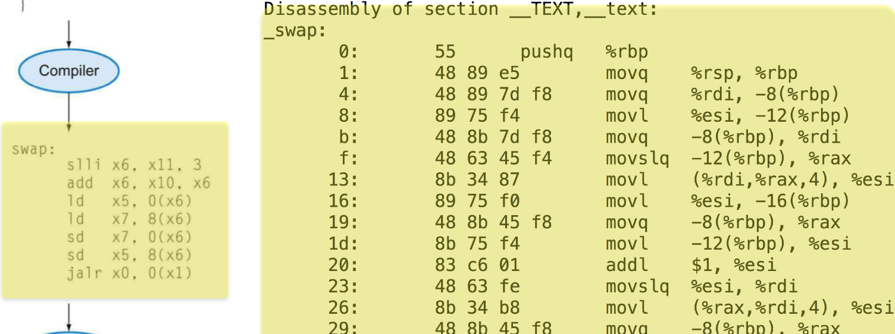
Instruction Set
§2.1 Introduction
The repertoire of instructions of a computer
Different computers have different instruction sets
  But with many aspects in common
Early computers had very simple instruction sets
  Simplified implementation
Many modern computers also have simple instruction sets

Slide 4
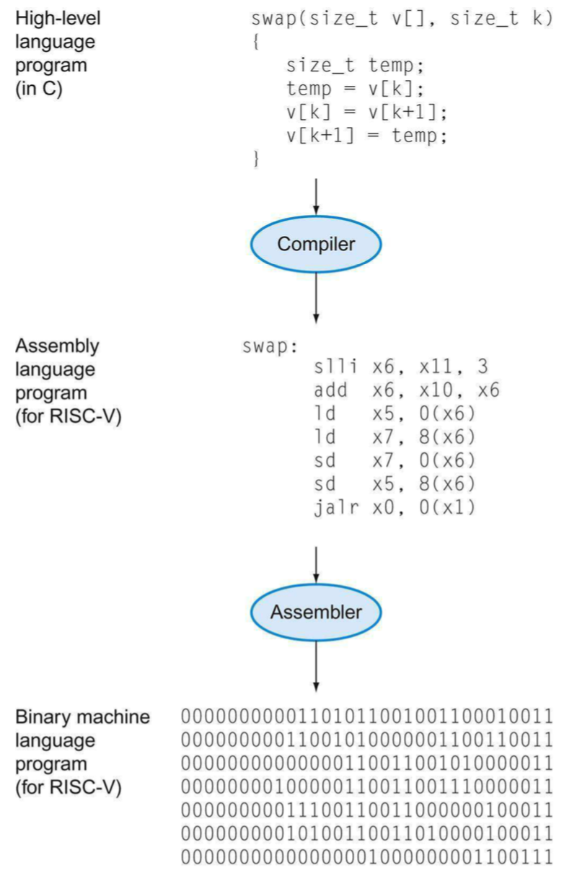
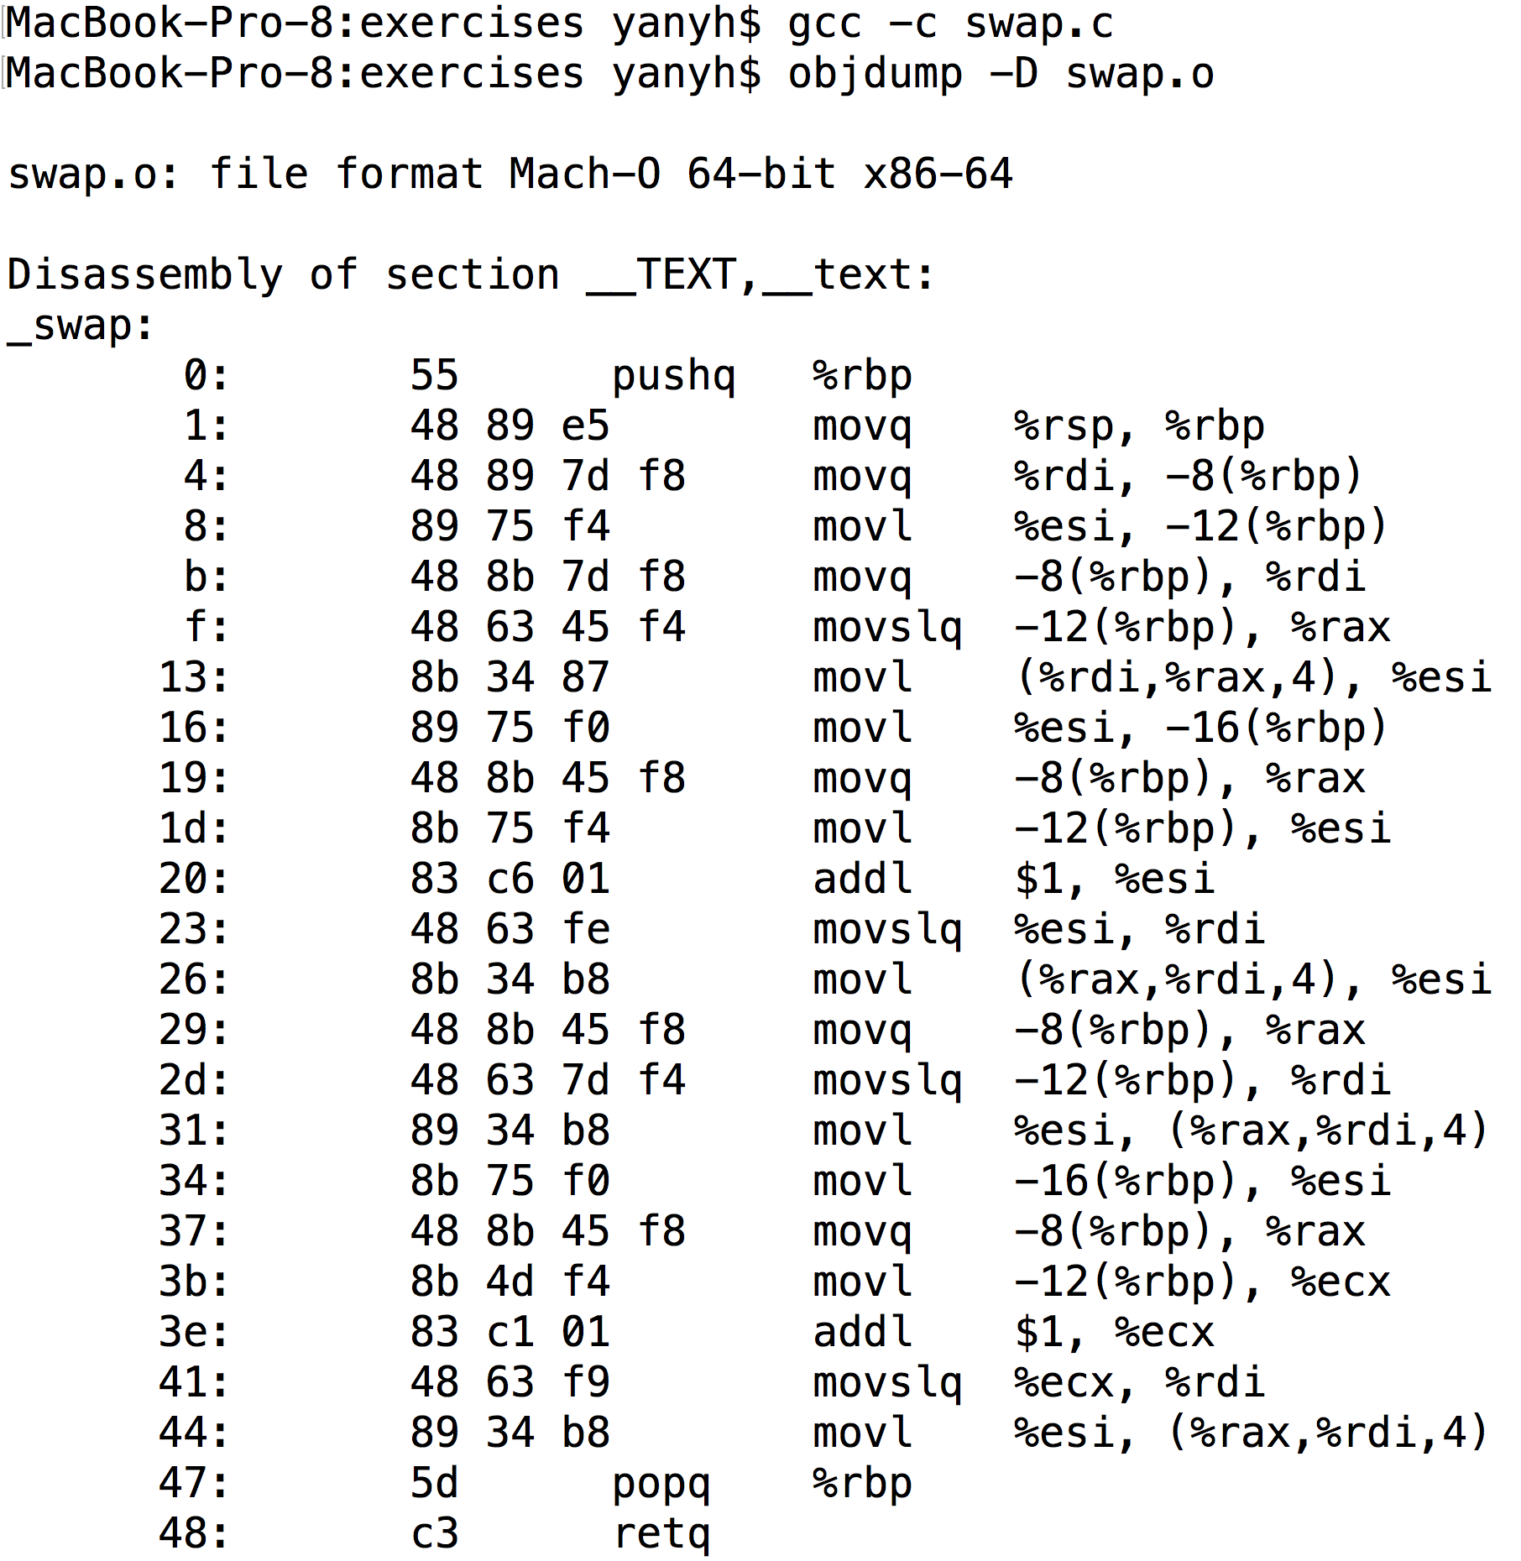
RISC-V and X86_64 Assembly Example

Slide 5
The RISC-V Instruction Set
Used as the example throughout the book
  We will use and study only three classes of instructions for a handful of ins
  Sufficient for most programs.
Developed at UC Berkeley as open ISA
Now managed by the RISC-V Foundation (riscv.org)
Typical of many modern ISAs
  See RISC-V Reference Data tear-out card
Similar ISAs have a large share of embedded core market
  Applications in consumer electronics, network/storage, cameras, printers, …
Other Instruction Set Architectures:
  X86 and X86_32: Intel and AMD, main-stream desktop/laptop/server
  ARM: smart phone/pad
  RISC-V: emerging and free ISA, closer to MIPS than other ISAs
    The same textbook in RISC-V version
  Others: Power, SPARC, etc

Slide 6
We Will Study Three Classes of Instructions
General form:
  <op word> <dest operand> <src operand 1> <src operand 2>
Arithmetic-logic instructions
  add, sub, addi, and, or, shift left|right, etc
Memory load and store instructions
  lw and sw: Load/store word
  ld and sd: Load/store doubleword
Control transfer instructions (changing sequence of instruction execution)
  Conditional branch: bne, beq
  Unconditional jump: j (
  Procedure call and return: jal and jr

Slide 7
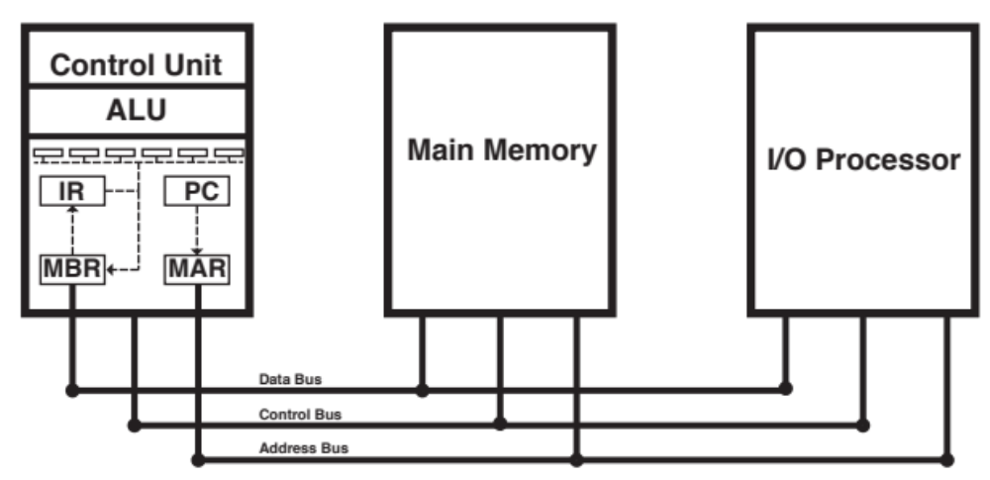
Components of a Computer
CPU or Processor
Input
Output
Notes:
CPU or Processor

Slide 8
Arithmetic Operations (of the First Class Instrs)
Add and subtract, three operands
  Two sources operands: provide input or source data
  One destination operand: where result goes to.
add a, b, c //sum of b and c is placed in a
All arithmetic operations have this form
  Three operands, two sources and one destination
  3-operands instructions
Design Principle 1: Simplicity favors regularity
  Regularity makes implementation simpler
  Simplicity enables higher performance at lower cost
§2.2 Operations of the Computer Hardware

Slide 9
Arithmetic Example
C code:
f = (g + h) - (i + j);
Compiled RISC-V code:
add t0, g, h // temp t0 = g + h
add t1, i, j // temp t1 = i + j
sub f, t0, t1 // f = t0 - t1
What are those symbols (t0, g, h, …) and where are their values are stored?
  Recall variables refers to memory locations
  Registers: super-fast small memory/storage used inside a CPU chip

Slide 10
Registers in CPU
Registers are super-fast small memory/storage used in CPU.
  General-purpose registers, program counter, instruction register, status register, floating-point register, etc
  32 GP Registers in RISC-V CPU, 32-bit or 64-bit size for each
Data and instructions need to be loaded to memory and then register in order to be processed.
§2.3 Operands of the Computer Hardware

Slide 11
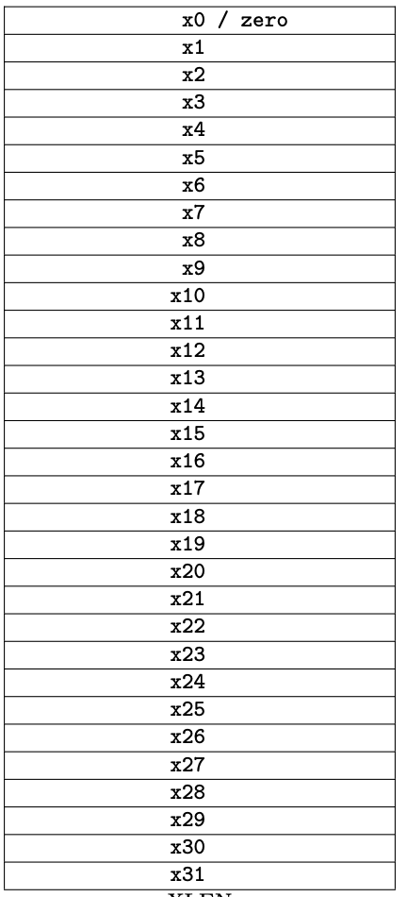
Register Operands
Arithmetic instructions use register operands
  add <dest>, <src1>, <src2>
64-bit RISC-V has 32 64-bit general purpose registers
  The storage for all GP registers is called a register file
    It is storage, i.e. to store data
  Use for frequently accessed data
  Numbered x0 to x31
    the “memory address” for register
  64-bit data is called a ”doubleword”
  32-bit data called a “word”
Design Principle 2: Smaller is faster
  c.f. main memory: millions of locations

Slide 12
RISC-V 32 64-Bit Registers, x0 to x31
Usage convention for most programs:
  x0: the constant value 0
  x1: return address of a function
  x2: stack pointer of a functon
  x3: global pointer
  x4: thread pointer
  x5 – x7, x28 – x31: temporaries
  x8: frame pointer
  x9, x18 – x27: saved registers
  x10 – x11: function arguments/results
  x12 – x17: function arguments
Notes:
32 64-bit registers are numbered x0 to x31
Assembler names (alias) of some registers
$t0, $t1, …, $t9 for temporary values
$s0, $s1, …, $s7 for saved variables

Slide 13
Register Operand Example
C code:
f = (g + h) - (i + j);
  f, …, j values are already loaded in x19, x20, …, x23
Compiled RISC-V code, all are register operands
  Three operands: the first operand is destination, last two are source operands
add x5, x20, x21 // x5 = x20 + x21
add x6, x22, x23 // x6 = x22 + x23
sub x19, x5, x6 // x19 = x5 – x6

Slide 14
Second Class Instr: Memory Access
Main memory used for composite data
  Arrays, structures, dynamic data
To apply arithmetic operations
  Load values from memory into registers
  Store result from register to memory
Memory is byte addressed
  Each address identifies an 8-bit byte
RISC-V is Little Endian
  Least-significant byte at least address of a word
  c.f. Big Endian: Most-significant byte at least address
To store number 12345678
Notes:
To store number 12345678

Slide 15
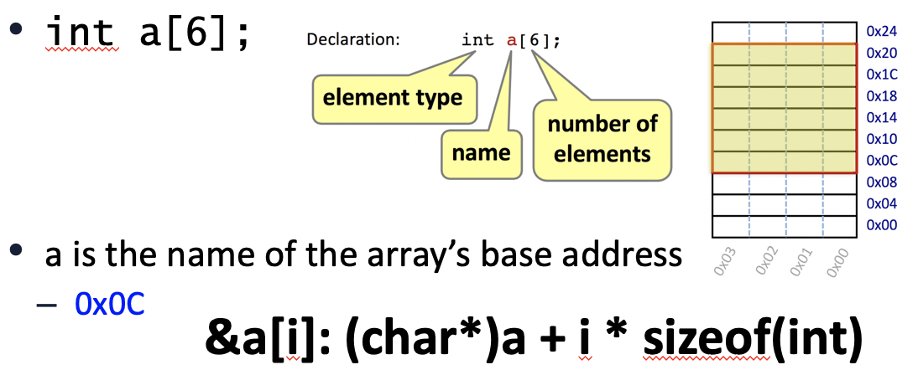
Memory Access Example
C code:
double A[N]; //double size is 8 bytes
A[12] = h + A[8];
  h in x21, base address of A in x22
Compiled RISC-V code:
  Index 8 requires offset of 64
  A[8] right-val, A[12]: left-val
ld x9, 64(x22) // load doubleword
add x9, x21, x9
sd x9, 96(x22) // store doubleword
64(x22) and 96(x22) are memory operands, in contrast to register operands (x9)

Slide 16
Load and Store Instructions
Format: ld rd, offset(rs1)
Example: ld x9, 64(x22) // load doubleword to x9
ld: load a doubleword from a memory location whose address is specified as rs1+offset (base+offset, x22+64) into register rd (x9)
  Base should be stored in an register, offset MUST be a constant number
  Address is specified similar to array element, e.g. A[8], for ld, the address is offset(base), e.g. 64(x22)
Format: sd rs2, offset(rs1)
Example: sd x9, 96(x22) // store a doubleword
sd: store a doubleword from register rs2 (x9 in the example) to a memory location whose address is specified as rs1+offset(base+offset, x22+96). Offset MUST be a constant number.
Load and store are the ONLY two instructions that access memory
lw: load a word from memory location to a register
sw: store a word from a register to a memory location

Slide 17
More Load/Store Examples: Addressing Memory
int A[100]; base address (A, or &A[0]) is in x23, int is 4 bytes
Format: lw rd, offset(rs1)
Example: lw x6, 16(x23) // load word from A[4] to x6
Format: sw rs2, offset(rs1)
Example: sw x7, 32(x23) // store a word from x7 to A[8]
L/S A[0]: address can be specified as 0(x23).
A scalar variable (e.g. int f;) can be considered as one-element array (e.g. int f[1]) for load/store its value between mem and reg
  L/S a variable’s (e.g. int f) 32-bit value stored in a specific memory address which is stored in register x6 to register x8
    lw x8, 0(x6) //offset is 0
    sw x8, 0(x6)

Slide 18
A[8] = A[10], base is in x23, each element 4 bytes
Lw x6, 40(x23)
Sw x6, 32(x23)
The context of the terms we use: base and offset
  For array/variable: base: &A[0], offset: bytes between A[0] and A[i];
  For LW/SW: base: base register, offset: the constant in the instr
  If you have address of A[4] in x9
    LW x5, 0(x9): load A[4]
    SW x5, 8(x9): store to A[6]
    SW x5, -8(x9): store to A[2]
Lab 02 helps you step-by-step for address

Slide 19
More Load/Store Examples: Addressing Memory B[i], i is NOT constant
int B[N], B2[N]; // int type, 4 byptes
B2[i] = B[i];
Base address for B and B2 are in register x22 and x23. i is stored in register x5
  We need load B[i] to a register, e.g. x9, and then store x9 to B[2]
  Need to use the address for B[i] and B2[i] in load and store
    base+offset: B+i*4, and B2+i*4
  But i*4 is not constant, cannot be the offset of load and store
  Solution: Calculate the address of B[i] and B2[i] and store in registers as base for LW/SW, and then use 0 as offset in L/S
  slliw x6, x5, 2 // x6 now store i*4, slliw is i<<2 (shift left logic)
  add x7, x22, x6 // x7 now stores address of B[i].
  lw x9, 0(x7) // load a word from memory location (x7+0), which is B[i], into
  // reg x9
  add x8, x23, x6 // x8 now stores the address of B2[i]
  sw x9, 0(x8) // store a word from register x9 to memory location (x8+0)
  // which is B2[i]

Slide 20
Registers vs. Memory
Registers are faster to access than memory
  ~100x faster, ~10 more expensive, and takes more space
Operating on memory data requires loads and stores
  More instructions to be executed
Compiler must use registers for variables as much as possible
  Only spill to memory for less frequently used variables
  Register optimization is important!

Slide 21
Constant or Immediate Operands
Constant data specified in an instruction
addi x22, x22, 4
No subtract immediate instruction
  Just use a negative constant
  addi x2, x1, -1
Design Principle 3: Make the common case fast
  Small constants are common
  Immediate operand avoids a load instruction

Slide 22
The Constant Zero
RISC-V register x0 is the constant 0 always
  Cannot be overwritten
Useful for common operations
  E.g., move between registers
  add x9, x5, x0
  addi x9, x5, 0

Slide 23
Two Classes of Instructions so Far
Arithmetic instructions
  Three operands, could be either register or immediate (for source operands only)
    add x10, x5, x6; sub x5, x4, x7
    addi x10, x5, 10;
Load and store (L/S) instructions: Load data from memory to register and store data from register to memory
  Remember the way of specifying memory address (base+offset)
  ld x9, 64(x22) // load doubleword
  sd x9, 96(x22) // store doubleword
With these two classes instructions, you can implement the following high-level code, and different ways of combining them
  f = (g + h) - (i + j);
  A[12] = h + A[8];
  For L/S: Left-value (of =) to Store, Right-value of (=) to Load

Slide 24
Psuedo-instructions Used in RARS
Are NOT machine instructions
Are assembly instructions that help programmers
  Translated to machine instructions by assembler
For example
  mv x6, x7 //move/copy value from x7 to x6
    Machine instruction: add x6, x7, x0 //since x0 is always 0
    Machine instruction: addi x6, x7, 0
  li x8, 100 //set the value of a register to be an immediate (load immediate)
    Machine instruction: addi x8, x0, 100
  la x10, label //load address of label to register
    Need two machine instructions
      auipc x8, xxx
      addi x0, x0, xxx

Slide 25
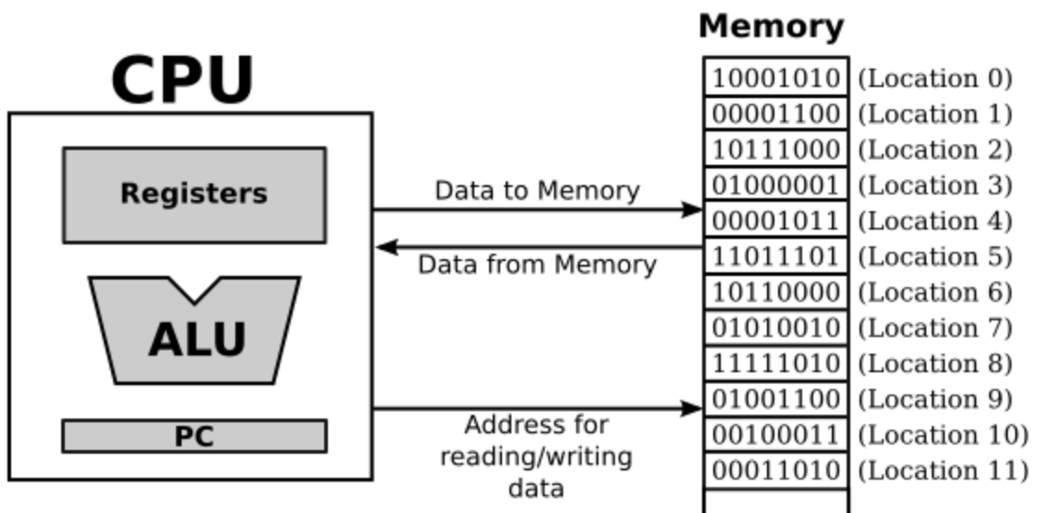
Clarifying the Terms
For ALU to access register
  Fetch and set
For move data between mem and register
  Load and store
For move data between storage and mem
  Read and write
Storage

Slide 26
Chapter 2: Instructions: Language of the Computer
Lecture
  2.1 Introduction
  2.2 Operations of the Computer Hardware
  2.3 Operands of the Computer Hardware
Lecture
  2.4 Signed and Unsigned Numbers
  2.5 Representing Instructions in the Computer
Lecture
  2.6 Logical Operations
  2.7 Instructions for Making Decisions
Lecture
  2.8 Supporting Procedures in Computer Hardware
  2.9 Communicating with People
  2.10 RISC-V Addressing for Wide Immediate and Addresses
Lecture
  2.11 Parallelism and Instructions: Synchronization
  2.12 Translating and Starting a Program
    We covered before along with C Basics
  2.13 A C Sort Example to Put It All Together
  2.14 Arrays versus Pointers
    We covered most before along with C Basics
  2.15 Advanced Material: Compiling C and Interpreting Java
  2.16 Real Stuff: MIPS Instructions
  2.17 Real Stuff: x86 Instructions
  2.18 Real Stuff: The rest of RISC-V
  2.19 Fallacies and Pitfalls
  2.20 Concluding Remarks
  2.21 Historical Perspective and Further Reading
☛

Slide 27
Unsigned (Positive) Binary Integers
Given an n-bit number
§2.4 Signed and Unsigned Numbers
Range: 0 to +2^{n} – 1
  3 digits for 000 to 111 (0 to 2³-1)
  0000 0000 0000 0000 0000 0000 0000 1011₂
  = 0 + … + 1×2³ + 0×2² +1×2¹ +1×2⁰
  = 0 + … + 8 + 0 + 2 + 1 = 11₁₀
Using 32 bits
  0 to +4,294,967,295

Slide 28
Representing Signed (Positive and Negative) Numbers: Two’s Complement
The most significant bit indicates the sign (1 = negative, 0 = positive)
  0111: +7₁₀
  1010: -6₁₀
Positive numbers: SignMagnitude
  0111: +7₁₀
Negative numbers: Special, NOT SignMagnitude format
  1010 is -6₁₀, why it is “1 010”
  1110 is NOT -6₁₀ (110 is binary 6)
Given a 2’s-complement binary number, what is its decimal value:
  Look at the most significant bit for the sign of the number:
    1 = negative, 0 = positive
  Positive: most significant bit is 0, the absolute value is the value of the binary number
    0111 = +7₁₀, 0 is sign (+), 111 is 7, so it is +7
  Negative: most significant bit is 1, the absolute value is the inverted bits of the number + 1. inverting/flipping bit: 0 → 1, 1 → 0
    1010 = (-1) (0101+1) = (-1)(0110) = -6₁₀ (inverting 1010 yields 0101)
    1110 = (-1) (0001+1) = (-1) (0010) = -2₁₀

Slide 29
What is the decimal value of the two’s complement number 1001₂?
Two’s Complement Examples
1001₂ is negative,
For the absolute value: invert it, which is 0110, and then plus 1:
0110
+ 1
0111₂ = 7_{10,} so 1001₂ = -7₁₀
For computer, the value of a 2’s complement number can be calculated using regular position binary form recognizing the sign bit
  1001 = (-1) * 2³ + 0 + 0 + 1*2⁰ = -7

Slide 30
Representing using 2’s-Complement Binary
Given a decimal number, what is its 2’s-complement binary representation?
Positive: its binary representation
  7₁₀ = 0111₂, most significant big MUST be 0 to indicate it is positive
Negative: invert bits of the binary representation of the absolute value of the number and add up 1
  -3 = xxxx₂
  Flip bits of 3₁₀ (0011₂)
  = 1100
  + 1
  1101₂ = -3₁₀

Slide 31
2’s-Complement Binary Representation of -6₁₀
6₁₀ = 0110₂, then invert +1
1001
+ 1
1010₂ = -6₁₀

Slide 32
Rang of Two’s Complement Numbers
4-digit 2’s-complment numbers:
  Most positive 4-bit number: 0111, 7
  Most negative 4-bit number: 1000, -8
    1111 is -1
  Range of an N-bit two’s comp number:
  [-(2^{N-1}), 2^{N-1}-1]

Slide 33
2’s-Complement Signed Integers (32 bits)
Given an n-bit number
Range: –2^{n – 1} to +2^{n – 1} – 1
Example
  1111 1111 1111 1111 1111 1111 1111 1100₂
  = –1×2³¹ + 1×2³⁰ + … + 1×2² +0×2¹ +0×2⁰
  = –2,147,483,648 + 2,147,483,644 = –4₁₀
  Or do invert+1: -(0011+1) = -(0100) = -4₁₀
For 32 bits
  –2,147,483,648 to + 2,147,483,647

Slide 34
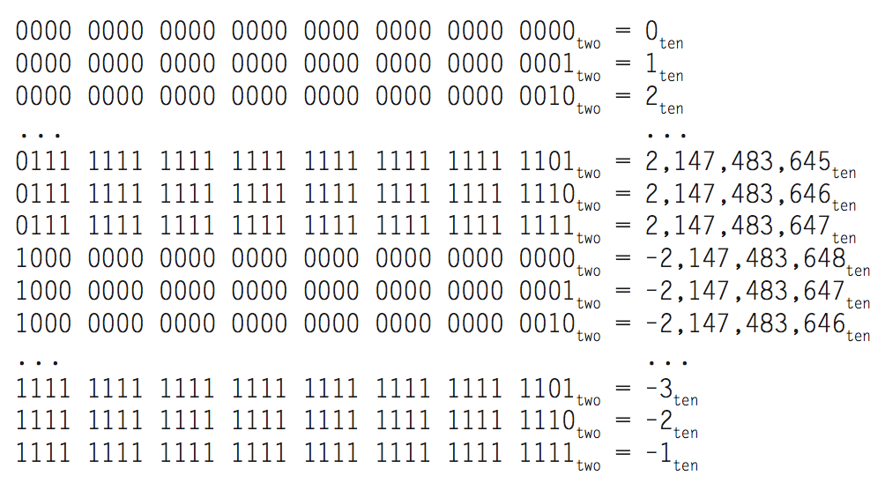
2s-Complement Signed Integers of 32 Bits
Bit 31 is sign bit
  1 for negative numbers
  0 for non-negative numbers
Range: [-(2³²-1), 2³²⁻¹-1]
2^{n – 1} can’t be represented
  1000… is negative now
Non-negative numbers have the same unsigned and 2s-complement representation
Some specific numbers
  0: 0000 0000 … 0000
  –1: 1111 1111 … 1111
  Most-negative: 1000 0000 … 0000, which is –2,147,483,648
  Most-positive: 0111 1111 … 1111, which is 2,147,483,647
Notes:
to + 2,147,483,647

Slide 35
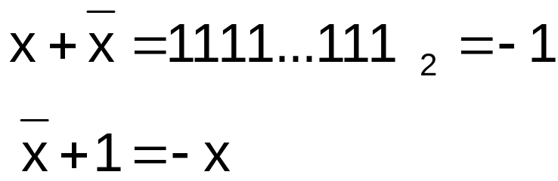
Signed Negation
Complement and add 1
  Complement means 1 → 0, 0 → 1
Example: negate +2
  +2 = 0000 0000 … 0010₂
  –2 = +2 +1 = 0000 0000 … 0010₂ + 1
  = 1111 1111 … 1101₂ + 1
  = 1111 1111 … 1110₂

Slide 36
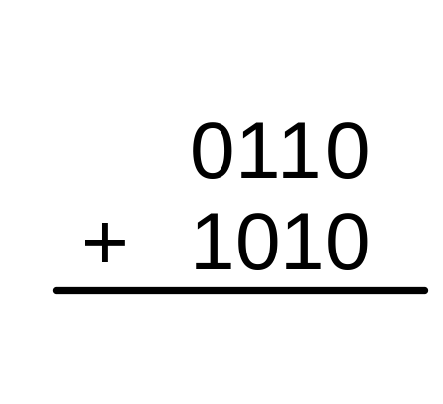
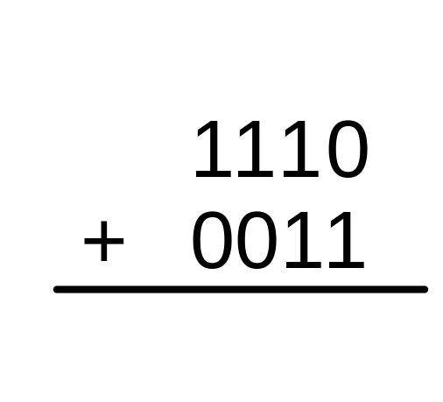
Add Two 2’s Complement Numbers: Just Bit-wise Addition
Add 6 + (-6) using two’s complement numbers
Add -2 + 3 using two’s complement numbers

Slide 37
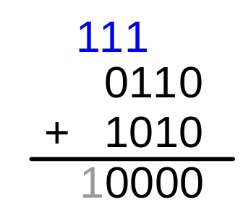
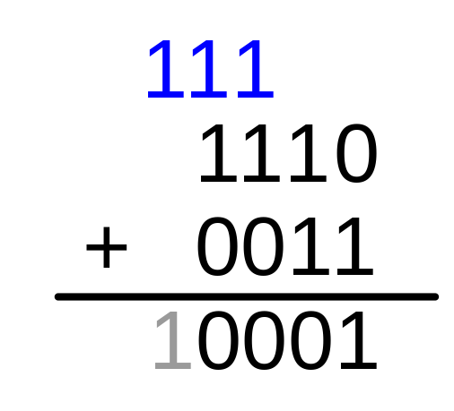
Add Two 2’s Complement Numbers:
Just Bit-wise Addition, no need to recognize positive/negative number, easier to implement in hardware
Add 6 + (-6) using two’s complement numbers
Add -2 + 3 using two’s complement numbers

Slide 38
Sign Extension
Representing a number using more bits
  E.g. char a = -5; int b = a;
    A char variable takes 1 byte of memory, and an int variable takes 4 bytes.
    How to fill in the bits of the 4 bytes of memory for an int variable with a 8-bit number?
  Preserve the numeric value
Replicate the sign bit to the left
  c.f. unsigned values: extend with 0s
  1011 (-5 with 4 bits) ➔ 1111 1011 (-5 in 8 bits char)
  11111011 (-5 in char) ➔ 11111111 11111111 11111111 11111011 (-5 in 32-bits int)
More examples: 8-bit to 16-bit
  +2: 0000 0010 => 0000 0000 0000 0010
  –2: 1111 1110 => 1111 1111 1111 1110
In RISC-V instruction set
  addi: extend immediate value
  lb,lh,lw,ld: extend loaded byte/halfword/word/doubleword
  lbu, lhu, lwu, ldu: zero extend loaded byte/halfword/word/doubleword
  beq, bne: extend the displacement

Slide 39
Three Classes of Instructions
Arithmetic-logic instructions
  add, sub, addi, and, or, shift left|right, etc
Memory load and store instructions
  lw and sw: Load/store word
  ld and sd: Load/store doubleword
Control transfer instructions (changing sequence of instruction execution)
  Conditional branch: bne, beq
  Unconditional jump: j (
  Procedure call and return: jal and jr

Slide 40
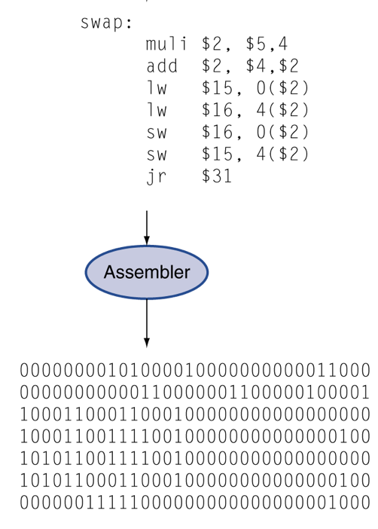
Representing Instructions
Instructions are encoded in binary
  Using binary numbers to represent
  operations, operands, and immediate
  Called machine code
RISC-V instructions
  Each instruction is encoded as a 32-bit instruction word
  Small number of formats encoding operation code (opcode), register numbers, …
  Regularity!
Instructions use 32 registers:
  We need 5 bit to identify 32 registers (0 to 31)
  00000 to 11111
§2.5 Representing Instructions in the Computer

Slide 41
Hexadecimal
Base 16 format to easily show binary number
  Compact representation of bit strings
  4 bits per hex digit
0 | 0000 | 4 | 0100 | 8 | 1000 | c | 1100
1 | 0001 | 5 | 0101 | 9 | 1001 | d | 1101
2 | 0010 | 6 | 0110 | a | 1010 | e | 1110
3 | 0011 | 7 | 0111 | b | 1011 | f | 1111
Example: eca8 6420
  1110 1100 1010 1000 0110 0100 0010 0000

Slide 42
RISC-V R-Format Instructions
R-Format: Operands are all from Registers
Arithmetic and logic instructions that use registers for ALL operands. Format: op rd, rs1, rs2.
Instruction fields
  opcode: operation code
  rd: destination register number
  funct3: 3-bit function code (additional opcode)
  rs1: the first source register number
  rs2: the second source register number
  funct7: 7-bit function code (additional opcode)
32 bits
funct7
rs2
rs1
funct3
rd
opcode
7 bits
5 bits
5 bits
3 bits
5 bits
7 bits

Slide 43
R-Format Encoding Example 1
add x9,x20,x21 (add rd, rs1, rs2)
x21, x20, x9 add
funct7
rs2
rs1
funct3
rd
opcode
7 bits
5 bits
5 bits
3 bits
5 bits
7 bits
0
21
20
0
9
51
0000000
10101
10100
000
01001
0110011
0000 0001 0101 1010 0000 0100 1011 0011_{two} =
015A04B3₁₆
5 bits for rd, rs1 and rs2 because we have 32 registers, thus only needs 5 bit to address a register

Slide 44
R-Format Encoding Example 2
add x6, x10, x6 (add rd, rs1, rs2)
x6, x10, x6 add
funct7
rs2
rs1
funct3
rd
opcode
7 bits
5 bits
5 bits
3 bits
5 bits
7 bits
0
6
10
0
6
51
0000000
00110
01010
000
00110
0110011
0000 0000 0110 0101 0000 0011 0011 0011_{two} =
00650333₁₆
Opcode (51), funct3 (0) and funct7(0) for each instruction are defined by the ISA standard.

Slide 45
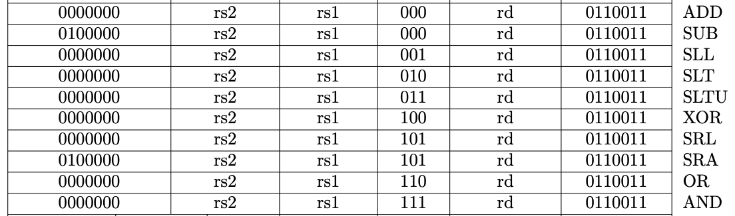
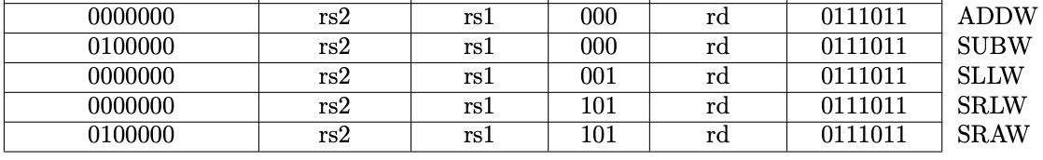
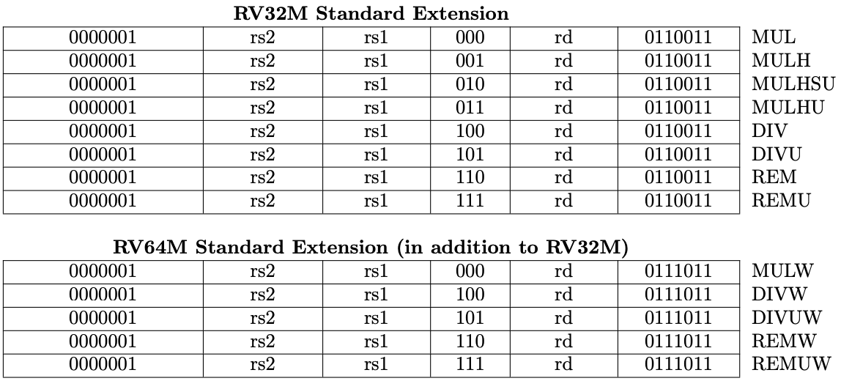
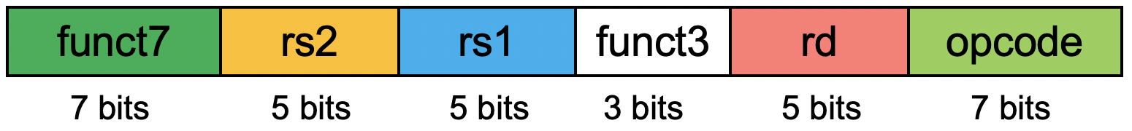
R-Format Instruction Encoding http://content.riscv.org/wp-content/uploads/2017/05/riscv-spec-v2.2.pdf#page=116
RV32I Base Instruction Set
Arithmetic instructions
RV64I Base Instruction Set (in addition to RV32I)
Logic instructions

Slide 46
RISC-V I-Format Instructions
I-Format: The second source operand is an Immediate, the first source operand is register, destination operand is register.
Immediate arithmetic/logic, and load instructions (NOT store instruction)
  addi x22, x22, 4; Format: addi rd, rs1, #immediate
  ld x9, 64(x22); Format: ld|lw, rd, #immediate(rs1)
  rs1: source or base address register number
  immediate: constant operand, or offset added to base address
    2s-complement, sign extended
  NOT for store: because destination for store is the memory location (not a register), thus no rd for store.
Design Principle 3: Good design demands good compromises
  Different formats complicate decoding, but allow 32-bit instructions uniformly
  Keep formats as similar as possible
immediate
rs1
funct3
rd
opcode
12 bits
5 bits
3 bits
5 bits
7 bits

Slide 47
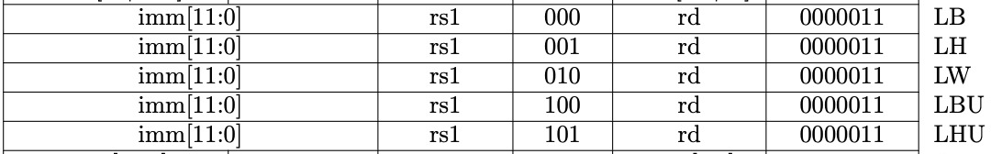
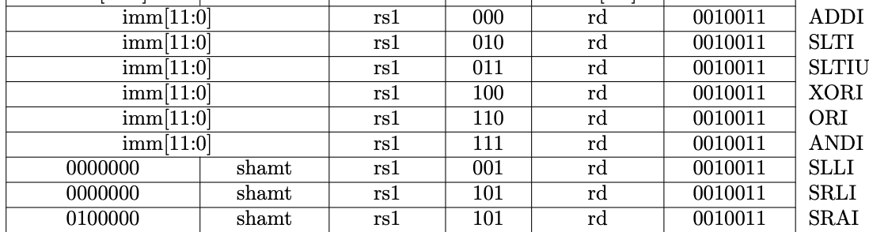
I-Format Instruction Encoding http://content.riscv.org/wp-content/uploads/2017/05/riscv-spec-v2.2.pdf#page=116
Immediate arithmetic/logic
load instructions
immediate
rs1
funct3
rd
opcode
12 bits
5 bits
3 bits
5 bits
7 bits

Slide 48
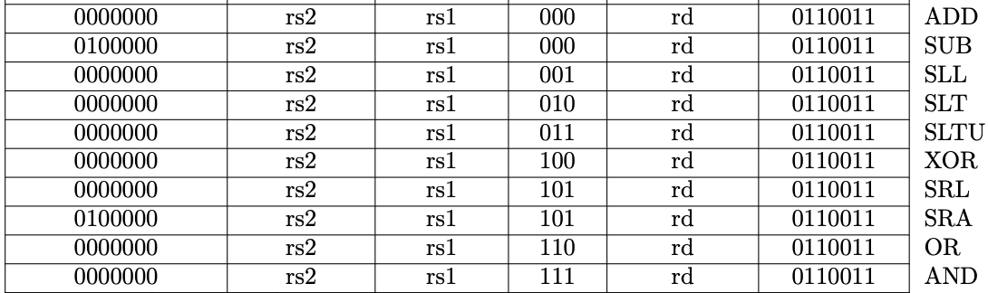
Shift Operation Encoding
Use immediate operands, I-Format
  Immediate: slli, sri, srai, etc
If use registers for all operands, R-Format
  Sll, sri, sra
funct6
immed
rs1
funct3
rd
opcode
6 bits
6 bits
5 bits
3 bits
5 bits
7 bits
funct7
rs2
rs1
funct3
rd
opcode
7 bits
5 bits
5 bits
3 bits
5 bits
7 bits

Slide 49
RISC-V S-Format Instructions
S-Format: instructions that use two source register operands and NO destination operand register (rd), only store instruction
Format: sd|sw, rs2, #immediate(rs1)
Different immediate format for store instructions
  sd x9, 96(x22);
  rs1: base address register number (x22)
  rs2: source operand register number (x9), which provide the value to be stored to memory
  immediate: offset added to base address
    Split so that rs1 and rs2 fields always in the same place as for R- or I-Format
imm[11:5]
rs2
rs1
funct3
imm[4:0]
opcode
7 bits
5 bits
5 bits
3 bits
5 bits
7 bits

Slide 50
S-Format Instruction Encoding http://content.riscv.org/wp-content/uploads/2017/05/riscv-spec-v2.2.pdf#page=116
imm[11:5]
rs2
rs1
funct3
imm[4:0]
opcode
7 bits
5 bits
5 bits
3 bits
5 bits
7 bits
Store instructions

Slide 51
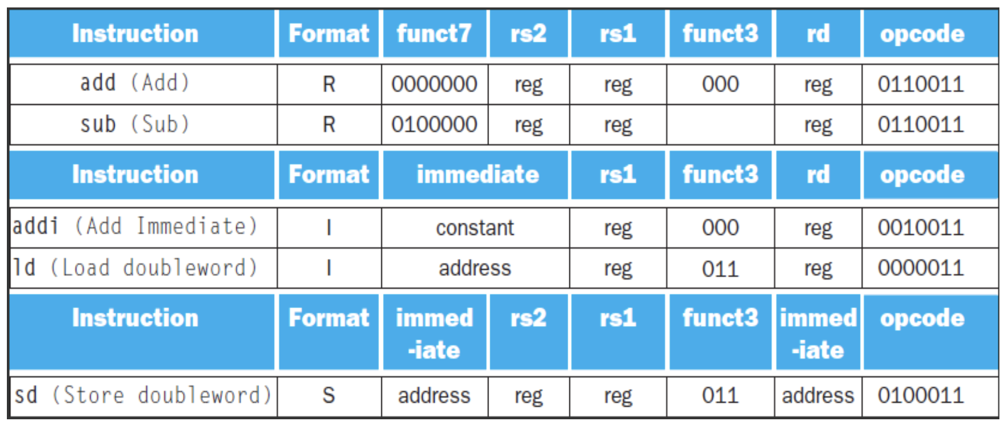
More Examples from Textbook 2.5

Slide 52
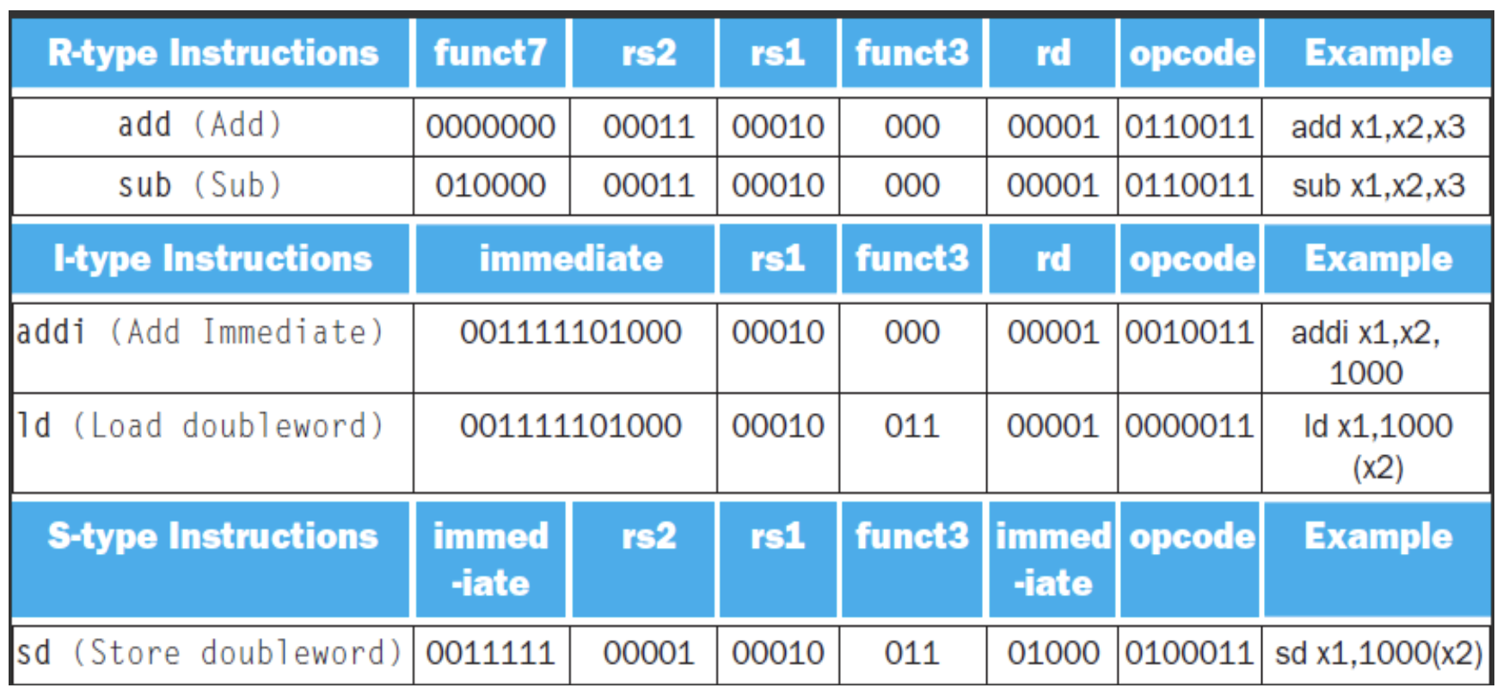
More Examples from Textbook 2.5

Slide 53
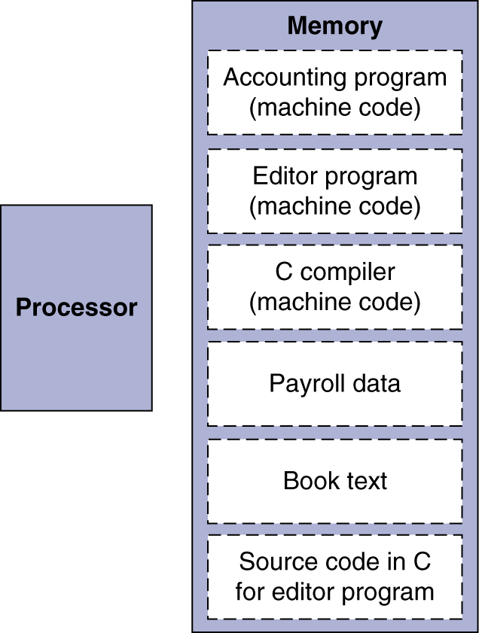
Stored Program Computers
The BIG Picture
Instructions represented in binary, just like data
Instructions and data stored in memory
Programs can operate on programs
  e.g., compilers, linkers, …
Binary compatibility allows compiled programs to work on different computers
  Standardized ISAs

Slide 54
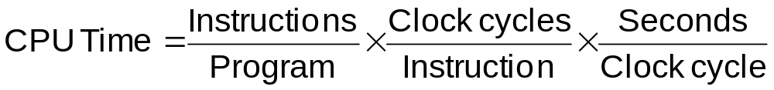
RISC vs. CISC
Design “philosophies” for ISAs: RISC vs. CISC
  CISC = Complex Instruction Set Computer
    X86, X86_64 (Intel and AMD, main-stream desktop/laptop/server)
    X86* internally are still RISC
  RISC = Reduced Instruction Set Computer
    ARM: smart phone/pad
    RISC-V: free ISA, closer to MIPS than other ISAs, the same textbook in RISC-V version
    Others: Power, SPARC, etc
Tradeoff:
RISC:
  Small instruction set
    Easier for compilers
  Limit each instruction to (at most):
    three register accesses,
    one memory access,
    one ALU operation
    => facilitates parallel instruction execution (ILP)
  Load-store machine: minimize off-chip access

