Slide 1
Chapter 2: Instructions: Language of the Computer
2.8 – 2.10 Procedure, String and Addressing for Wide
ITSC 3181 Introduction to Computer Architecture
Fall 2021 https://passlab.github.io/ITSC3181/
Department of Computer Science
Yonghong Yan
yyan7@uncc.edu
https://passlab.github.io/yanyh/

Slide 2
Chapter 2: Instructions: Language of the Computer
☛
Lecture
  2.1 Introduction
  2.2 Operations of the Computer Hardware
  2.3 Operands of the Computer Hardware
Lecture
  2.4 Signed and Unsigned Numbers
  2.5 Representing Instructions in the Computer
Lecture
  2.6 Logical Operations
  2.7 Instructions for Making Decisions
Lecture
  2.8 Supporting Procedures in Computer Hardware
  2.9 Communicating with People
  2.10 RISC-V Addressing for Wide Immediate and Addresses
Lecture
  2.11 Parallelism and Instructions: Synchronization
  2.12 Translating and Starting a Program
    We covered before along with C Basics
  2.13 A C Sort Example to Put It All Together
  2.14 Arrays versus Pointers
    We covered most before along with C Basics
  2.15 Advanced Material: Compiling C and Interpreting Java
  2.16 Real Stuff: MIPS Instructions
  2.17 Real Stuff: x86 Instructions
  2.18 Real Stuff: The rest of RISC-V
  2.19 Fallacies and Pitfalls
  2.20 Concluding Remarks
  2.21 Historical Perspective and Further Reading

Slide 3
Three Classes of Instructions We Will Focus On:
Arithmetic-logic instructions
  add, sub, addi, and, or, shift left|right, etc
Memory load and store instructions
  lw and sw: Load/store word
  ld and sd: Load/store doubleword
Control transfer instructions (changing sequence of instruction execution)
  Conditional branch: bne, beq
  Unconditional jump: j
  Procedure call and return: jal and jr

Slide 4
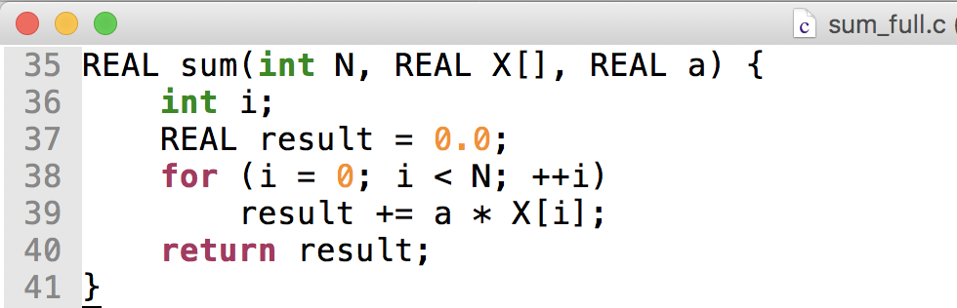
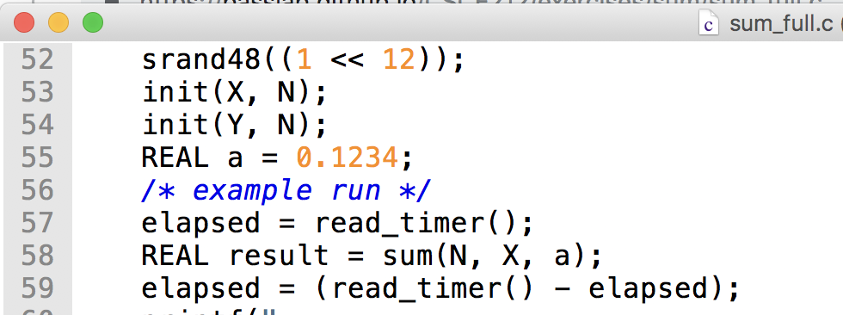
Procedure Call: sum_full.c
§2.8 Supporting Procedures in Computer Hardware
https://passlab.github.io/ITSC3181/exercises/sum

Slide 5
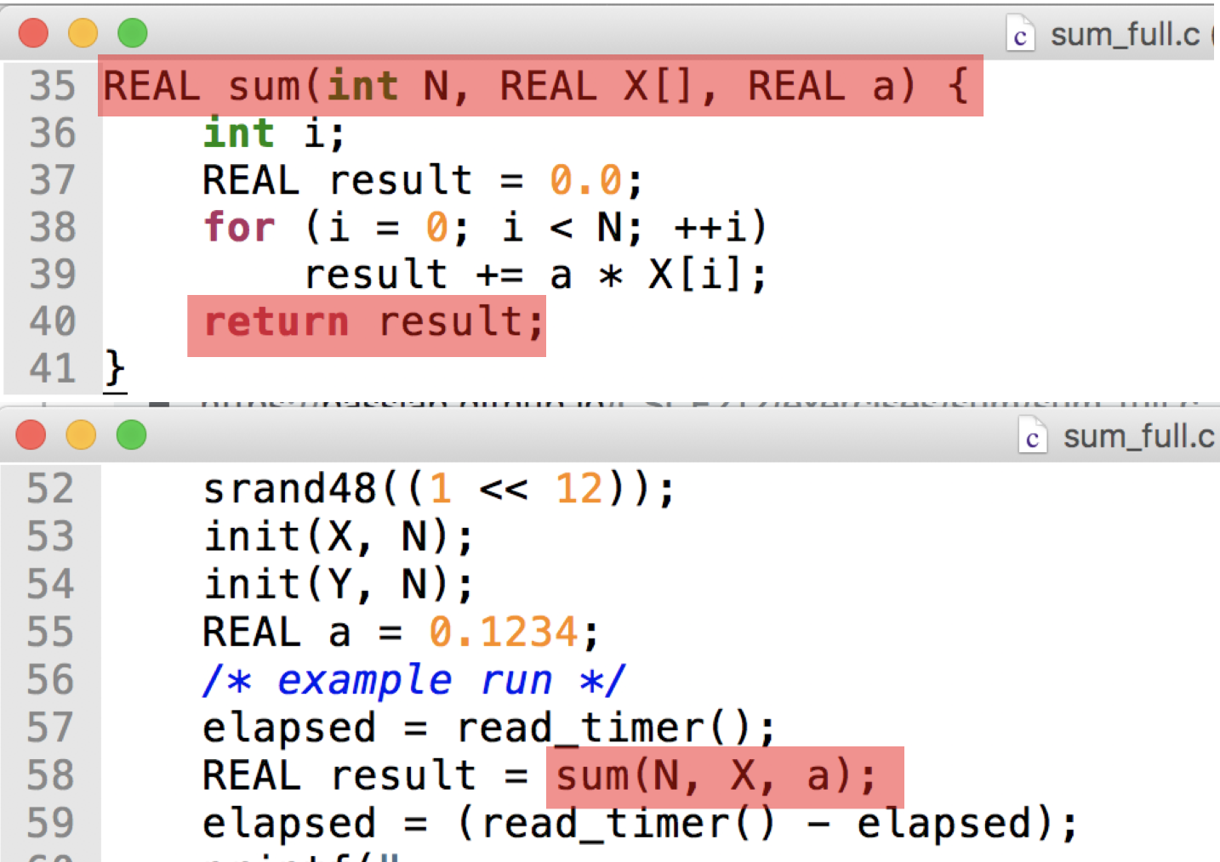
Procedure Call
Control is transferred when there is procedure call and return
Steps required
  Place parameters in registers
  Transfer control to procedure
  Acquire storage for procedure
  Perform procedure’s operations
  Place result in register for caller
  Return to place of call

Slide 6

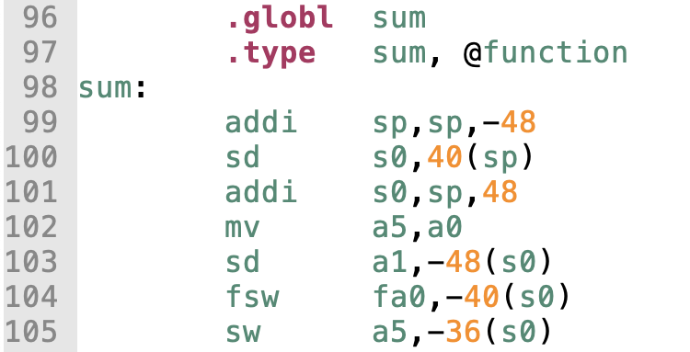
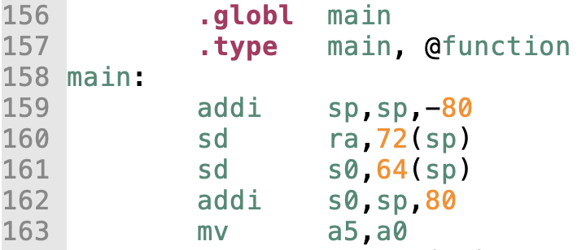
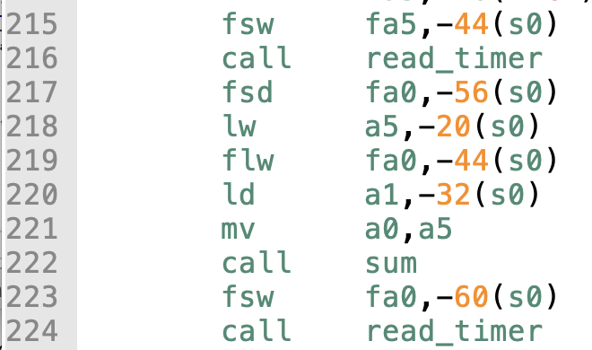
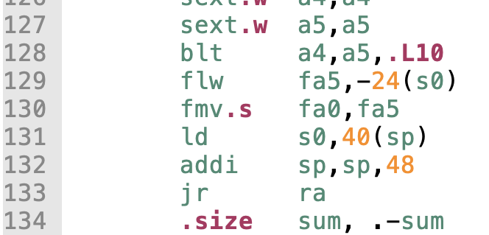
Sum Example, sum_full_riscv.s
Args for sum call
Store return address in reg and call transfer to sum
Return to caller with return value stored in register
https://passlab.github.io/ITSC3181/exercises/sum

Slide 7
Procedure Call Instructions
Procedure call: jump and link
jal x1, ProcedureLabel
  Address of following instruction put in x1
  Jumps to target address
Procedure return: jump and link register
jalr x0, 0(x1)
  Like jal, but jumps to 0 + address in x1
  Use x0 as rd (x0 cannot be changed)
  Can also be used for computed jumps
    e.g., for case/switch statements

Slide 8
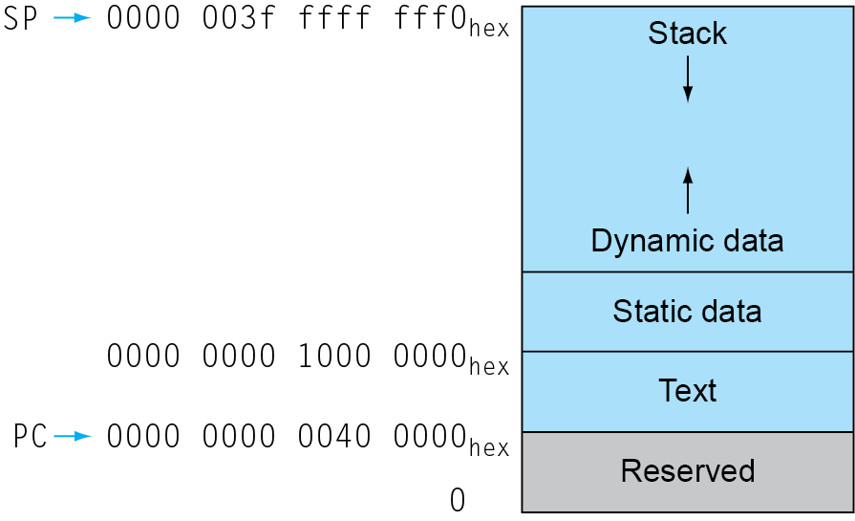
Memory Layout of a Process
Text: program code
Static data: global variables
  e.g., static variables in C, constant arrays and strings
  x3 (global pointer) initialized to address allowing ±offsets into this segment
Dynamic data: heap
  E.g., malloc in C, new in Java
Stack: automatic storage

Slide 9
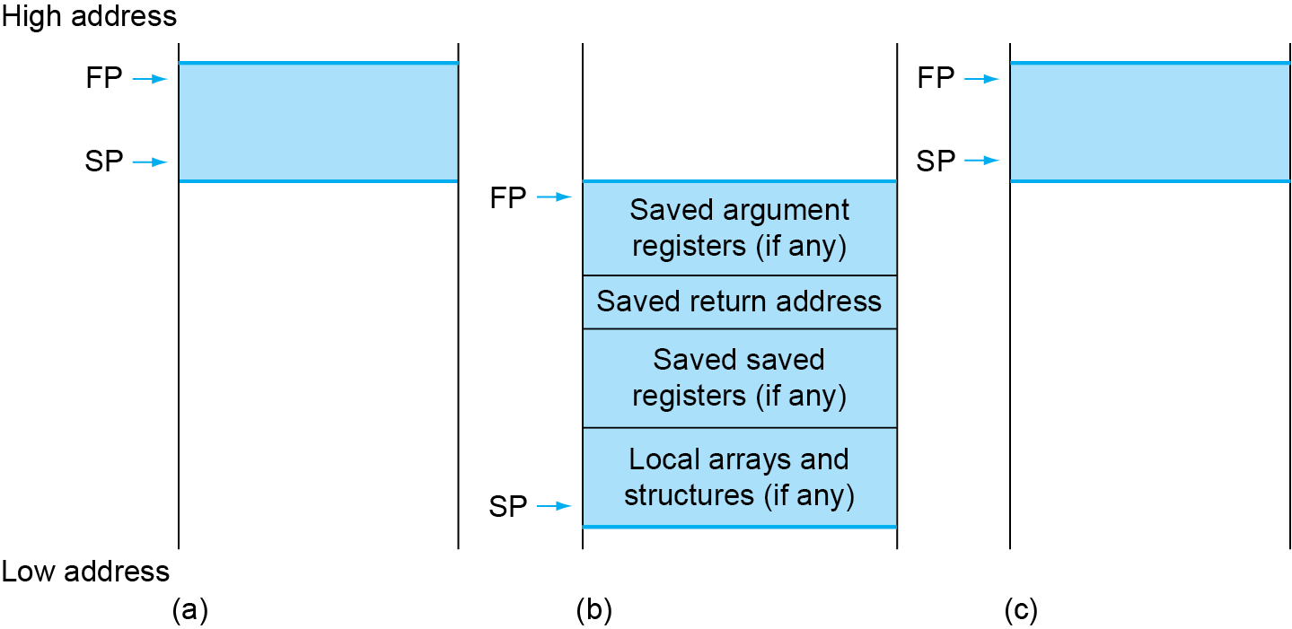
Local Data on the Stack
Local data allocated by callee
  e.g., C automatic variables
Procedure frame (activation record)
  Used by some compilers to manage stack storage

Slide 10
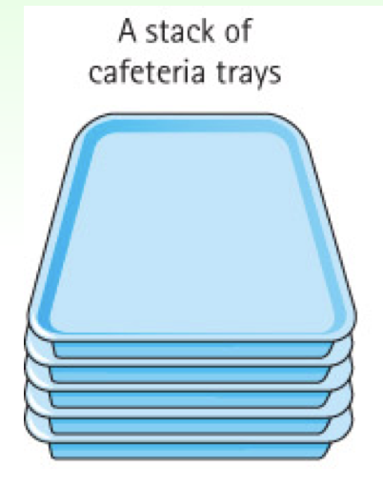
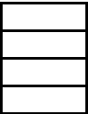
Stack Memory Used for Function Calls
Stack is Last-In-First-Out (LIFO) data structure to store the info of each function of the call path
  Main() calls foo(), foo() calls bar(), bar() calls tar()
  Call in: push function to the stack top
  Return: pop function from the top
Stack frame, function frame, activation record
  The memory and the data of the info for each function call
main()
foo()
bar()
tar()
top
push
pop

Slide 11
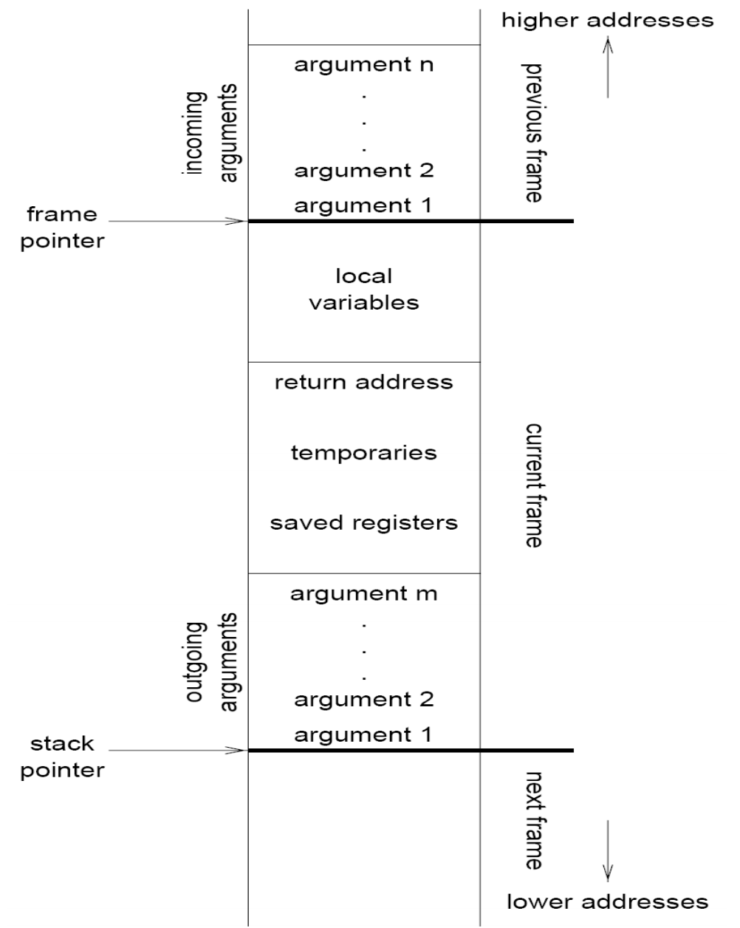
Stack Frame (Activation Record) of a Function Call
Information:
  Parameters
  Local variables
  Return address
  Location to put return value when function exits
  Control link to the caller’s activation record
  Saved registers
  Temporary variables and intermediate results
  (not always) Access link to the function’s static parent
Frame pointer (fp register): the starting address of AR
Stack pointer (sp register): the ending address of AR

Slide 12
Leaf Procedure Example
Leaf procedure
  A procedure does not call other procedures
    Thinking of procedure calls as a tree
C code:
long long int leaf_example (
long long int g, long long int h,
long long int i, long long int j) {
long long int f;
f = (g + h) - (i + j);
return f;
}
  Arguments g, …, j in x10, …, x13
  f in x20
  temporaries x5, x6
  Need to save x5, x6, x20 on stack

Slide 13
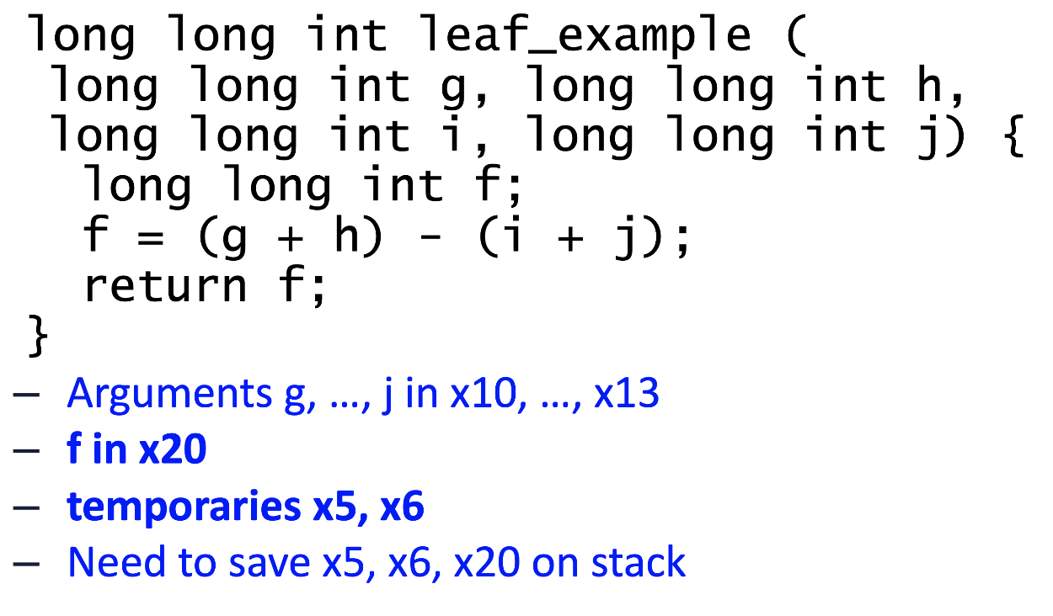
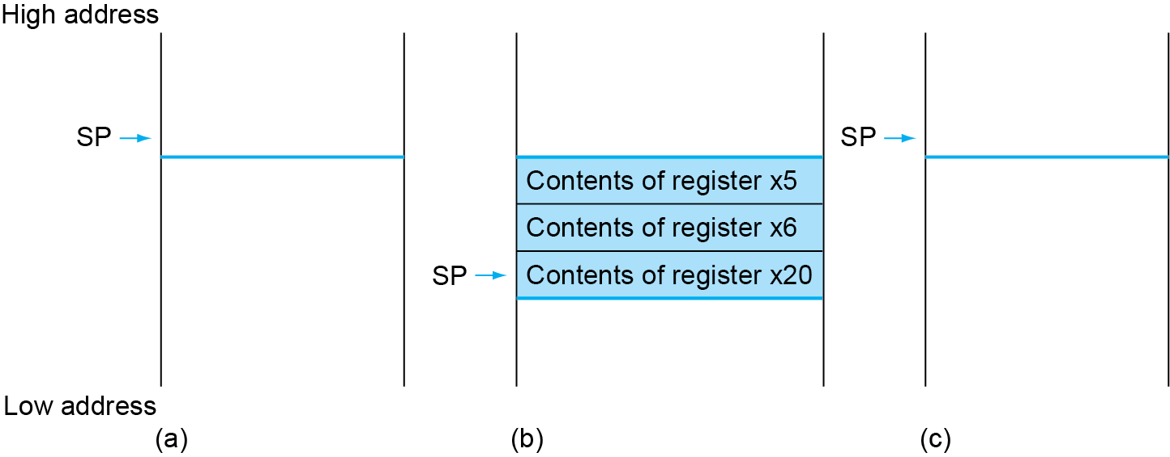
Local Data on the Stack
Stack before, during and after the function call
  SP (stack pointer) is the register that store the address of the current function call
int main ( … ) {
…
long long int result = leaf_example( … );
…
}
If caller uses x5, x6 or x20, we have to preserve them. They are preserved in the callee stack.

Slide 14
Leaf Procedure Example
RISC-V code:
leaf_example:
addi sp,sp,-24
sd x5,16(sp)
sd x6,8(sp)
sd x20,0(sp)
add x5,x10,x11
add x6,x12,x13
sub x20,x5,x6
addi x10,x20,0
ld x20,0(sp)
ld x6,8(sp)
ld x5,16(sp)
addi sp,sp,24
jalr x0,0(x1)
Adjust stack to make room for 3 items
Save x5, x6, x20 on stack
x5 = g + h
x6 = i + j
f = x5 – x6
copy f to return register
Resore x5, x6, x20 from stack
Adjust back to return memory for 3 items
Return to caller

Slide 15
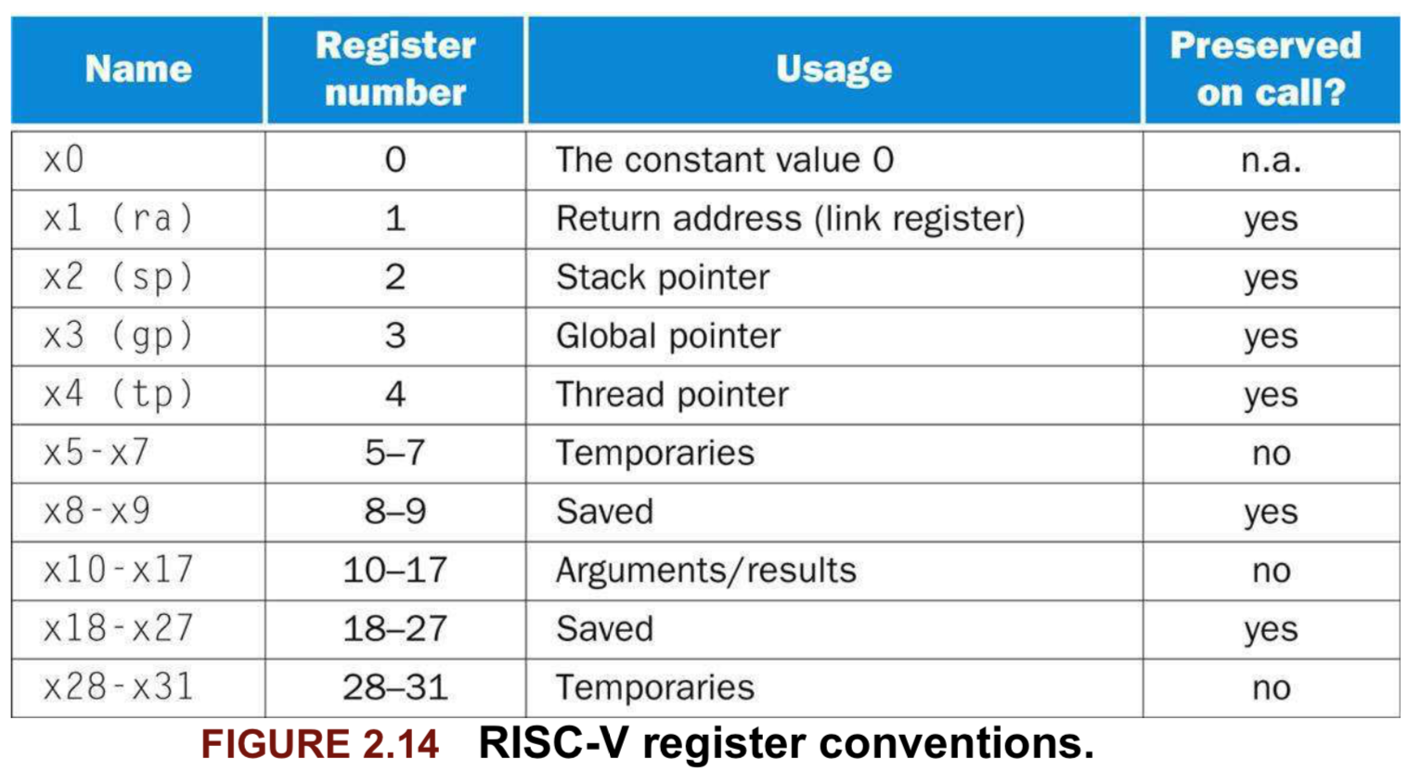
Register Usage
x5 – x7, x28 – x31: temporary registers
  Not automatically preserved by the callee
x8 – x9, x18 – x27: saved registers
  If used, the callee saves and restores them

Slide 16
Non-Leaf Procedures
Procedures that call other procedures
For nested call, caller needs to save on the stack:
  Its return address
  Any arguments and temporaries needed after the call
Restore from the stack after the call

Slide 17
Non-Leaf Procedure Example
C code:
long long int fact (long long int n)
{
if (n < 1) return n;
else return n * fact(n - 1);
}
  Argument n in x10
  Result in x10
It is a recursive function.

Slide 18
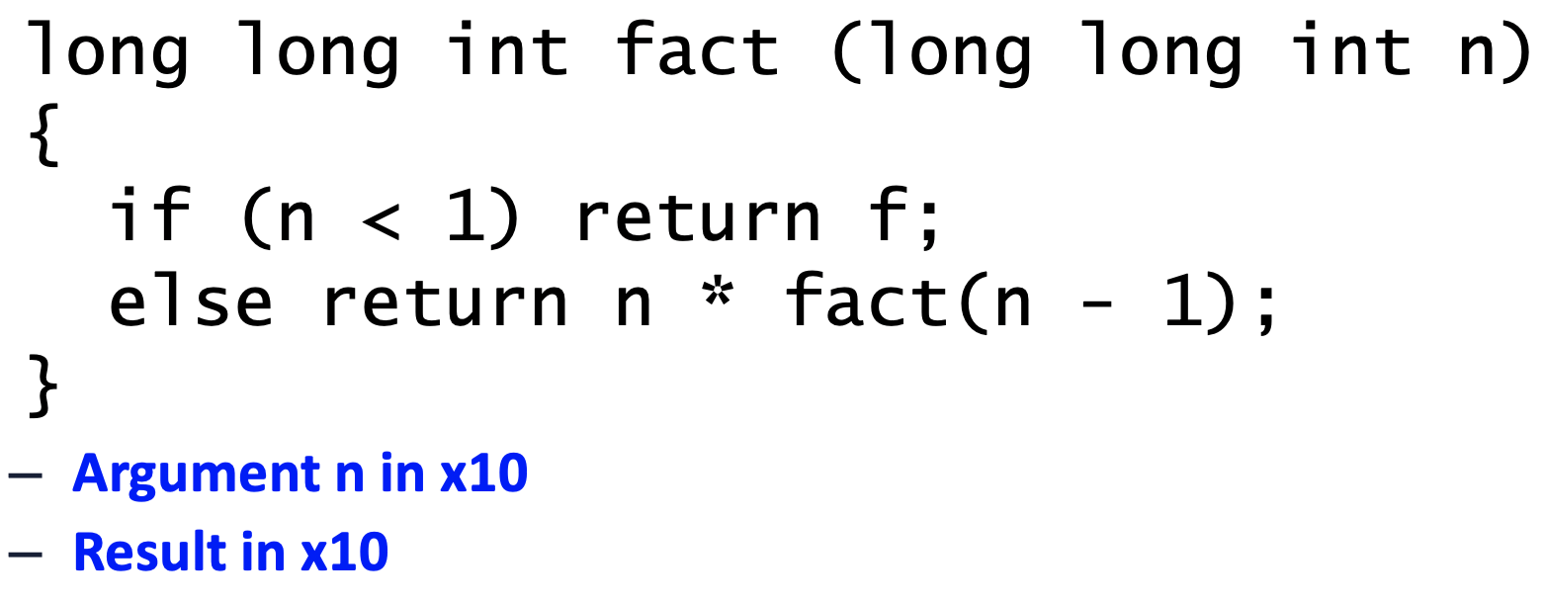
Leaf Procedure Example
RISC-V code:
fact:
addi sp,sp,-16
sd x1,8(sp)
sd x10,0(sp)
addi x5,x10,-1
bge x5,x0,L1
addi x10,x0,1
addi sp,sp,16
jalr x0,0(x1)
L1: addi x10,x10,-1
jal x1,fact
addi x6,x10,0
ld x10,0(sp)
ld x1,8(sp)
addi sp,sp,16
mul x10,x10,x6
jalr x0,0(x1)
Adjust stack for two items
Save return address and n on stack
Save the argument n
x5 = n - 1
if n >= 1, go to L1
Else, set return value to 1
Pop stack, don’t bother restoring values
Return
n = n - 1
call fact(n-1)
move result of fact(n - 1) to x6
Restore caller’s n
Restore caller’s return address
Pop stack
return n * fact(n-1)
return

Slide 19
Character Data
Byte-encoded character sets
  ASCII: 128 characters
    95 graphic, 33 control
  Latin-1: 256 characters
    ASCII, +96 more graphic characters
Unicode: 32-bit character set
  Used in Java, C++ wide characters, …
  Most of the world’s alphabets, plus symbols
  UTF-8, UTF-16: variable-length encodings
§2.9 Communicating with People

Slide 20
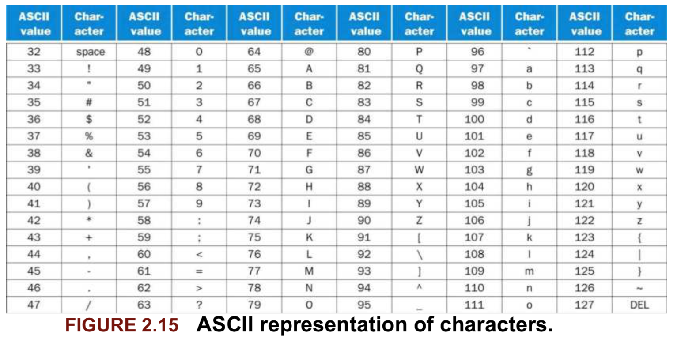
ASCII Characters
Each character is represented by a 8-bit byte ➔ max 256

Slide 21
Byte/Halfword/Word Operations
RISC-V byte/halfword/word load/store
  Load byte/halfword/word: Sign extend to 64 bits in rd
    lb rd, offset(rs1)
    lh rd, offset(rs1)
    lw rd, offset(rs1)
  Load byte/halfword/word unsigned: Zero extend to 64 bits in rd
    lbu rd, offset(rs1)
    lhu rd, offset(rs1)
    lwu rd, offset(rs1)
  Store byte/halfword/word: Store rightmost 8/16/32 bits
    sb rs2, offset(rs1)
    sh rs2, offset(rs1)
    sw rs2, offset(rs1)

Slide 22
String Copy Example
C code:
  A string is an array of characters with` \0` as the last character
    char x[100]; a string of 100 character
    char * x2; is used for refer to a string
  Null-terminated string
void strcpy (char x[], char y[])
{ size_t i;
i = 0;
while ((x[i]=y[i])!='\0')
i += 1;
}
  Base address for x and y are in x10 and x11
  i is in x19

Slide 23
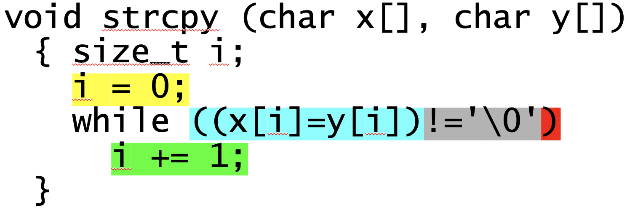
String Copy Example
RISC-V code:
strcpy:
addi sp,sp,-8 // adjust stack for 1 doubleword
sd x19,0(sp) // save x19
add x19,x0,x0 // i=0
L1: add x5,x19,x10 // x5 = addr of y[i]
lbu x6,0(x5) // x6 = y[i]
add x7,x19,x10 // x7 = addr of x[i]
sb x6,0(x7) // x[i] = y[i]
beq x6,x0,L2 // if y[i] == \0 then exit
addi x19,x19, 1 // i = i + 1
jal x0,L1 // next iteration of loop
L2: ld x19,0(sp) // restore saved x19
addi sp,sp,8 // pop 1 doubleword from stack
jalr x0,0(x1) // and return

Slide 24
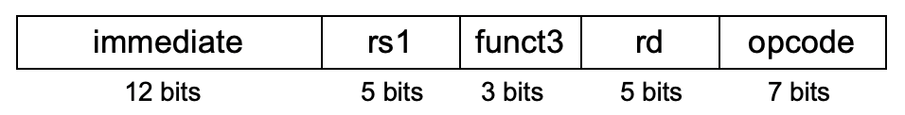
32-bit Constants
Most constants are small
  I-format instructions have only 12 bits for immediate
    E.g. addi x6, x0, 1024
  12-bit immediate is sufficient most of the time
For the occasional 32-bit constant
lui rd, constant (load upper immediate)
  Copies 20-bit constant to bits [31:12] of rd
  Extends bit 31 to bits [63:32]
  Clears bits [11:0] of rd to 0
§2.10 RISC-V Addressing for Wide Immediates and Addresses
lui x19, 976 // 0x003D0
0000 0000 0000 0000
0000 0000 0000 0000
0000 0000 0011 1101 0000
0000 0000 0000
addi x19,x19,128 // 0x500
0000 0000 0000 0000
0000 0000 0000 0000
0000 0000 0011 1101 0000
0101 0000 0000
Now x19 has 976*2¹² + 128

Slide 25
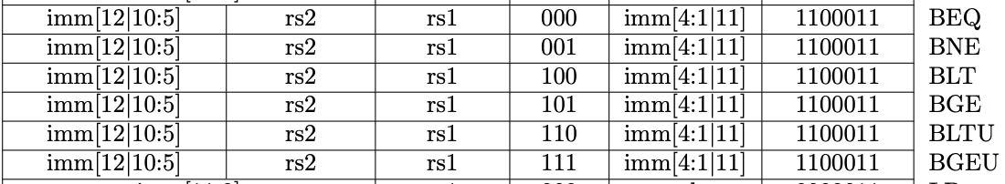
SB-Format Encoding for Branch Instr (e.g. beq) http://content.riscv.org/wp-content/uploads/2017/05/riscv-spec-v2.2.pdf#page=116
Branch instructions, e.g. ”beq x3, x4, EXIT”, specify
  Opcode, two source registers (rs1 and rs2), target address as imm
  Most branch targets are near branch, Forward or backward
SB-Format instructions: beq x8, x9, 4
PC-relative addressing
  Branch target address is encoded as the offset off the the address of the branch instruction itself
  Target address = PC (Branch address) + immediate × 2
imm
[10:5]
rs2
rs1
funct3
imm
[4:1]
opcode
imm[12]
imm[11]

Slide 26
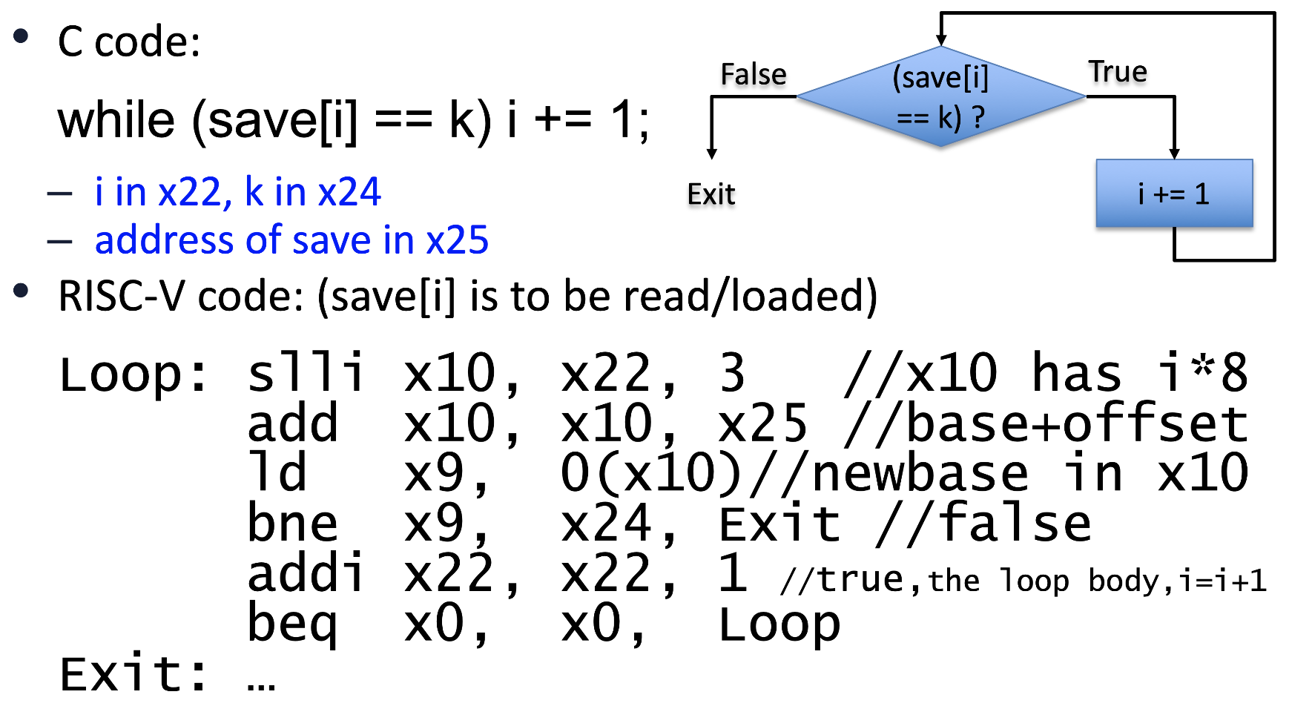
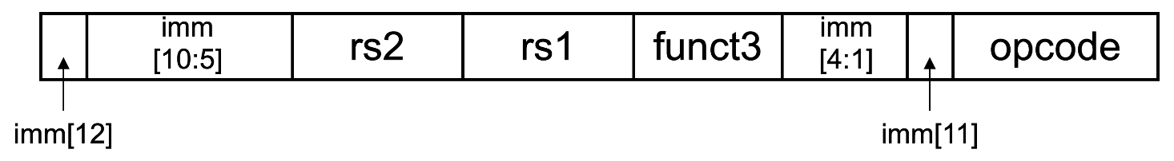
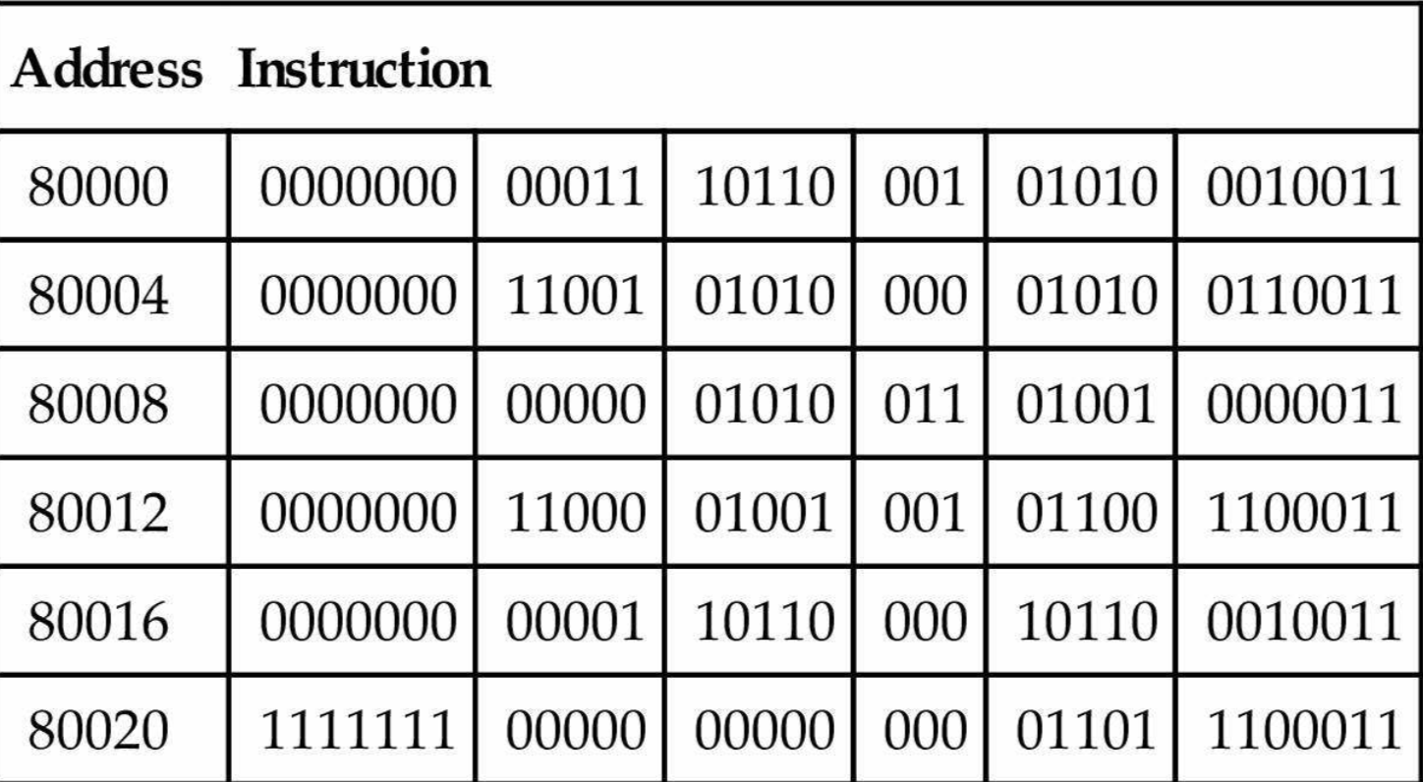
imm of beq instruction is the offset between the address of beq instruction and the target address (page 115 of the text book)
The Exit offset of the bne is encoded as 6 (..0110)
  Offset is 6*2 = 12 bytes, i.e. 3 instr forward
  Exit’s address = bne’s address (80012) + 12 = 80024 (Exit)
The Loop offset of the beq is encoded as -10 (..110110)
  Offset is -10*2 = -20 bytes, i.e. 5 instr backward
  Loop’s address = beq’s address (80020) + -20 = 80000 (Loop)
imm[11] is the sign bit of the imm → help decoding
To calculate the imm for beq: (target-PC)/2

Slide 27
Jump Addressing
Jump and link (jal) target uses 20-bit immediate for larger range
UJ format:
imm[10:1]
imm[19:12]
rd
opcode
5 bits
7 bits
imm[20]
imm[11]
For long jumps, eg, to 32-bit absolute address
  lui: load address[31:12] to temp register
  jalr: add address[11:0] and jump to target

Slide 28
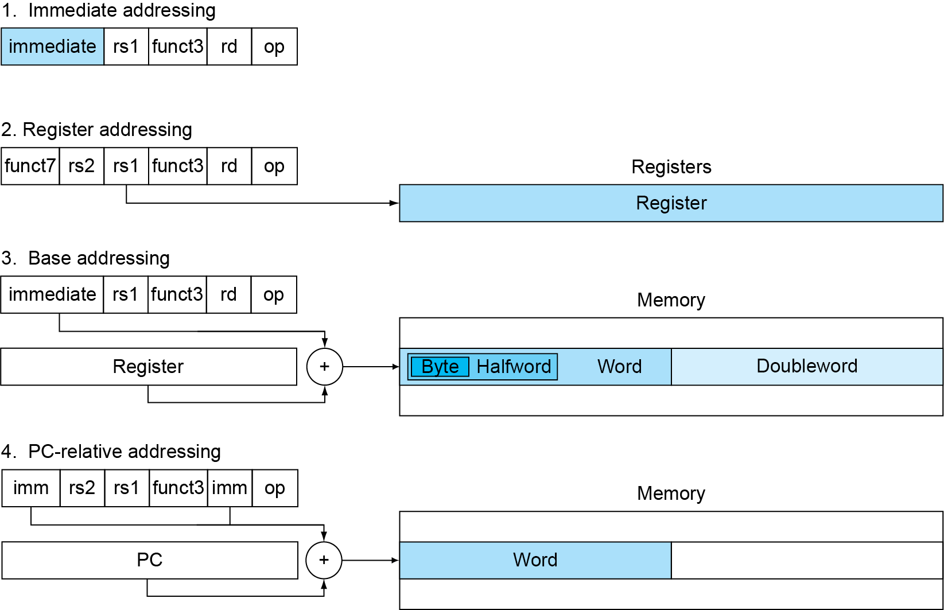
Summary of RISC-V Addressing (How Operands are Specified or Provided)

Slide 29
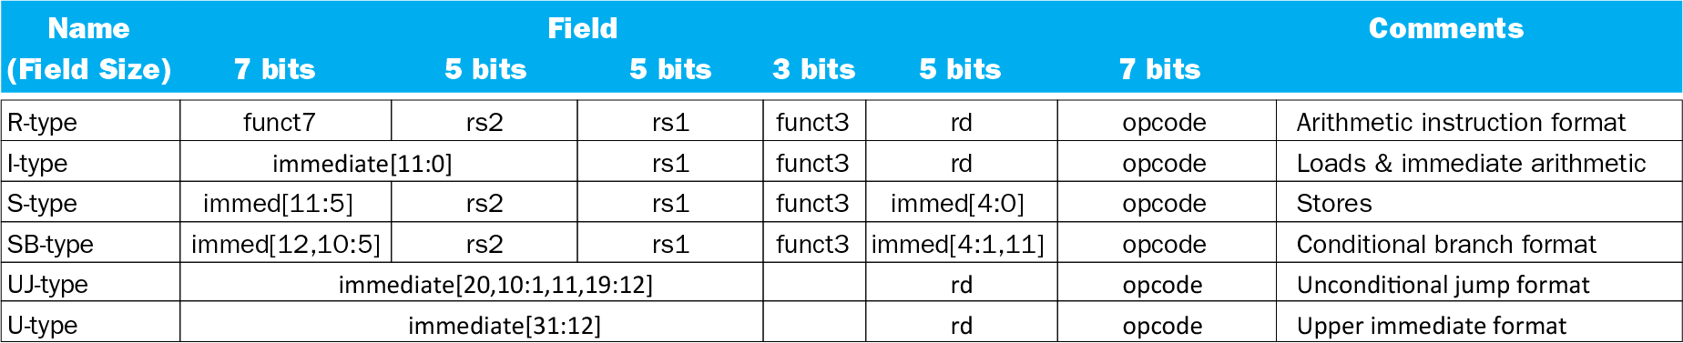
RISC-V Encoding and Decoding: Encoding Format

Slide 30
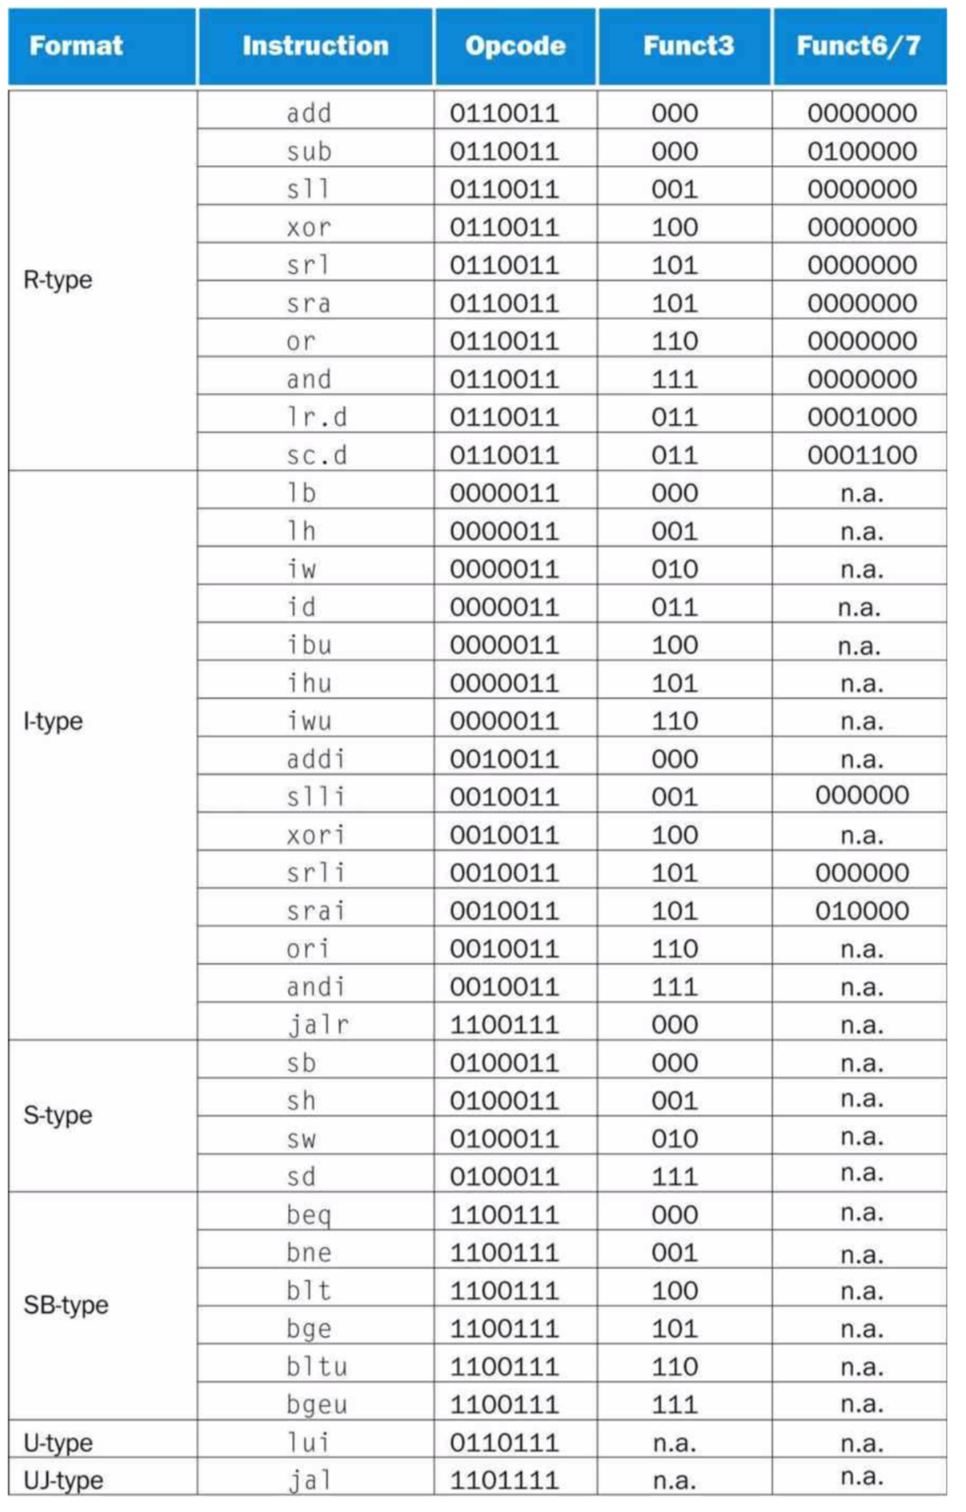
RISC-V Encoding and Decoding: Opcode/Funct

Slide 31
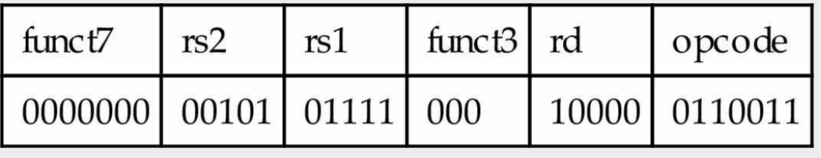
To Decode an Instruction Word
To decode an instruction word: 00578833_{hex}
  Convert to binary: 0000 0000 0101 0111 1000 1000 0011 0011
  Determine the opcode, the rightmost 7 bits: 011 0011
  It is R-type arithmetic instruction
  Decode the rest, func3 and funct7 and then rs1, rs2, rd
  Add x16, x15, x5

