Slide 1
Chapter 2: Instructions: Language of the Computer
RARS RISC-V Architecture and Runtime Simulator
ITSC 3181, Introduction to Computer Architecture https://passlab.github.io/ITSC3181/
Department of Computer Science
Yonghong Yan
yyan7@uncc.edu
https://passlab.github.io/yanyh/

Slide 2
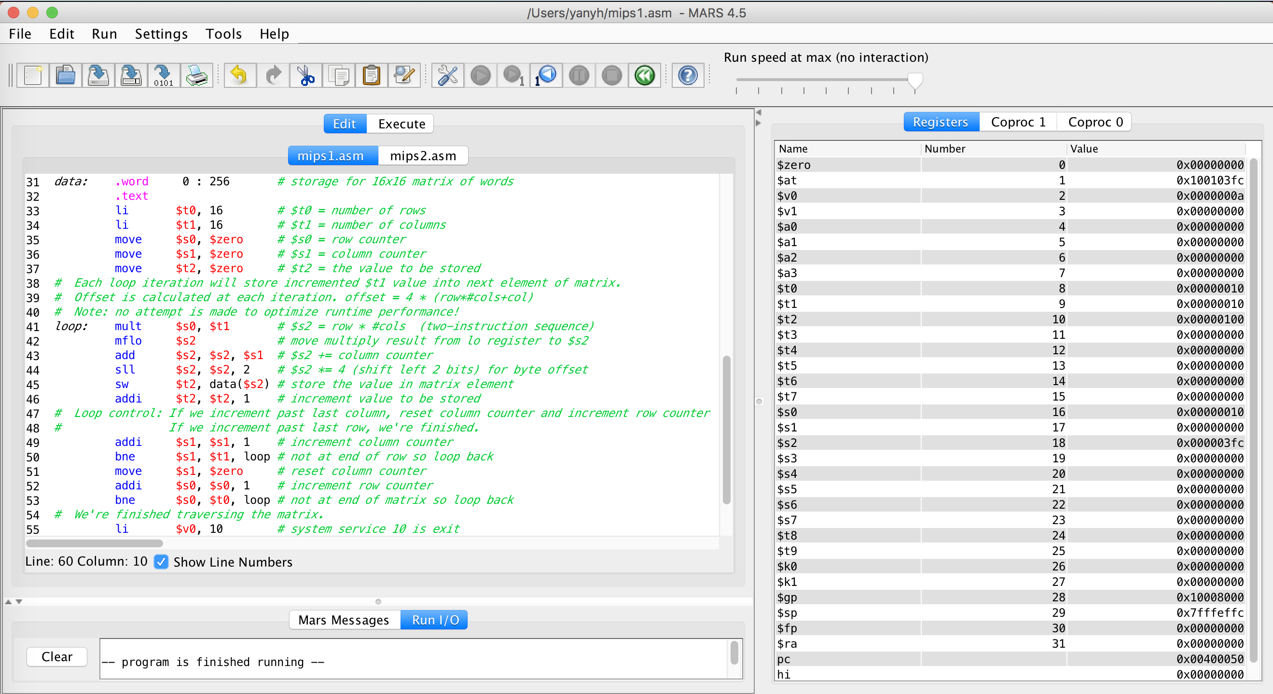
MIPS Simulator
MARS (MIPS Assembler and Runtime Simulator)
  http://courses.missouristate.edu/KenVollmar/MARS/index.htm
  https://courses.missouristate.edu/KenVollmar/mars/tutorial.htm

Slide 3
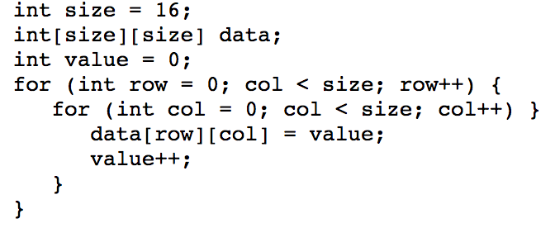
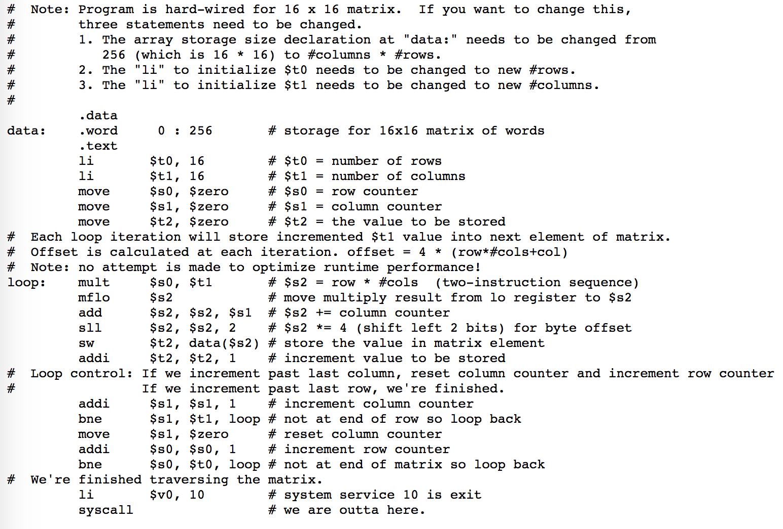
Write Assembly Code in MARS https://courses.missouristate.edu/KenVollmar/mars/tutorial.htm
.data segment
.text segment
row-major.asm example

Slide 4
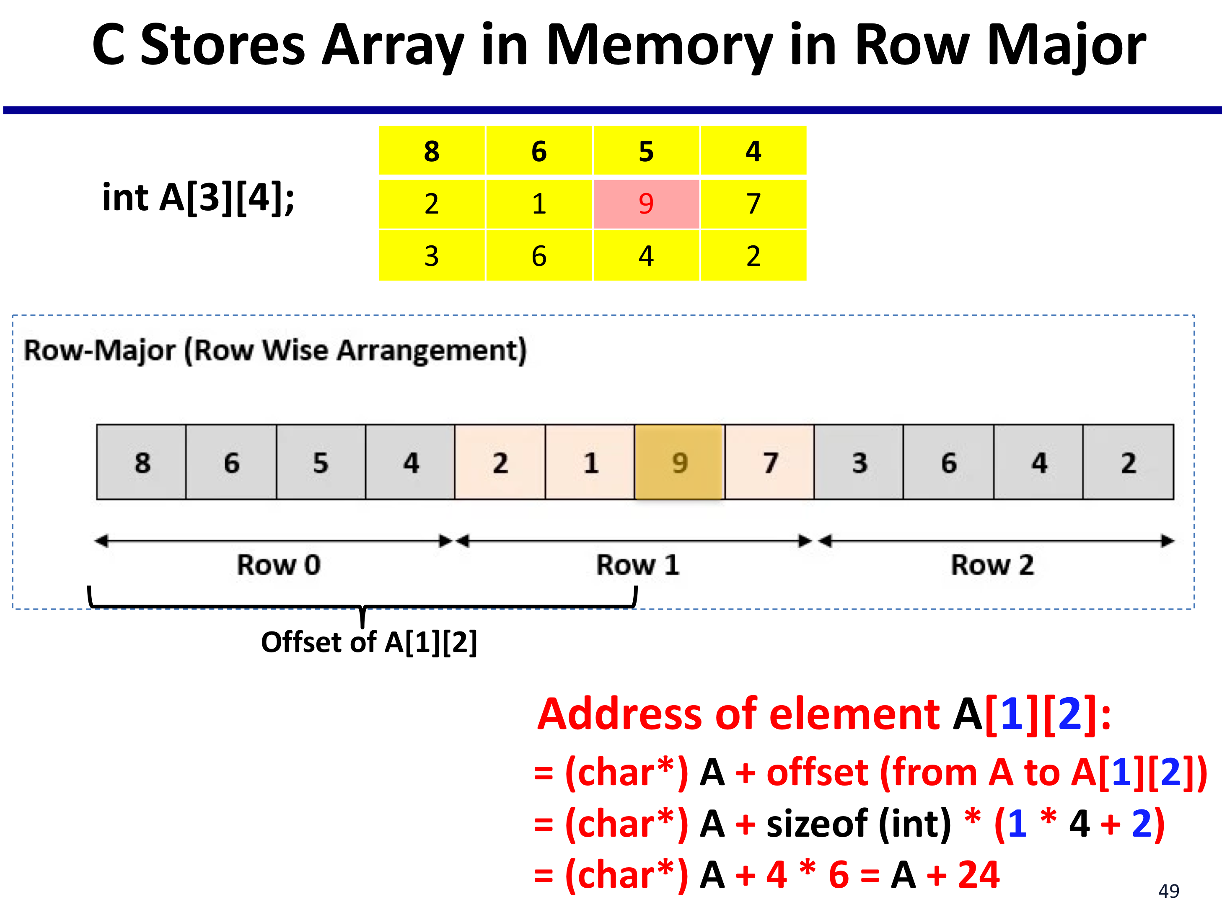
row-major.asm: Offset and Address for row-major 2-dimensional array
Slides 49 https://passlab.github.io/CSCE212/notes/lecture06_CBasic.pdf

Slide 5
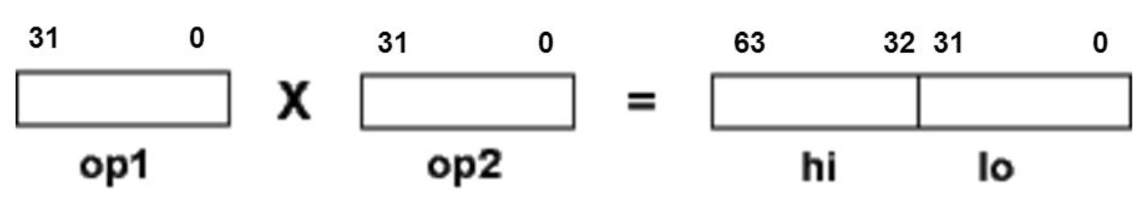
Multiplication in MIPS
Multiplication, Textbook 3.3, page 188
  MIPS multiply unit contains two 32-bit registers called hi and lo
    They are not general purpose registers
  The product of multiplying two 32-bits operands are stored in hi and lo registers
    Need mfhi and mflo to load values in hi and lo to general purpose register

Slide 6
row-major.asm Example

Slide 7
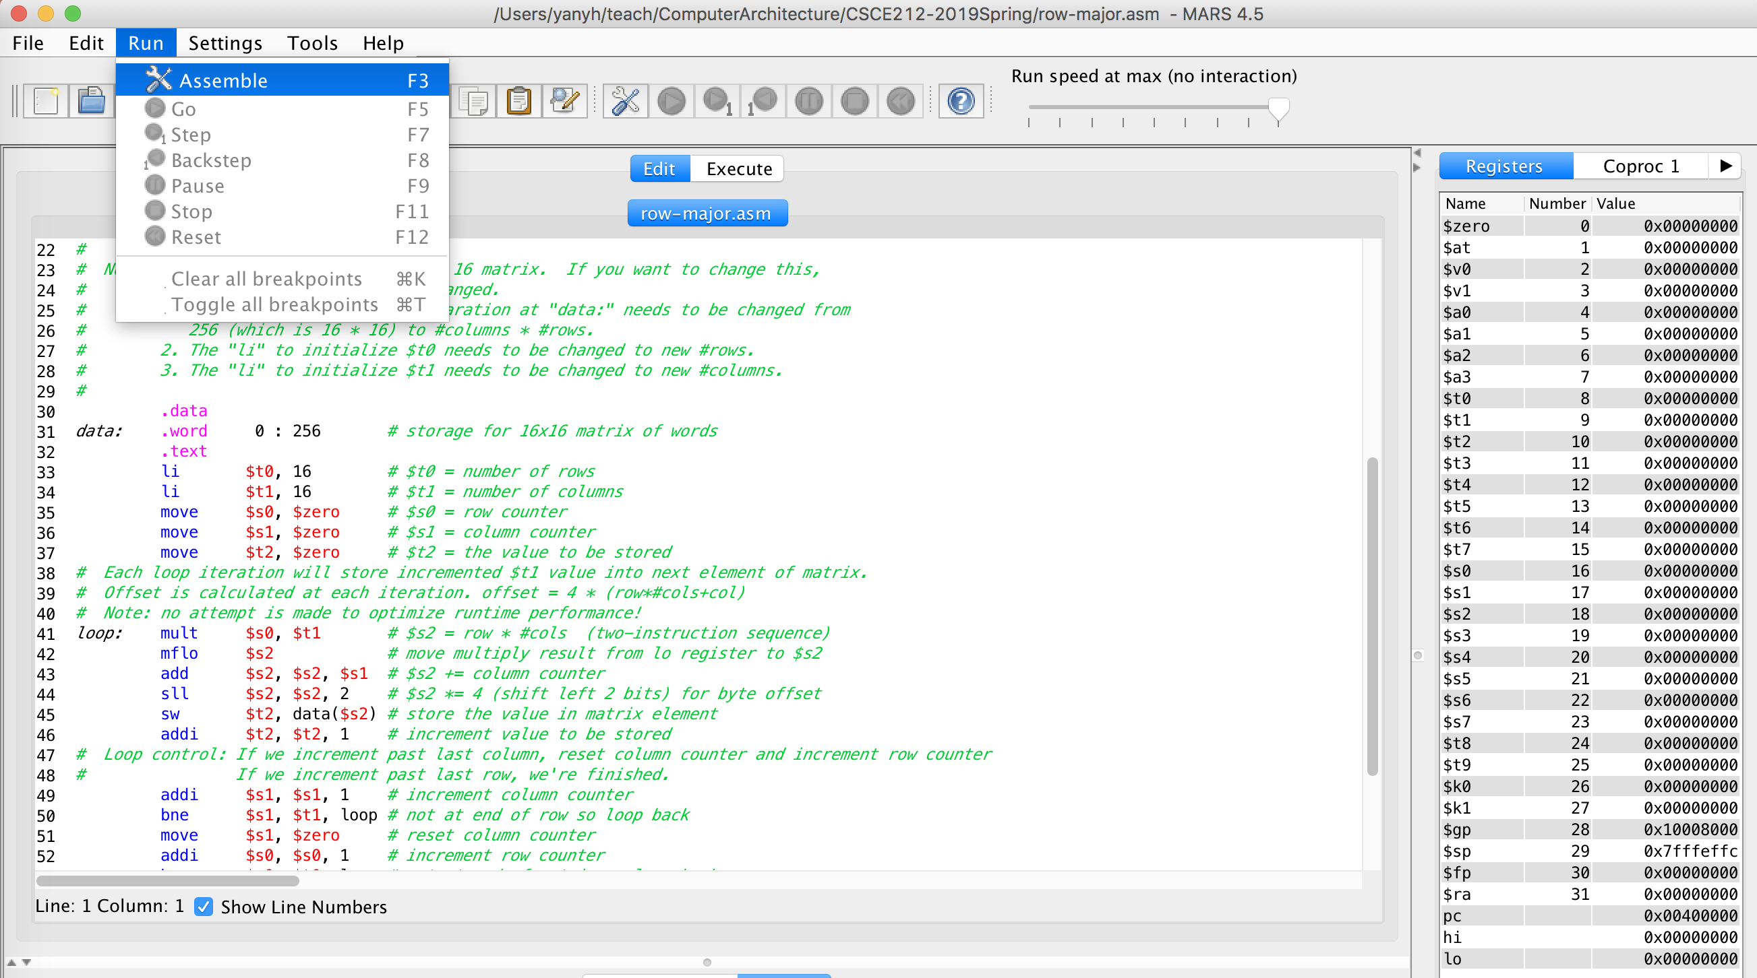
row-major.asm Example in MARS
Edit window and To Assembly

Slide 8
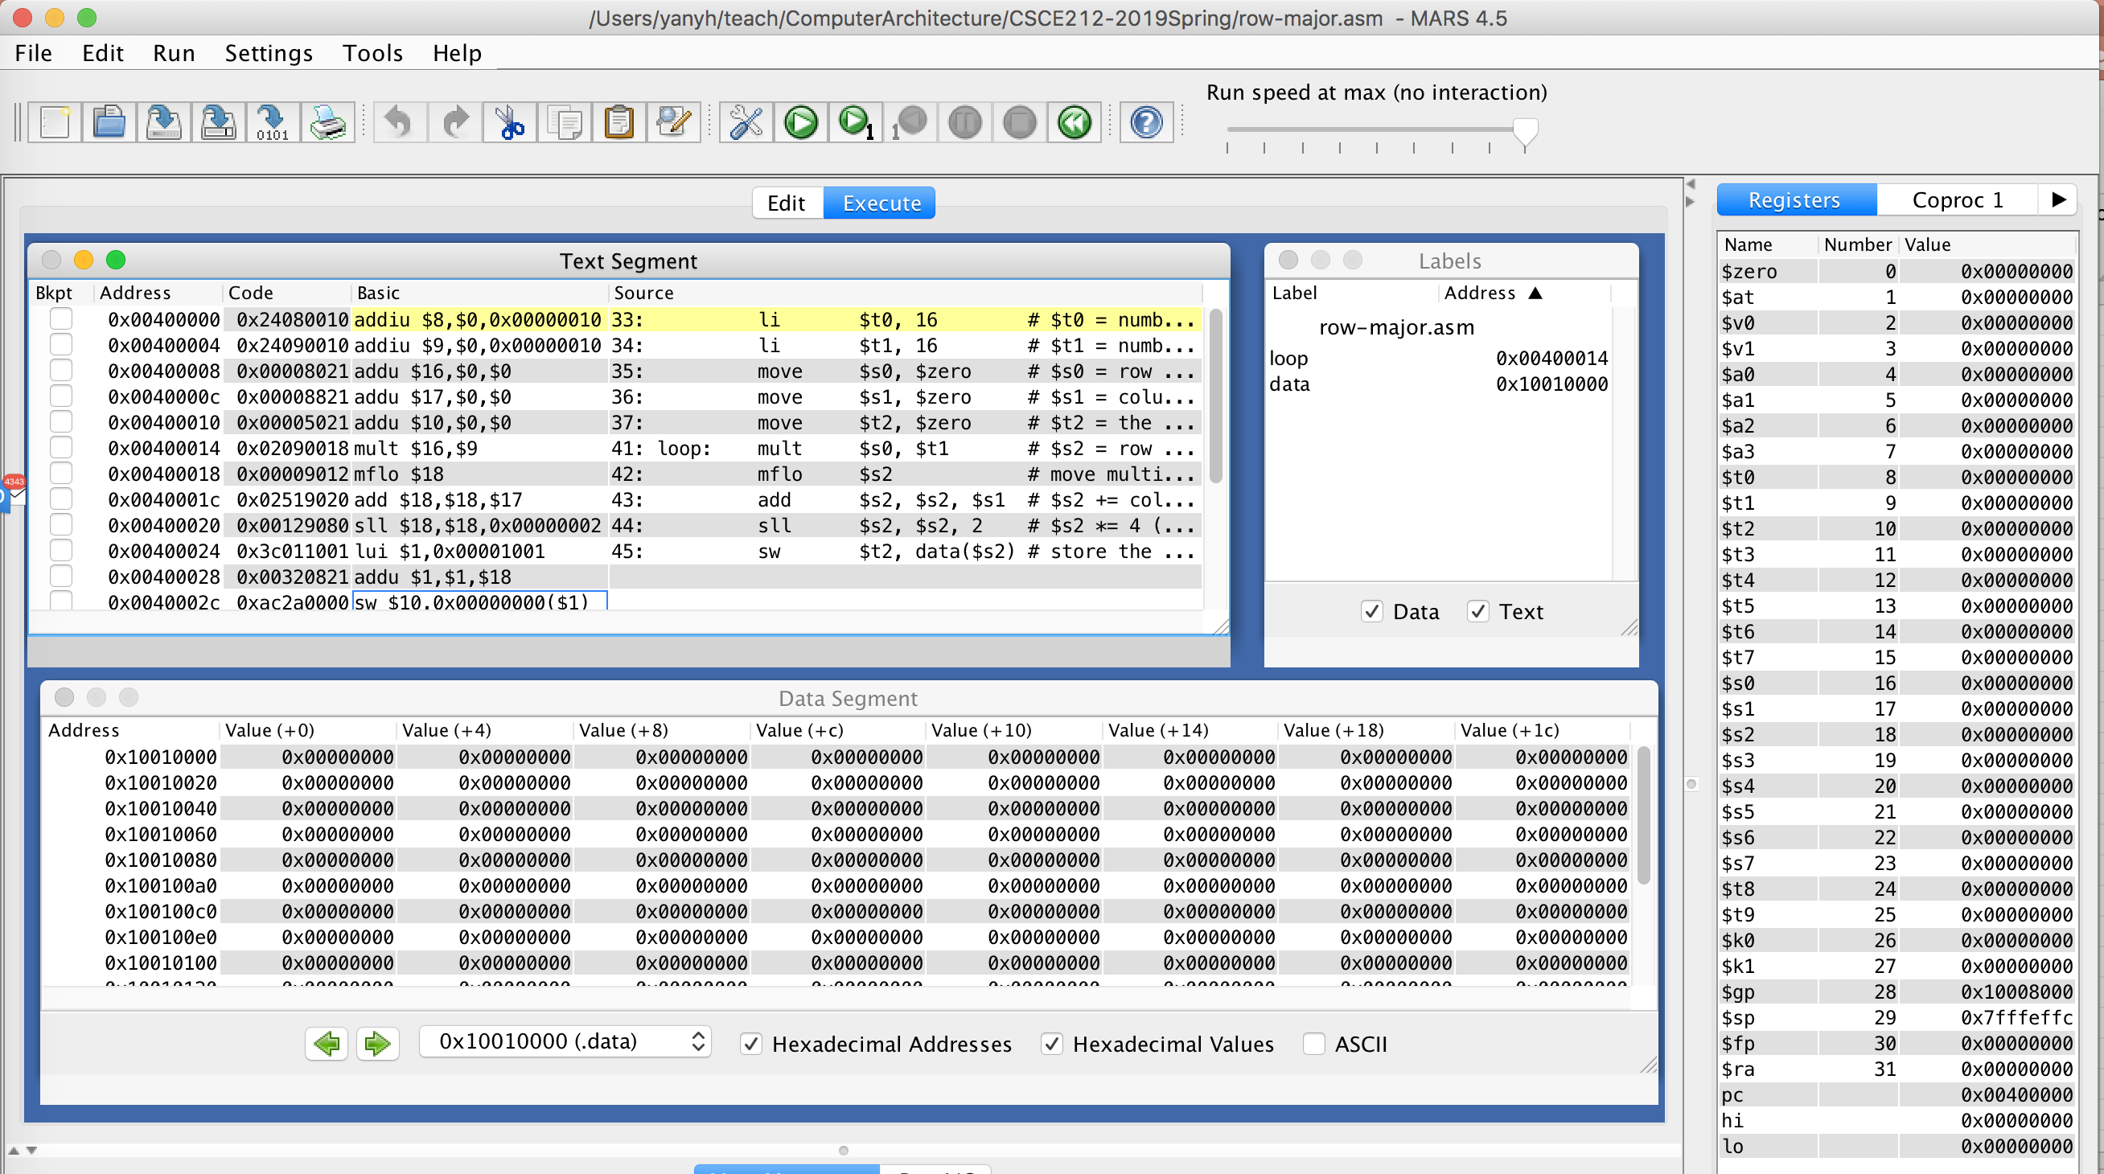
row-major.asm Example in MARS
Assembly window

Slide 9
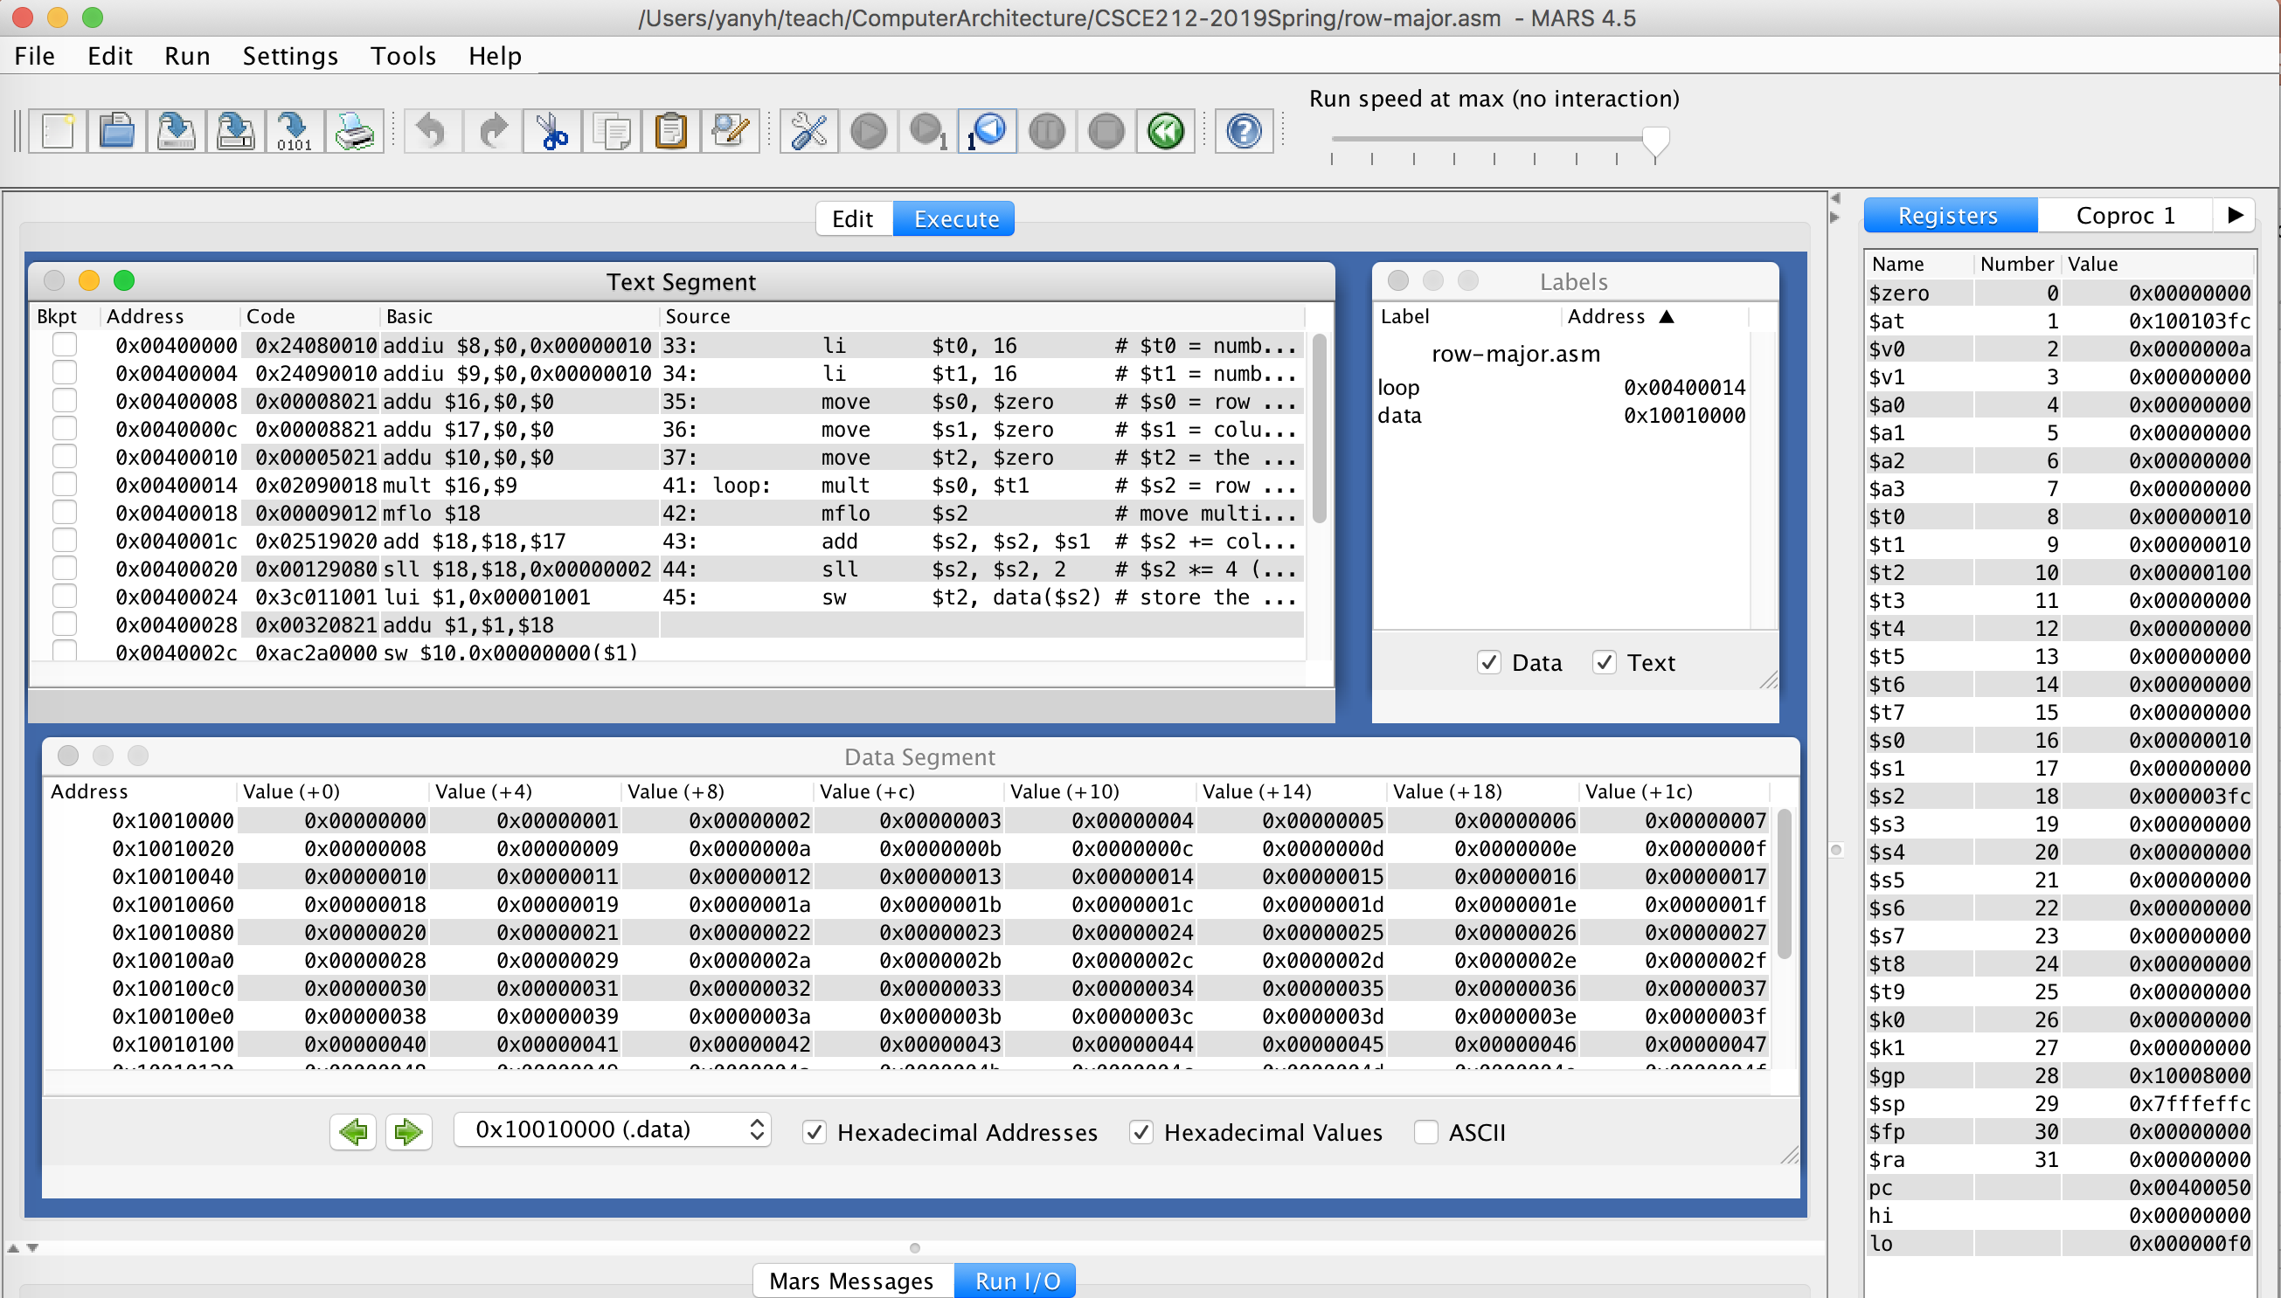
row-major.asm Example in MARS
After Execution

Slide 10
Download and Try Examples
MARS Tutorial: https://courses.missouristate.edu/KenVollmar/mars/tutorial.htm
  Fibonacci.asm
  row-major.asm
  column-major.asm
Rewrite textbook example to make it run
  C sort
  Array vs pointer

