Slide 1

ITSC 2181: Introduction to Computer Systems
Module 1, Part 1: Introduction to Computer Systems

Slide 2
In This Course, You Will Learn
How program data gets encoded into machine code and how the hardware performs arithmetic on it
How a compiler translates C programs into assembly and machine code (assembly is the human-readable form of machine code)
How a CPU executes binary instructions on binary program data, from basic logic gates to complex circuits that store values, perform arithmetic, and control program execution

Slide 3
Introduction to Computer Systems
A computer system is a system that combines both hardware and software, that together make the computer usable by users and programs.
Hardware: The physical parts of a computer, such as the Monitor, Keyboard, CPU, RAM, and I/O ports.
Software: The programs (e.g., Microsoft Word, Google Chrome) and operating systems (e.g., Windows, Mac OS, Linux) used by a computer.

Slide 4
Hardware Components
Input/Output (I/O) Ports: Enable communication between the computer and its environment. Examples are Speaker/Headphone Jack and USB-C.
Central Processing Unit (CPU): Executes instructions provided by the software. The CPU is often referred to as the “brain” of the computer
Random Access Memory (RAM): Stores data and instructions of running programs, lost when power is lost.
Secondary Storage Devices: Permanently store programs and data, even without power.

Slide 5
Software Components
Programs: Software that users interact with such as Microsoft Word and Google Chrome.
Operating Systems (OS): Software layer that lies between the hardware of the computer and the programs that users interact with.
  Implements features to enable users to easily run and interact with programs.
  Controls and manages the underlying hardware components of the computer.
  Oversees how and when programs are executed.
  Implements policies and mechanisms to allow multiple programs to run simultaneously.
  Ensures that programs run in an efficient, protected, and seamless manner.

Slide 6
Our Computer Systems Focus in This Course
In this course, we will focus specifically on computer systems that have the following qualities:
  Have IO Ports, CPU, RAM, secondary storage device(s), and an OS
  They are “general purpose”, meaning that their function is not tailored to any specific application.
  They are “reprogrammable”, meaning that they support running a different program without modifying the computer hardware or system software.
Per the definition above, examples of such computer systems would be Personal Computers (laptops and desktops), and Smartphones and Tablets

Slide 7
Examples of What Isn’t Considered a Computer System
Calculators: while they usually have a processor, limited amounts of memory, and I/O capability, calculators typically do not have an operating system and do not have secondary storage; and are not general purpose.
Microcontroller (compact circuit designed to govern specific operations in an embedded system such as toys): although microcontrollers are general purpose, reprogrammable, contain a processor, internal memory, secondary storage, and are I/O capable, they lack an operating system.

Slide 8
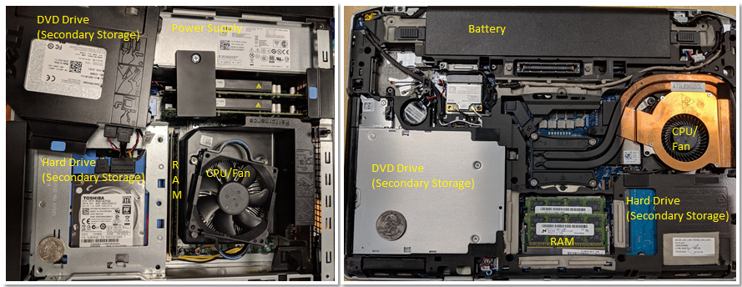
What Do Modern Computer Systems Look Like?
The image below depicts two types of computer hardware systems (excluding peripherals): a desktop computer (left) and a laptop computer (right)
Notes:
Notice that both contain the same hardware components
A dedicated power supply helps provide the desktop power
In both the desktop and the laptop, the CPU is obscured by a heavyweight CPU fan, which helps keep the CPU at a reasonable operating temperature
In terms of power consumption, desktop computers typically consume 100 - 400 W of power, while a laptop typically consumes 50 - 100 W of power and uses an external charger to supplement the battery as needed.

Slide 9
Desktops vs. Laptops: A Hardware Overview
Feature | Desktop | Laptop
Cooling System | More robust cooling options | More constrained cooling design
Power Consumption | Higher, requires outlet | Lower, battery-powered
CPU (Processor) | Often more powerful options | Generally efficient, may be less powerful
RAM (Memory) | Usually more, easily upgradable | Often less, may be harder to upgrade
Storage | More options, easily upgradable | More limited, may be harder to upgrade
I/O Ports | More variety and quantity | Limited due to size

Slide 10
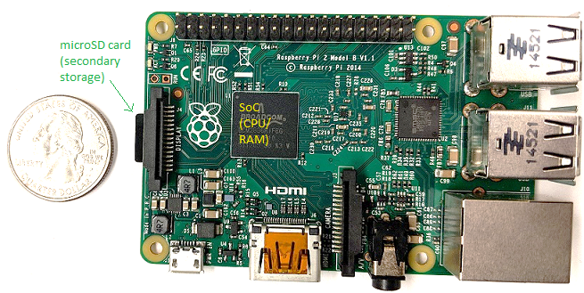
What Do Modern Computer Systems Look Like?
This image depicts a Raspberry Pi single-board computer (SBC). An SBC is a device in which the entire computer is printed on a single circuit board.

Slide 11
More About the Raspberry Pi
The Raspberry Pi SBC contains a system-on-a-chip (SoC) processor with integrated RAM and CPU.
  The SoC technology found on the Raspberry Pi is also commonly found in smartphones.
Raspberry Pi is roughly the size of a credit card, and consumes about 5W of power
Raspberry Pi (in addition to desktops, laptops, and smartphones) can have multicore processors. I.e. their CPUs are capable of executing multiple programs simultaneously.
  We refer to this simultaneous execution as parallel execution.

