Slide 1

ITSC 2181: Introduction to Computer Systems
Module 1, Part 2: Introduction to Computer Architecture

Slide 2
Understanding Computer Architecture
Computer architecture is like the blueprint of a computer’s hardware. It describes how all the physical components of a computer are arranged and how they interact with each other.
Computer architecture is often related to the computer's brain, known as the processor, or Central Processing Unit (CPU).
  The CPU is the part of the computer that executes program instructions.

Slide 3
The CPU – The Brain of the Computer
As mentioned before, the central processing unit (CPU) is like the brain of the computer. The CPU executes program instructions to carry out tasks.
These instructions and data are stored in Random Access Memory (RAM); think of RAM as the computer's short-term memory.
The CPU reads and writes data in RAM to perform its functions. The CPU is connected to the RAM using sets of wires, which we refer to as busses (e.g. data bus or address bus).

Slide 4
Instruction Set Architecture – The Language of the CPU
Instruction Set Architecture (ISA) defines the instructions a CPU can understand.
  Just like humans understand words and sentences, the CPU understands specific commands known as instructions. ISA is the collection of these instructions that a particular CPU can understand. It's like the vocabulary and grammar for the CPU.
Different CPUs have different ISAs, like languages in human culture.
  Examples include SPARC, IA32, MIPS, ARM, and x86.
ISAs tell the CPU how to understand and execute instructions.
Notes:
Different CPUs have different ISAs, like languages in human culture.
Elaboration: CPUs from different manufacturers or even different models from the same manufacturer may have unique ISAs. This means they understand different sets of instructions, similar to how people from different regions speak different languages.
Examples include SPARC, IA32, MIPS, ARM, and x86.
Elaboration: These are well-known types of ISAs used in various computer systems. They are like different dialects, each having its own set of rules and instructions that the CPU follows.
ISAs tell the CPU how to understand and execute instructions.
Elaboration: An ISA doesn't just list the instructions; it also explains how the CPU should carry them out. This includes the binary encoding of instructions, the effects of executing instructions, and the registers used, akin to grammar rules that dictate how sentences are formed.

Slide 5
Microarchitecture – The Building Blocks of ISA
Microarchitecture is the circuitry for a specific ISA.
  The microarchitecture describes how a specific ISA is implemented in hardware. It’s like a blueprint that guides how the physical components are arranged to execute the set of instructions.
Different microarchitectures can implement the same ISA.
  Just as different builders can construct houses that all comply with the same building codes, different microarchitectures can execute the same instruction set but with distinct design approaches.
Understanding microarchitecture allows us to:
  Bridge the gap between the high-level programming languages and the actual hardware operations.
  Create more efficient and effective software.

Slide 6
Types of ISAs: RISC vs CISC
ISAs can be classified into RISC (Reduced Instruction Set Computer) or CISC (Complex Instruction Set Computer).
RISC uses simple instructions that execute quickly, like basic building blocks.
  Popular RISC architectures include ARM and MIPS.
CISC provides more complex instructions that perform multiple functions.
  Popular CISC architectures include x86, used in many personal computers.
Imagine RISC as a simple Lego set, each block doing one thing; CISC is like a multi-tool Swiss knife, with each tool serving several purposes.

Slide 7
Historical Perspective and Development
RISC was developed in the 1980s at Berkeley and Stanford.
David Paterson and John Hennessy won the 2017 Turing Award for RISC development.
RISC uses simple instructions that execute quickly, like basic building blocks.
  Popular RISC architectures include ARM and MIPS.
CISC provides more complex instructions that perform multiple functions.
  Popular CISC architectures include x86, used in many personal computers.
Imagine RISC as a simple Lego set, each block doing one thing; CISC is like a multi-tool Swiss knife, with each tool serving several purposes.

Slide 8
Comparing RISC and CISC Today
RISC is more common in high-end servers and mobile devices.
CISC dominates desktop and many server-class computers.
It’s important to keep in mind that the comparison between RISC and CISC is not always clear-cut, as the line between the two has blurred with modern technological advances.
In this course, we will learn about about ARM assembly language, which is a RISC architecture.

Slide 9
The Origin of Modern Computing Architectures
Modern computer architecture emerged from various 1930s and 1940s ideas.
Claude Shannon made the connection between Boolean algebra and electrical circuit design in 1937.
  This laid the foundation for all digital circuit design and helped lead to modern computer architecture.
Shannon’s ideas were instrumental in moving from analog to digital computing.
  The binary system became the core of how computers process information, representing data in a series of ones and zeros.

Slide 10
Introduction to von Neumann Architecture
The von Neumann architecture is the blueprint for most modern computers.
  Almost all personal computers, laptops, and even smartphones follow this architecture.
It consists of five main parts that work together.
  These parts are the processing unit, control unit, memory unit, input, and output units.
Buses connect these units to enable communication.
  Buses are like the computer’s highway system, allowing data to flow between different parts of the computer.
We’ll explore each of these components in more detail in this lecture.

Slide 11
The CPU – The Brain of the Computer
The CPU is made of two main parts: the processing unit and the control unit.
The processing unit executes instructions (e.g., addition or subtraction).
The control unit guides the execution of these instructions.
  The control unit acts like a traffic cop, directing the flow of data and instructions in the CPU.
  It works with the processing unit by fetching instructions from memory, decoding them, and then executing them.
Together, these two units make up the CPU, handling all calculations.

Slide 12
Processing Unit – ALU and Registers
The Arithmetic/Logic Unit (ALU) does the math.
  This includes both arithmetic operations (such as addition, subtraction, multiplication, and division) and logical operations (such as comparisons).
Registers are small storage areas that hold data and instructions.
  Registers are like variables in programming but within the hardware itself; they temporarily hold data or instructions, allowing quick access for the CPU during execution
In the von Neumann architecture, instructions are treated as data.
  This means that the processing unit works with both numbers and code.

Slide 13
Control Unit – Managing Execution
The control unit manages how instructions are performed.
It loads instructions from memory and sends them to the processing unit.
The program counter (PC) and instruction register (IR) help track progress.
PC keeps the address of the next instruction; IR stores the current one.
It’s like a conductor leading an orchestra, ensuring each part plays in sync.

Slide 14
Memory Unit – Storing Data and Instructions
The term memory sometimes refers to an entire hierarchy of storage in the system. It can include registers in the processing unit as well as secondary storage devices like hard disk drives (HDD) or solid-state drives (SSD)
For now, we use the term “memory” interchangeably with internal random access memory (RAM) — memory that can be accessed by the central processing unit
Memory stores program data and instructions close to the CPU.
Think of memory as the desk where you keep all your tools and documents.

Slide 15
Input and Output Units – Connecting with the World
Input units like keyboards and mice let you communicate with the computer.
Output units like monitors and speakers show the computer’s responses.
Some devices, like touchscreens, serve both input and output functions.
These units make the computer an interactive tool, not just a number-cruncher.
The I/O units are integral to the functionality and usability of the computer; without them, the computer would be a closed system, unable to interact with users or other devices.

Slide 16
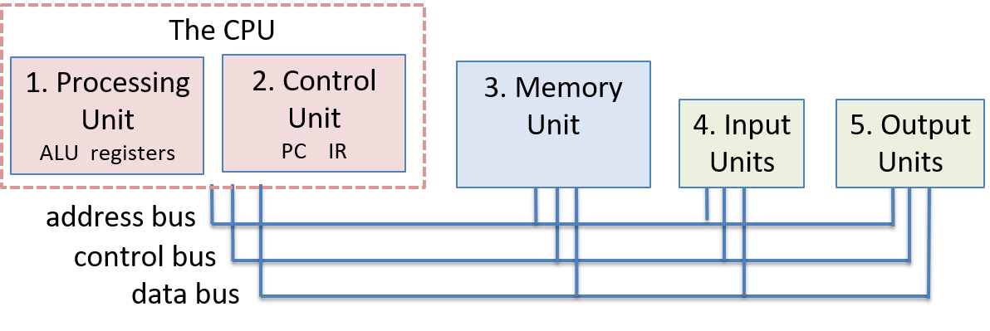
The von Neumann Architecture
The von Neumann architecture consists of the processing, control, memory, input, and output units. The control and processing units make up the CPU, which contains the ALU, the general-purpose CPU registers, and some special-purpose registers (IR and PC). The units are connected by buses used for data transfer and communication between the units.

Slide 17
Buses and Word Sizes – Communication and Standards
Buses are channels/wires that allow different parts to talk to each other.
They carry data, memory addresses, and control signals between units.
  The width of a data bus (e.g., 32 bits) determines how much data can be transferred at once.
Word size is the standard data size handled by the processor.
  It’s like the standard portion size for the computer’s meals.
Word sizes have changed over time, from 16 bits to today’s 64 bits.
This communication system and standardization make the architecture universally applicable.

Slide 18
Fetching Instructions: The First Step
The control unit starts by locating the next instruction.
The program counter (PC) register holds the address of this instruction.
A read command sends the address to the memory unit.
The memory unit reads the bytes and sends them back to the control unit.
The instruction register (IR) stores these bytes; the PC is updated for the next fetch.

Slide 19
Decoding: Understanding the Instruction
The control unit reads the instruction from the IR.
It breaks down the bits to understand the operation and operands.
The definition of encoding is based on the ISA (Instruction Set Architecture).
Operand values are fetched from locations like CPU registers or memory.
Now, the instruction is ready for execution by the processing unit.

Slide 20
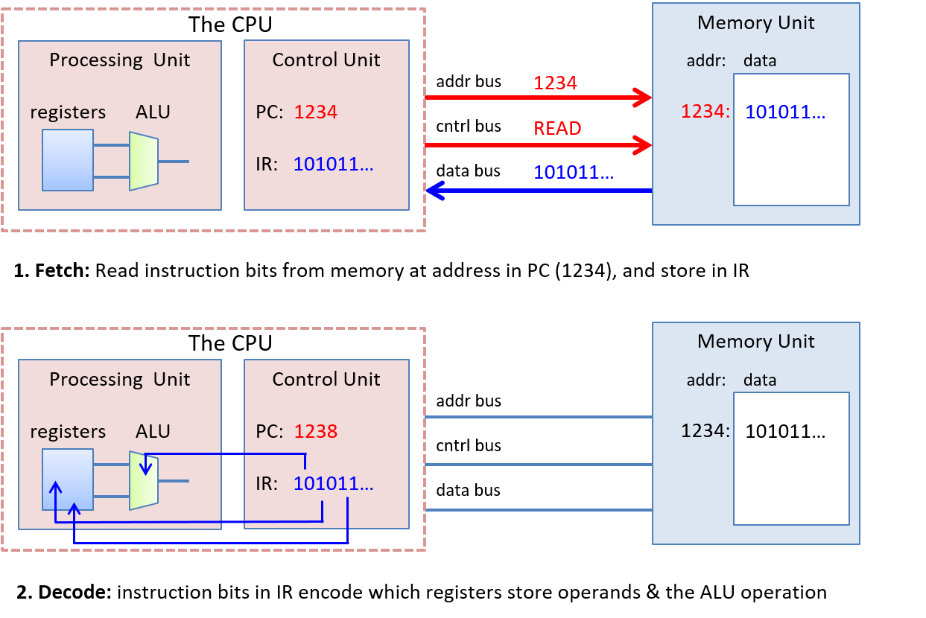
Notes:
In the fetch phase, the control unit reads the instruction at the memory address stored in the PC (1234). It sends the address on the address bus, and a READ command on the control bus.
The memory unit receives the request, reads the value at address 1234, and sends it to the control unit on the data bus.
The control unit places the instruction bytes in the IR register and updates the PC with the address of the next instruction (1238 in this example).
In the decode phase, the control unit feeds bits from the instruction that specify which operation to perform to the processing in the ALU, and uses instruction bits that specify which registers store operands to read operand values from the processing unit’s registers into the ALU (the operand values are 3 and 4 in this example)

Slide 21
Execution & Storing: Performing & Saving the Operation
The processing unit (ALU) carries out the instruction on the data operands.
The result of this execution is ready to be stored.
The control unit places the result on the data bus.
The address for storage is placed on the address bus; a write command is issued.
The memory unit writes the value to memory at the specified address.

Slide 22
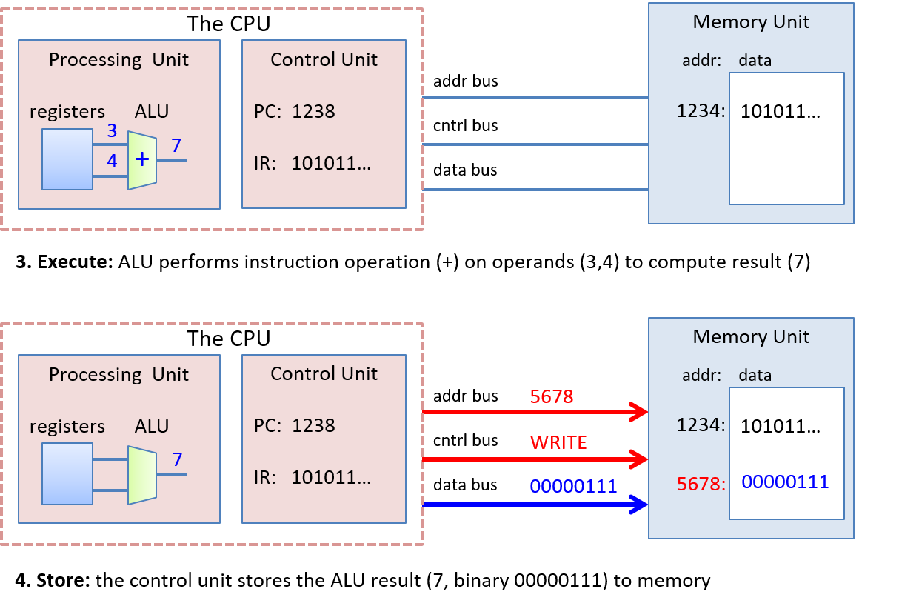
Notes:
In the execute phase, the ALU part of the processing unit executes the operation on the operands to produce the result (3 + 4 is 7). Finally, in the store phase the control unit writes the result (7) from the processing unit to the memory unit.
The memory address (5678) is sent on the address bus, a WRITE command is sent on the control bus, and the data value to store (7) is sent on the data bus. The memory unit receives this request and stores 7 at memory address 5678. In this example, we assume that the memory address to store the result is encoded in the instruction bits.

Slide 23
Execution & Storing: Performing & Saving the Operation
The processing unit (ALU) carries out the instruction on the data operands.
The result of this execution is ready to be stored.
The control unit places the result on the data bus.
The address for storage is placed on the address bus; a write command is issued.
The memory unit writes the value to memory at the specified address.

