Slide 1
Module 6: Instruction Set Architecture, ARMv8 Assembly and Assembly Programming
ITSC 2181, Introduction to Computer Systems https://passlab.github.io/ITSC2181
Department of Computer Science
Yonghong Yan
yyan7@uncc.edu
https://passlab.github.io/yanyh/

Slide 2
Module 6: Module 6: Instruction Set Architecture, ARMv8 Assembly and Assembly Programming
☛
Instruction Set Architecture (ISA), Registers and Assembly Programs
Common instruction format and accessing memory
More arithmetic and logic instructions for computing
Conditional control and instructions for making Decisions (if-else) and loops
Supporting Functions and procedures
Access arrays/matrices/structs

Slide 3
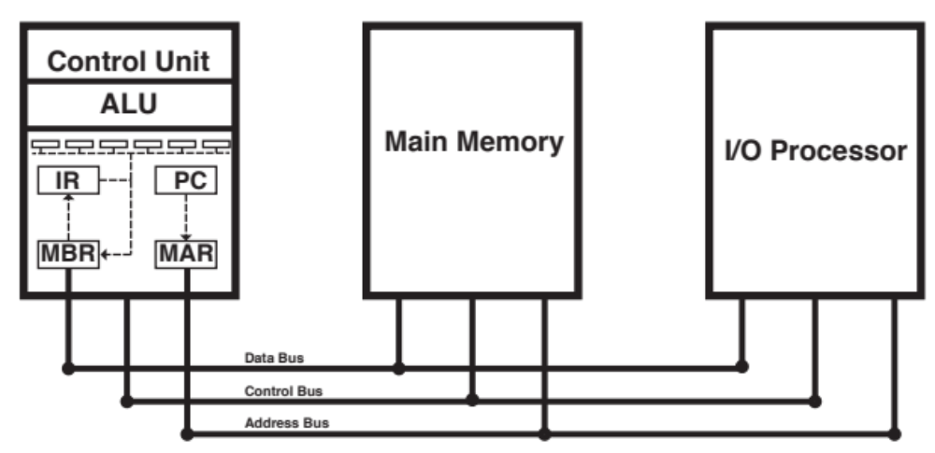
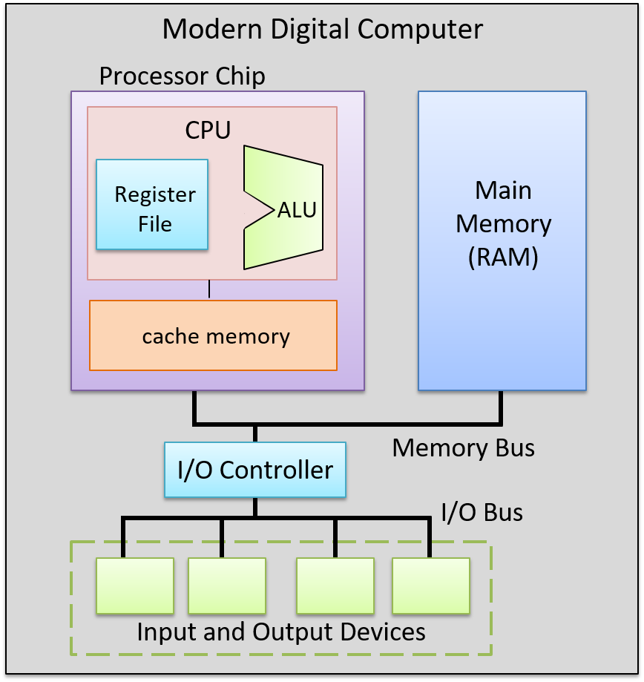
Components of a Computer
CPU or Processor
Input
Output
Notes:
CPU or Processor

Slide 4
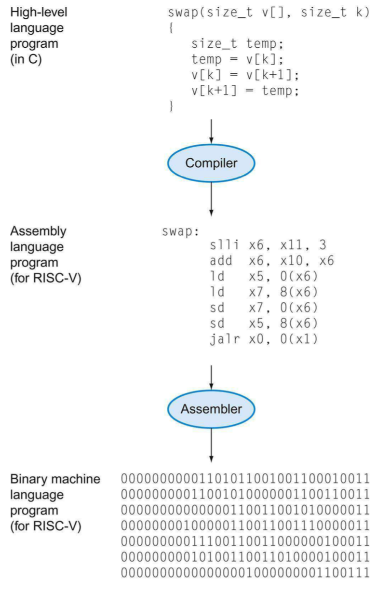
Levels of Program Code
High-level language
  Level of abstraction closer to problem domain
  Provides for productivity and portability
Assembly language
  Textual representation of instructions
  Interface between HW and SW
Hardware representation
  Binary digits (bits)
  Encoded instructions and data

Slide 5
Instruction Set Architecture: The Interface Between Hardware and Software
The words of a computer language are called instructions, and its vocabulary/dictionary is called an instruction set
  lowest software interface, assembly level, to the users or to the compiler writer
Instruction Set Architecture – A type of computers
software
instruction set
hardware

Slide 6
Major Types of ISA (Computers)
X86: Intel and AMD, Desktop, laptop, server market
ARM: embedded, pad/phone, etc, now laptop/server
RISC-V: fast growing one, embedded so far
Power (mainly IBM) and SPARC (mainly Oracle and Fujitsu): server market

Slide 7
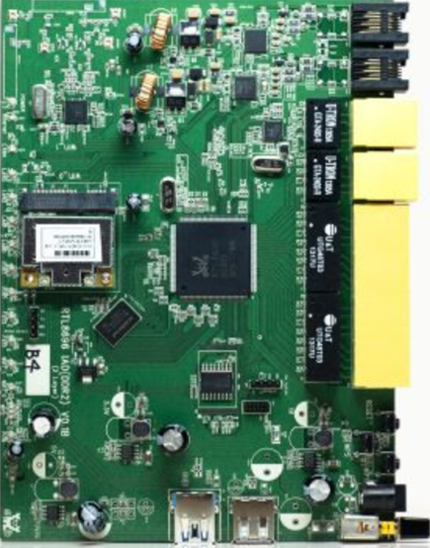

Levels of Program Code to
Multiple Target Architectures
Java
C/C++
Python
Javac and JIT
gcc/clang
python
RISC-V
X86/X86_64
ARM

Slide 8
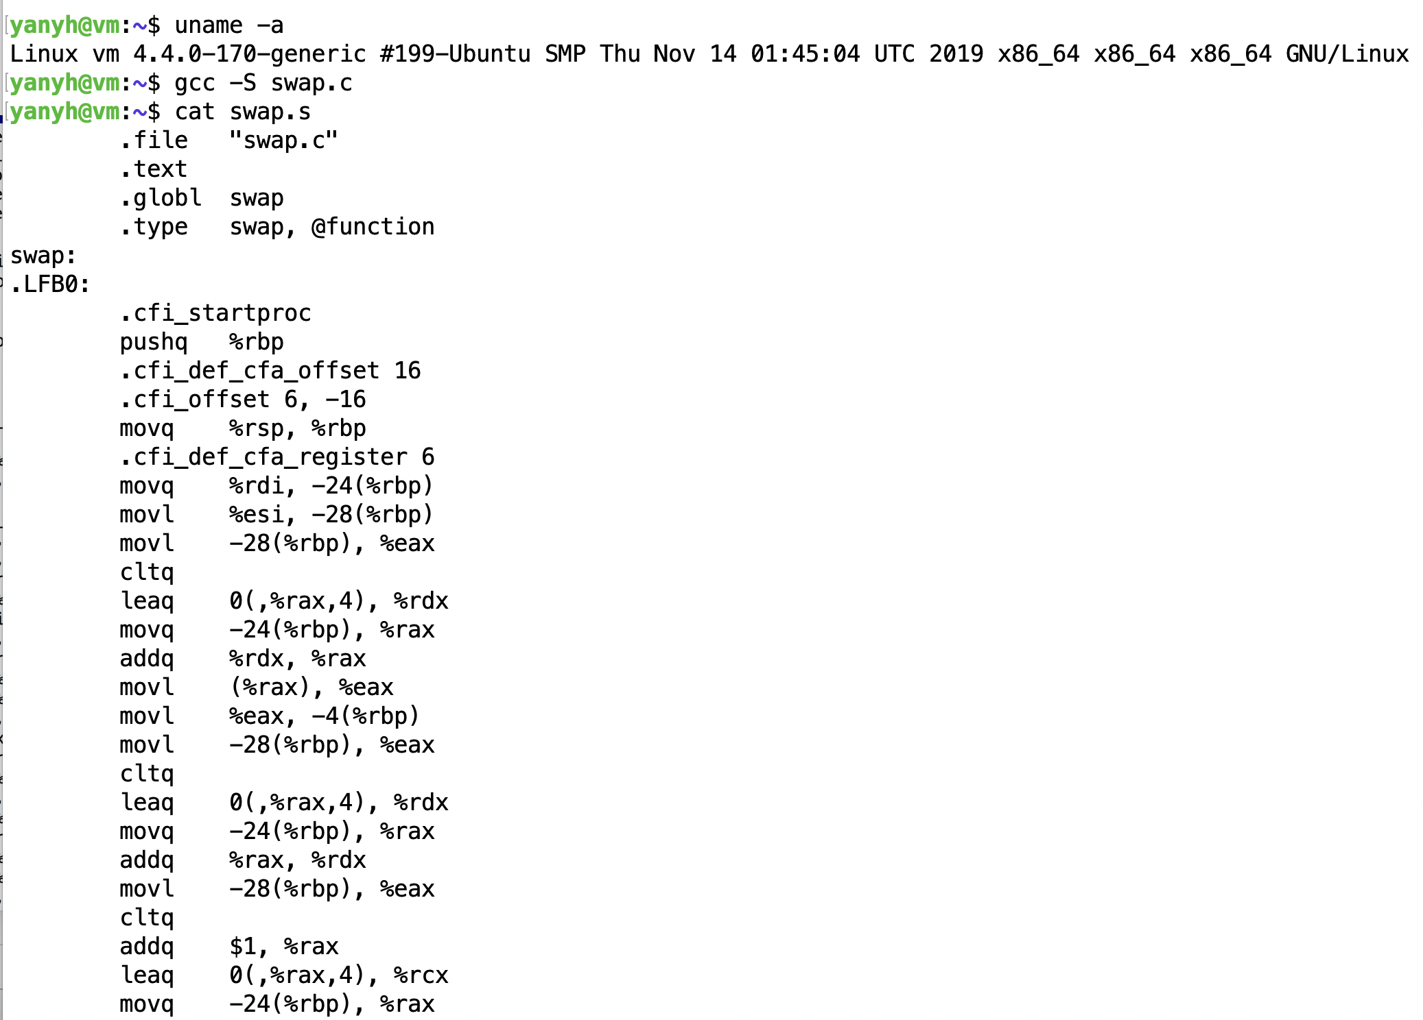
X86_64 Assembly Example
Using “-S” compiler flag to translate high-level code to assembly instructions
X86_64 is ISA Architecture for most Intel and AMD desktop/server CPUs
RISC-V is one ISA
ARM is another ISA
  Most cellphone/smartphone are ARM CPUs
Try the highlighted command for swap.c from the terminal of
https://repl.it/languages/c
https://passlab.github.io/ITSC3181/exercises/swap/

Slide 9
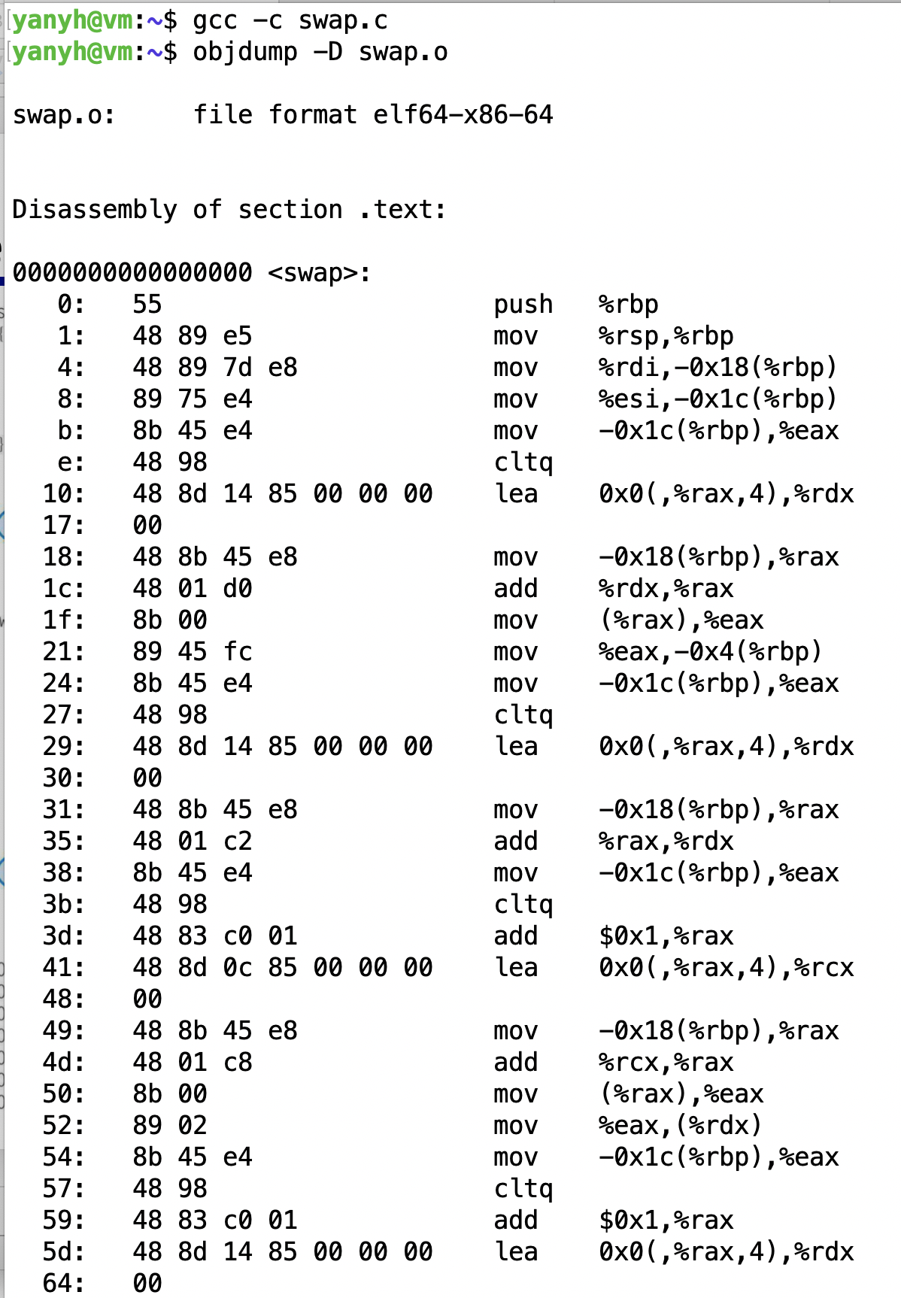
X86_64 Assembly Example
Disassembly a machine binary code to assembly instructions using “objdump”
https://repl.it/languages/c
Disassembly

Slide 10
Exercise: Inspect ISA for addr2
adder2 example
  https://passlab.github.io/ITSC3181/exercises/swap/
Check
  swap.x86_64.s,
  swap.x86_64_objdump.txt
Generate and execute
  gcc -s swap.c -o swap.x86_64.s
  gcc -c swap.c
  objdum -D swap.o > swap.x86_64_objdump.txt
For how to compile and run Linux program
  https://passlab.github.io/ITSC3181/notes/lecture01_LinuxCProgramming.pdf
Other system commands:
  cat /proc/cpuinfo to show the CPU and #cores
  top command to show system usage and memory

Slide 11
Exercise: Inspect ISA for swap
Swap example
  https://passlab.github.io/ITSC3181/exercises/swap/
Check
  swap.x86_64.s,
  swap.x86_64_objdump.txt
Generate and execute
  gcc -s swap.c -o swap.x86_64.s
  gcc -c swap.c
  objdum -D swap.o > swap.x86_64_objdump.txt
For how to compile and run Linux program
  https://passlab.github.io/ITSC3181/notes/lecture01_LinuxCProgramming.pdf
Other system commands:
  cat /proc/cpuinfo to show the CPU and #cores
  top command to show system usage and memory

Slide 12
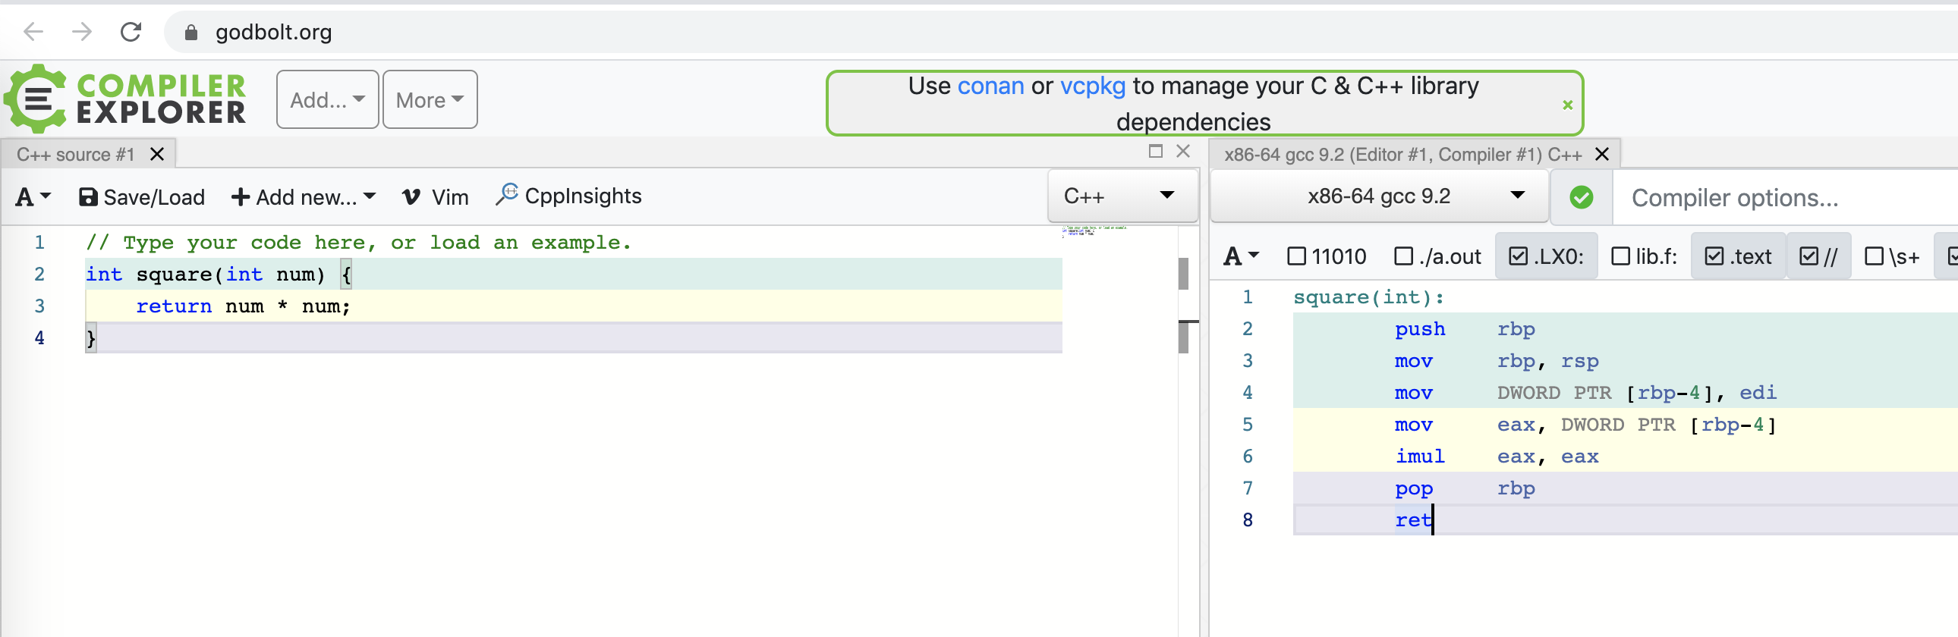
Compiler Explorer
Explore other ISA assembly from Compiler Explorer at https://godbolt.org/
Work on Lab 01 Tomorrow

Slide 13
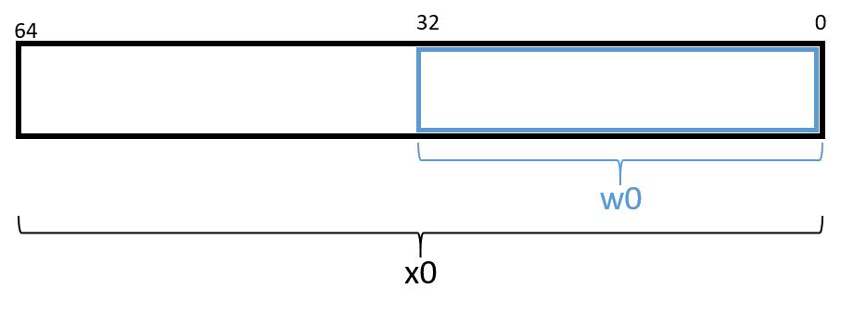
Registers in CPU
Registers are super-fast small memory/storage used in CPU.
  General-purpose registers, program counter, instruction register, status register, floating-point register, etc
  ARMv8 CPU has 31 GP 64-bit Registers named as x0 to x30 program and read from or write to
    w0: lower 32-bit of x0, so as w1, …, w30
  ARVMv8 special purpose register:
    Stack pointer register (sp)
    Program counter register (pc)
    Zero register zr: permanently stores the value 0
Data and instructions need to be loaded to memory and then register in order to be processed.
Notes:
The compiler reserves the sp register for maintaining the layout of the program stack. The pc register points to the next instruction to be executed by the CPU; unlike the other registers, programs cannot write directly to the pc register. Next,

Slide 14
Instruction Structure
opcode D, O1, O2
  opcode: specifies the operation
  Three operands for each/most instructions:
    One destination operands
    Two source operands
  Three types of operands:
    Constant: values preceded by the # sign, e.g. #0x2
    Register: sp, x0 to x30
    Memory: refering to a memory address, format: [register, constant], e.g. [sp, #12], [x11, #-16]
Destination operands MUST be register
Source operands can be register, constant or memory
Data in memory must be transferred to registers before being operated on, and transferred back to memory after the operations are complete.

Slide 15
Instruction Operands and Registers
Table 1. Example Operands
Operand | Form | Translation | Value
x0 | Register | x0 | 0x804
[x0] | Memory | *(0x804) | 0xCA
#0x804 | Constant | 0x804 | 0x804
[x0, #8] | Memory | *(x0 + 8) or *(0x80c) | 0x12
[x0, x1] | Memory | *(x0 + x1) or *(0x810) | 0x1E
[x0, w3, SXTW] | (Sign-Extend) Memory | *(x0 + SignExtend(w3)) or *(0x808) | 0xFD
[x0, x2, LSL, #2] | Scaled Memory | *(x0 + (x2 << 2)) or *(0x80c) | 0x12
[x0, w3, SXTW, #1] | (Sign-Extend) Scaled Memory | *(x0 + SignExtend(w3 << 1)) or *(0x80c) | 0x12

Slide 16
Three Classes of Instructions
General form:
  <op word> <dest operand> <src operand 1> <src operand 2>
Arithmetic-logic instructions
  add, sub, addi, and, or, shift left|right, etc
Memory load and store instructions
  lw and sw: Load/store word
  ld and sd: Load/store doubleword
Control transfer instructions (changing sequence of instruction execution)
  Conditional branch: bne, beq
  Unconditional jump: j (
  Procedure call and return: jal and jr

Slide 17
Three Major Operations of A/Any C/* Program
N = 1000
Arithmetic and logic operation:
  i++, +, *: three operations per iteration ➔ 3000
Array reference
  X[i]: one array reference per iteration ➔ 1000
Condition check (if-else, loop)
  i < N: one check per iteration ➔ 1000
float sum(int N, float X[], float a) {
int i;
float result = 0.0;
for (i = 0; i < N; ++i) {
result += a * X[i];
}
return result;
}

Slide 18
Common Instructions
Table 1. Most Common Instructions
Instruction | Translation
ldr D, [addr] | D = *(addr) (loads the value in memory into register D)
str S, [addr] | *(addr) = S (stores S into memory location *(addr) )
mov D, S | D = S (copies value of S into D)
add D, O1, O2 | D = O1 + O2 (adds O1 to O2 and stores result in D)
sub D, O1, O2 | D = O1 - O2 (subtracts O2 from O1 and stores result in D)
str w0, [sp, #12]
ldr w0, [sp, #12]
add w0, w0, #0x2
Store the value in register w0 in the memory location specified by sp + 12 (or *(sp + 12)).
Load the value from memory location sp + 12 (or *(sp + 12)) into register w0.
Add the value 0x2 to register w0, and store the result in register w0 (or w0 = w0 + 0x2).
https://diveintosystems.org/book/C9-ARM64/common.html

Slide 19
Instruction for Accessing Stack Memory

Slide 20
Arithmetic and Logic Instructions
Add and subtract, three operands
  Two source operands: provide input or source data
  One destination register operand: where result goes to.
add w0, w1, w2 //sum of [w1] and [w2] is placed in [w0]
All arithmetic operations have this form
  Three operands, two sources and one destination
  3-operands instructions

Slide 21
Register Operand Example
C code:
f = (g + h) - (i + j);
  f, …, j values are already loaded in x19, x20, …, x23
Compiled RISC-V code, all are register operands
  Three operands: the first operand is destination, last two are source operands
add x5, x20, x21 // x5 = x20 + x21
add x6, x22, x23 // x6 = x22 + x23
sub x19, x5, x6 // x19 = x5 – x6

Slide 22
Logical Operations
§2.6 Logical Operations
Instructions for bitwise manipulation
Operation | C | Java | RISC-V
Shift left | << | << | Sll, slli
Shift right | >> | >>> | Srl, srli
Bit-by-bit AND | & | & | and, andi
Bit-by-bit OR | | | | | or, ori
Bit-by-bit XOR | ^ | ^ | xor, xori
Bit-by-bit NOT | ~ | ~
Useful for extracting and inserting groups of bits in a word

Slide 23
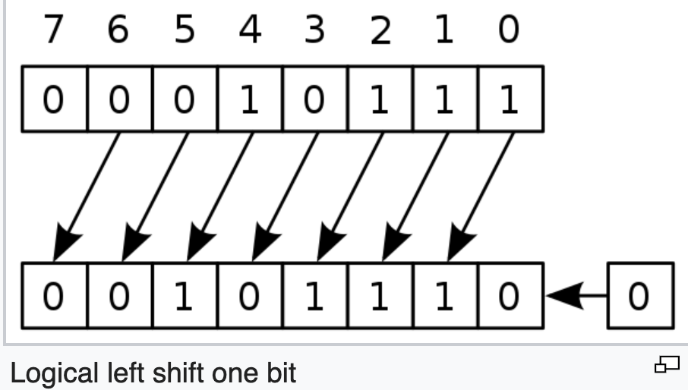
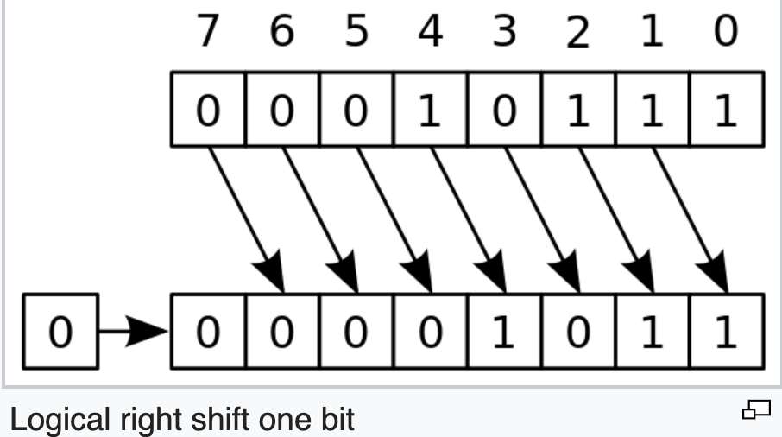
Shift Logic Operation Examples
Shift Left Logic: slli by i bits: multiplies by 2^{i}
  C/java: int i = 23; int j = i<<1; //46
  RISC-V: If i is in x5, and j is stored in x6:
    slliw x6, x5, 1
    slliw: shift left logic immediate word
Instruction name
  Carries the operand type it operates
    B: byte, H: half-word, W: word, D: double word
Shift Right Logic
  Java: int i = 23; int j = i >>> 1; //j=11
  C: int i = 23; int j = i >> 1; //j=11
  RISC-V: if i is in x5, j will be in x6:
    srliw x6, x5, 1
  Fill in 0, not much used for signed

Slide 24
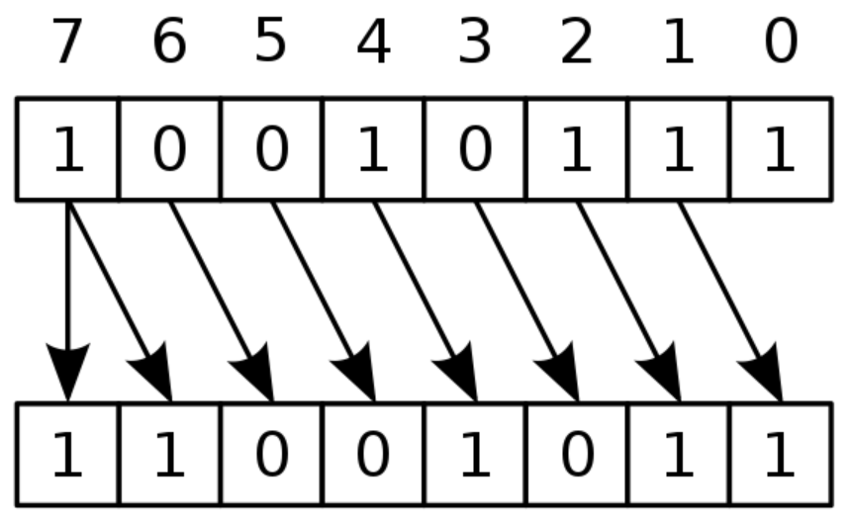
Shift Right Arithmetic
Shift right arithmetic (srai): Format: srai(w) rd, rs, #immediate
  Shift right and fill with sign bit
  srai by i bits: divides by 2^{i}
  Java: i=-105; int j=i>>1; //-53
  RISC-V: if i is in x5, j will be in x6:
    sraiw x6, x5, -1;
-105
-53

Slide 25
Summary of Shift Operations
immed: how many positions to shift
Shift left logical (sll): Format: slli(w) rd, rs, #immediate
  Shift left and fill with 0 bits
  slli by i bits: multiplies by 2^{i}
  E.g. int a = b<<2; //a = b * 4 (2²)
Shift right logical (srl): Format: srli(w) rd, rs, #immediate
  Shift right and fill with 0 bits
  srli by i bits: divides by 2^{i} (unsigned only)
  E.g. int a = b>>2; //a = b / 4 (2²)
Shift right arithmetic (sra): Format: srai(w) rd, rs, #immediate
  Shift right and fill with sign bit
  srai by i bits: divides by 2^{i}
funct6
immed
rs1
funct3
rd
opcode
6 bits
6 bits
5 bits
3 bits
5 bits
7 bits

Slide 26
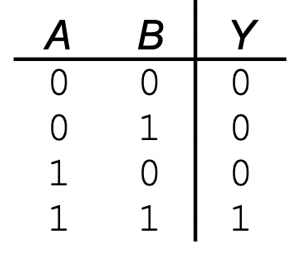
AND Operations
Useful to mask bits in a word
  Select only some bits, clear others to 0
and x9,x10,x11
  To only select 4 bits of x10 in the specific positions: Set the bits of x11 in the same positions 1, and the bits in other positions 0, and then perform AND and store the result in a new register x9
x10
00000000 00000000 00000000 00000000 00000000 00000000 00001101 11000000
x11
00000000 00000000 00000000 00000000 00000000 00000000 00111100 00000000
x9
00000000 00000000 00000000 00000000 00000000 00000000 00001100 00000000

Slide 27
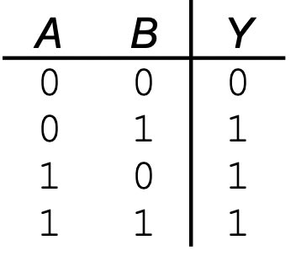
OR Operations
Useful to include bits in a word
  Set some bits to 1, leave others unchanged
or x9,x10,x11
  To only set 4 bits of x10 in the specific positions 1: Set the bits of x11 in the same positions 1, and the bits in other positions 0, and then perform OR and store the result in a new register x9
x10
00000000 00000000 00000000 00000000 00000000 00000000 00001101 11000000
x11
00000000 00000000 00000000 00000000 00000000 00000000 00111100 00000000
x9
00000000 00000000 00000000 00000000 00000000 00000000 00111101 11000000

Slide 28
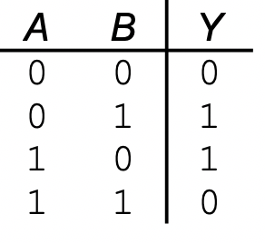
XOR Operations
Differencing operation
  E.g. NOT operation
xor x9,x10,x12 // NOT operation, invert bits
  To invert bit (logical NOT) of x10: set all bits of x12 as 1, do xor of x10 and x11, and store the result in x9
x10
00000000 00000000 00000000 00000000 00000000 00000000 00001101 11000000
x12
11111111 11111111 11111111 11111111 11111111 11111111 11111111 11111111
x9
11111111 11111111 11111111 11111111 11111111 11111111 11110010 00111111

Slide 29
Second Class Instr: Memory Access
Main memory used for composite data
  Arrays, structures, dynamic data
To apply arithmetic operations
  Load values from memory into registers
  Store result from register to memory
Memory is byte addressed
  Each address identifies an 8-bit byte
RISC-V is Little Endian
  Least-significant byte at least address of a word
  c.f. Big Endian: Most-significant byte at least address
To store number 12345678
Notes:
To store number 12345678

Slide 30
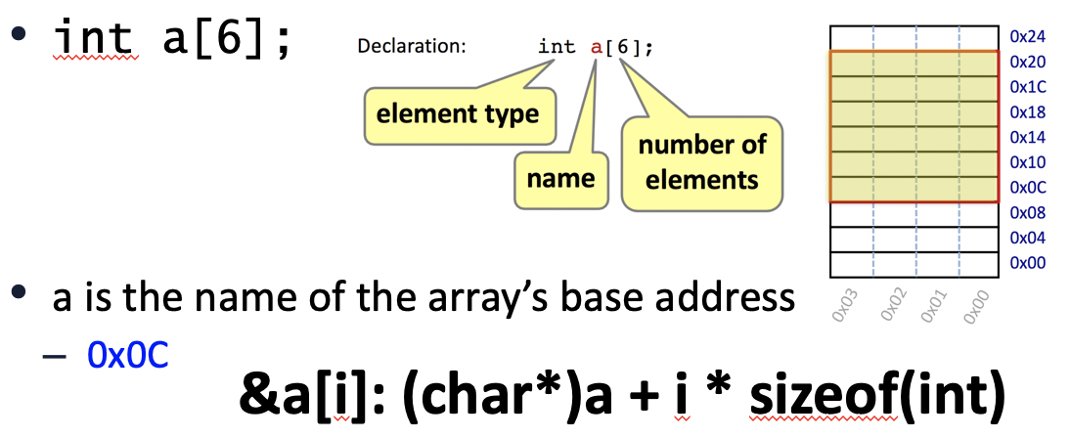
Memory Access Example
C code:
double A[N]; //double size is 8 bytes
A[12] = h + A[8];
  h in x21, base address of A in x22
Compiled RISC-V code:
  Index 8 requires offset of 64
  A[8] right-val, A[12]: left-val
ld x9, 64(x22) // load doubleword
add x9, x21, x9
sd x9, 96(x22) // store doubleword
64(x22) and 96(x22) are memory operands, in contrast to register operands (x9)

Slide 31
Load and Store Instructions
Format: ld rd, offset(rs1)
Example: ld x9, 64(x22) // load doubleword to x9
ld: load a doubleword from a memory location whose address is specified as rs1+offset (base+offset, x22+64) into register rd (x9)
  Base should be stored in an register, offset MUST be a constant number
  Address is specified similar to array element, e.g. A[8], for ld, the address is offset(base), e.g. 64(x22)
Format: sd rs2, offset(rs1)
Example: sd x9, 96(x22) // store a doubleword
sd: store a doubleword from register rs2 (x9 in the example) to a memory location whose address is specified as rs1+offset(base+offset, x22+96). Offset MUST be a constant number.
Load and store are the ONLY two instructions that access memory
lw: load a word from memory location to a register
sw: store a word from a register to a memory location

Slide 32
More Load/Store Examples: Addressing Memory
int A[100]; base address (A, or &A[0]) is in x23, int is 4 bytes
Format: lw rd, offset(rs1)
Example: lw x6, 16(x23) // load word from A[4] to x6
Format: sw rs2, offset(rs1)
Example: sw x7, 32(x23) // store a word from x7 to A[8]
L/S A[0]: address can be specified as 0(x23).
A scalar variable (e.g. int f;) can be considered as one-element array (e.g. int f[1]) for load/store its value between mem and reg
  L/S a variable’s (e.g. int f) 32-bit value stored in a specific memory address which is stored in register x6 to register x8
    lw x8, 0(x6) //offset is 0
    sw x8, 0(x6)

Slide 33
A[8] = A[10], base is in x23, each element 4 bytes
Lw x6, 40(x23)
Sw x6, 32(x23)
The context of the terms we use: base and offset
  For array/variable: base: &A[0], offset: bytes between A[0] and A[i];
  For LW/SW: base: base register, offset: the constant in the instr
  If you have address of A[4] in x9
    LW x5, 0(x9): load A[4]
    SW x5, 8(x9): store to A[6]
    SW x5, -8(x9): store to A[2]
Lab 02 helps you step-by-step for address

Slide 34
More Load/Store Examples: Addressing Memory B[i], i is NOT constant
int B[N], B2[N]; // int type, 4 byptes
B2[i] = B[i];
Base address for B and B2 are in register x22 and x23. i is stored in register x5
  We need load B[i] to a register, e.g. x9, and then store x9 to B[2]
  Need to use the address for B[i] and B2[i] in load and store
    base+offset: B+i*4, and B2+i*4
  But i*4 is not constant, cannot be the offset of load and store
  Solution: Calculate the address of B[i] and B2[i] and store in registers as base for LW/SW, and then use 0 as offset in L/S
  slliw x6, x5, 2 // x6 now store i*4, slliw is i<<2 (shift left logic)
  add x7, x22, x6 // x7 now stores address of B[i].
  lw x9, 0(x7) // load a word from memory location (x7+0), which is B[i], into
  // reg x9
  add x8, x23, x6 // x8 now stores the address of B2[i]
  sw x9, 0(x8) // store a word from register x9 to memory location (x8+0)
  // which is B2[i]

Slide 35
Registers vs. Memory
Registers are faster to access than memory
  ~100x faster, ~10 more expensive, and takes more space
Operating on memory data requires loads and stores
  More instructions to be executed
Compiler must use registers for variables as much as possible
  Only spill to memory for less frequently used variables
  Register optimization is important!

Slide 36
Constant or Immediate Operands
Constant data specified in an instruction
addi x22, x22, 4
No subtract immediate instruction
  Just use a negative constant
  addi x2, x1, -1
Design Principle 3: Make the common case fast
  Small constants are common
  Immediate operand avoids a load instruction

Slide 37
The Constant Zero
RISC-V register x0 is the constant 0 always
  Cannot be overwritten
Useful for common operations
  E.g., move between registers
  add x9, x5, x0
  addi x9, x5, 0

Slide 38
Two Classes of Instructions so Far
Arithmetic instructions
  Three operands, could be either register or immediate (for source operands only)
    add x10, x5, x6; sub x5, x4, x7
    addi x10, x5, 10;
Load and store (L/S) instructions: Load data from memory to register and store data from register to memory
  Remember the way of specifying memory address (base+offset)
  ld x9, 64(x22) // load doubleword
  sd x9, 96(x22) // store doubleword
With these two classes instructions, you can implement the following high-level code, and different ways of combining them
  f = (g + h) - (i + j);
  A[12] = h + A[8];
  For L/S: Left-value (of =) to Store, Right-value of (=) to Load

Slide 39
Psuedo-instructions Used in RARS
Are NOT machine instructions
Are assembly instructions that help programmers
  Translated to machine instructions by assembler
For example
  mv x6, x7 //move/copy value from x7 to x6
    Machine instruction: add x6, x7, x0 //since x0 is always 0
    Machine instruction: addi x6, x7, 0
  li x8, 100 //set the value of a register to be an immediate (load immediate)
    Machine instruction: addi x8, x0, 100
  la x10, label //load address of label to register
    Need two machine instructions
      auipc x8, xxx
      addi x0, x0, xxx

Slide 40
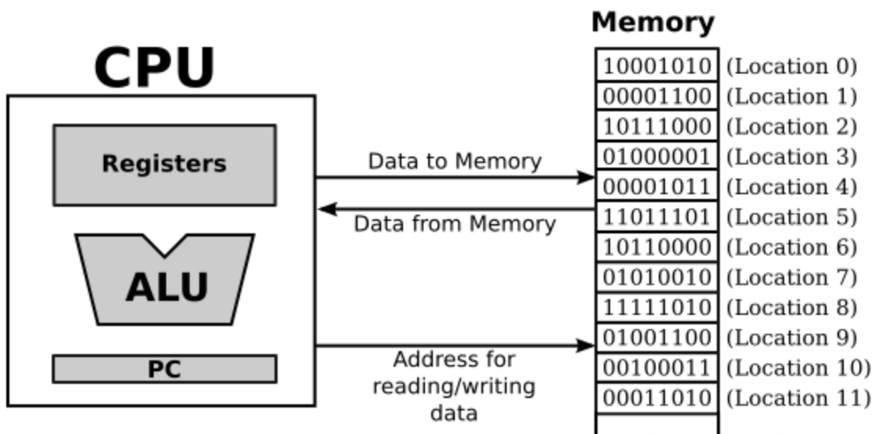
Clarifying the Terms
For ALU to access register
  Fetch and set
For move data between mem and register
  Load and store
For move data between storage and mem
  Read and write
Storage

Slide 41
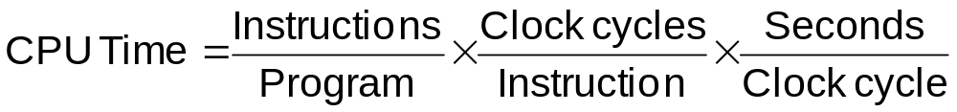
RISC vs. CISC
Design “philosophies” for ISAs: RISC vs. CISC
  CISC = Complex Instruction Set Computer
    X86, X86_64 (Intel and AMD, main-stream desktop/laptop/server)
    X86* internally are still RISC
  RISC = Reduced Instruction Set Computer
    ARM: smart phone/pad
    RISC-V: free ISA, closer to MIPS than other ISAs, the same textbook in RISC-V version
    Others: Power, SPARC, etc
Tradeoff:
RISC:
  Small instruction set
    Easier for compilers
  Limit each instruction to (at most):
    three register accesses,
    one memory access,
    one ALU operation
    => facilitates parallel instruction execution (ILP)
  Load-store machine: minimize off-chip access

Slide 42
Conditional Branch
Branch to the labeled instruction if a condition is true, otherwise continue
beq rs1, rs2, L1
  if (rs1 == rs2, i.e. true) branch to instruction labeled L1 (branch target);
  else continue the following instruction
  beq x1, x2, label1
  add x5, x6, x7
  …
  addi …
  label1: sub x5, x6, x7
  …
bne rs1, rs2, L1
  if (rs1 != rs2) branch to instruction labeled L1 (branch target);
  else continue the following instruction
J: unconditional jump (not an instruction)
  beq x0, x0, L1
§2.7 Instructions for Making Decisions
  beq x1, x2, label1
  add x5, x6, x7
  …
  addi …
  label1: sub x5, x6, x7
  …
False
True
True
Notes:
L2: addi x5, x5, 1 //L1 could be here
add x10, x5, x11
beq x5, x6, L1 //can branch backward
add x10, x10, x9
sub ….
…
L1: sub x10, x10, x9
add …
…
True

Slide 43
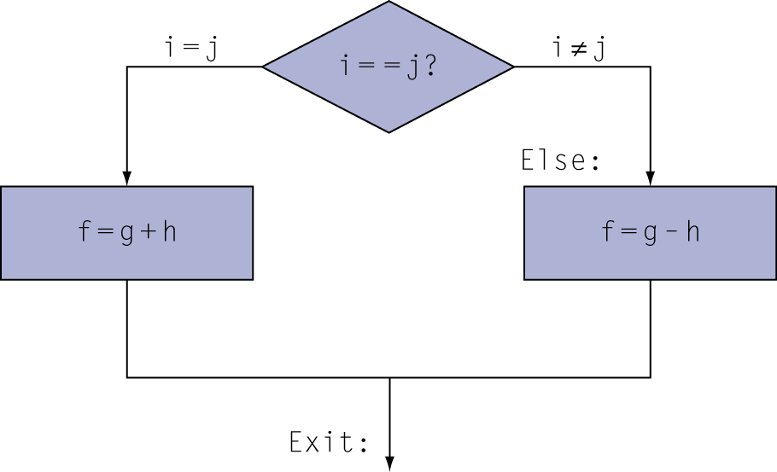
Translating If Statements 1/2
C code:
if (i==j) f = g+h;
else f = g-h;
Compiled RISC-V code:
bne x22, x23, Else //branch if not equal
add x19, x20, x21 //Then path
beq x0, x0, Exit //unconditional
Else: sub x19, x20, x21 //Else path
Exit: …
Variable | f | g | h | i | j
Register | x19 | x20 | x21 | x22 | x23
Using bne (reverse of if (==)) to branch to the Else path b.c. we want the code following the bne to be the code of the Then path
We need “beq x0 x0 Exit”, an unconditional jump, to let Then path terminate since CPU executes instruction in the sequence if not branching.

Slide 44
Translating If Statements 2/2
C code:
if (i==j) f = g+h;
else f = g-h;
Compiled RISC-V code:
beq x22, x23, Then //branch if equal
sub x19, x20, x21 //Else path
beq x0, x0, Exit //unconditional
Then: add x19, x20, x21 //Then path
Exit:
Variable | f | g | h | i | j
Register | x19 | x20 | x21 | x22 | x23
Using beq (for if (==)) to branch to the Then path
The instruction that follows the beq is the Else path
We need “beq x0 x0 Exit”, a unconditional jump, to let Else path terminate since CPU executes instruction in the sequence if not branching.
Notes:
beq x22 x23 then
F = g-h
Beq x0 x0 exit
Then: f=g+h
Exit

Slide 45
Translating Loop Statement
i = 0;
for (i=0; i<100; i++) { … }
while (i<100) { …; i++; }
Do the loop structure first
  Init condition
  Loop condition (using reverse relationship for branch instr)
  True path (the loop body)
  Loop back
  False path (break the loop)
Then translate the loop body
False
i < 100 ?
True
…
Exit
i ++
Loop: beq/bge x22, x23, Exit
… # loop body
addi x22, x22, 1
beq x0, x0, loop
Exit:
Using bge for (<) to branch to the false/exit path, which breaks the loop
The instruction(s) following bge are for the true path, which are for the loop body.
beq to jumping back to the beginning of the loop

Slide 46
Translating Loop Statement: for loop
i = 0;
C code:
for (i=0; i<100; i++) …
  i in x22
RISC-V code:
addi x22, x0, 0
li x23, 100
Loop: bge x22, x23, Exit //beq works
… …
addi x22, x22, 1 //true,the loop body,i++
beq x0, x0, Loop
Exit: …
False
i < 100 ?
True
…
Exit
i ++
Using bge for (<) to branch to the false/exit path, which breaks the loop
The instruction(s) following bge are for the true path, which are for the loop body.
beq to jumping back to the beginning of the loop

Slide 47
Translating Loop Statement: while loop (textbook 2.7)
C code:
while (save[i] == k) i += 1;
  i in x22, k in x24
  address of save in x25
RISC-V code: (save[i] is to be read/loaded)
Loop: slli x10, x22, 3 //x10 has i*8
add x10, x10, x25 //base+offset
ld x9, 0(x10)//save[i] in x9
bne x9, x24, Exit //false
addi x22, x22, 1 //true,the loop body,i=i+1
beq x0, x0, Loop
Exit: …
False
(save[i] == k) ?
True
Exit
i += 1
Using bne for (==) to branch to the false path, which breaks the loop by going to the Exit
The instruction(s) following bne are for the true path, which are for the loop body.
beq to jumping back to the beginning of the loop

Slide 48
More Conditional Operations
blt rs1, rs2, L1
  if (rs1 < rs2) branch to instruction labeled L1
bge rs1, rs2, L1
  if (rs1 >= rs2) branch to instruction labeled L1
Example:
if (a > b) a += 1; //a in x22, b in x23
  bge x23, x22, Exit // branch if b >= a
  addi x22, x22, 1
  Exit:

Slide 49
for (i=1; i<M-1; i++) B2[i] = B[i-1] + B[i] + B[i+1];
1-D stencil: B2[i] = B[i-1] + B[i] + B[i+1]; int type
  Representing a typical program pattern: Need to access a memory location and its surrounding area
Converting to assembly
  Similar to while loop
  Do the loop structure first (init, condition, loop back, etc)
  Then do the loop body
B[0]
B[1]
B[2]
B[3]
B[i-2]
B[i-1]
B[i]
B[i+1]
B[i+2]
B[N-4]
B[N-3]
B[N-2]
B[N-1]
B2[0]
B2[1]
B2[2]
B2[3]
B2[i-2]
B2[i-1]
B2[i]
B2[i+1]
B2[i+2]
B2[N-4]
B2[N-3]
B2[N-2]
B2[N-1]

Slide 50
for (i=1; i<M-1; i++) B2[i] = B[i-1] + B[i] + B[i+1];
Base address B and B2 are in register x22 and x23. i is stored in register x5, M is stored in x4.
  addi x5, x0, 1 // i=1
  addi x21, x4, -1 // loop bound x21 has M-1
  LOOP: bge x5, x21, Exit
  slliw x6, x5, 2 // x6 now store i*4, slliw is i<<2 (shift left logic)
  add x7, x22, x6 // x7 now stores address of B[i].
  lw x9, 0(x7) // load B[i] from memory location (x7+0) to x9
  lw x10, -4(x7) // load B[i-1] to x10
  add x9, x10, x9 // x9 = B[i] + B[i-1]
  lw x10, 4(x7) //load B[i+1] to x10
  add x9, x10, x9 // x9 = B[i-1] + B[i] + B[i+1]
  add x8, x23, x6 // x8 now stores the address of B2[i]
  sw x9, 0(x8) // store value for B2[i] from register x9 to memory (x8+0)
  addi x5, x5, 1 // i++
  beq x0, x0, LOOP
  Exit:
Using bge (>=) for <, i.e. reverse relationship, to exit

Slide 51
Why Use Reverse Relationship between High-level Language Code and instructions
L2: addi x5, x5, 1
add x10, x5, x11
beq x5, x6, L1
add x10, x10, x9
sub ….
…
L1: sub x10, x10, x9
add …
…
To keep the original code sequence
and structure as much as possible.
High level language
  If (==|>|<, …) true do the following things
  while (==|>|<, …) do the following things
  for (; i<M; …) do the following things
b* Instructions
  If (true), go to branch target,
    i.e. do NOT the following things of b*

Slide 52
Signed vs. Unsigned
Signed comparison: blt, bge
Unsigned comparison: bltu, bgeu
Example
  x22 = 1111 1111 1111 1111 1111 1111 1111 1111
  x23 = 0000 0000 0000 0000 0000 0000 0000 0001
  x22 < x23 // signed
    –1 < +1
    “blt x22 x23” true and branch to target
  x22 > x23 // unsigned
    +4,294,967,295 > +1
    “bltu x22 x23” false and not branch

Slide 53
Code Structure of A Program
.globl main #declare main function
.data # The .data section of the program is used to
# reserve memory to use for the variables/arrays
.text #The .text section is the actual code
main: #definition of main function

Slide 54
Declare An Array
.globl main #declare main function
.data #The .data section, for the variables/arrays
buffer: .space 8 #declare a symbol named "buffer" for
# 8 bytes of memory.
# For a word element, this correspond to "int buffer[2]"
#If you need to declare an array of 100 elements of int,
# use "myArray: .space 400
.text #The .text section of the program is the actual code
main: #definition of main function
la t0, buffer # set register t0 to have the address of the buffe[0]
li t1, 8 # Set register t1 to have immediate number 8

Slide 55
Random Number Generator
li a0, 0 # for random number seed
li a1, 100 # range of random number
li a7, 42 # rand code
ecall # call random number generator to generate a random number stored in a0
Check: https://github.com/TheThirdOne/rars/wiki/Environment-Calls

Slide 56
Memory.s file
.globl main #declare main function
.data #The .data section of the program is used to claim memory to use for the variables/arrays of the program
buffer: .space 8 #declare a symbol named "buffer" for 8 bytes of memory. For a word element, this coorespond to "int buffer[2]"
#This declaration claims 8 bytes of memory.
#If you need to declare an array of 100 elements of word, use "myArray: .space 400
.text #The .text section of the program is the actual code
main: #definition of main function
la t0, buffer # set register t0 to have the address of the buffer variable
li t1, 8 # Set register t1 to have immediate number 8
sw t1, 0(t0) # store a word (4 bytes) of what register t1 contains (8) to memory address 0(t0), which is buffer[0]
lw t2, 0(t0) # load a word from memory address 0(t0) to register t2, i.e. buffer[0] -> t2
bne t1, t2, failure # check whether register t1 and t2 contain the same value or not. If not, branch to failure, else continue the next instruction
li t3, 56 # set register t3 to have immediate 56
sw t3, 4(t0) # store a word of what register t3 contains (56) to memory address 4(t0), which is buffer[1]
addi t0, t0, 4 # increment register t0 (&buffer) by 4, t0 now contains buffer+4, which is &buffer[1]
lw t4, 0(t0) # load a word from memory 0(t0) (&buffer[1]) to register t4
bne t3, t4, failure # check whether register t3 and t4 contain the same value or not. If not, branch to failure, else continue.
lw t5, -4(t0) # load a word from memory -4(t0) to register t5. -4(t0) address is actually &buffer[0] since register t0 now contains the address of buffer[1]
bne t5,t1, failure # check whether register t5 and t1 contain the same value or not. They should both contain 8
li t1, 0xFF00F007 # set register t1 to have value 0xFF00F007
sw t1, 0(t0) # store a word of what register t1 contains to memory address 0(t0) (&buffer[1])
lb t2, 0(t0)

Slide 57
Example
Find the minimum of an array
    A is in t0, min is in t1, i is in t2, N is in t3
    # Init condition: i=0
    add t2, x0, x0 # li t2, 0
    lw t1, 0(t0)
Loop: bge t2, t3, Exit # (if i >= N) break the loop, the false path
    slli t6, t2, 2 #mul t6, t2, 4
    add t7, t0, t6
    lw t4, 0(t7)
    blt t4, t1, TRUE
    J FALSE
TRUE: add t1, x0, t4 # copy A[i] to min
FALSE:
    addi t2, t2, 1
    J loop #beq x0 x0 loop
Exit:
    int A[N];
    int min = A[0];
    for (i=0; i<N; i++) {
    if (A[i] < min) min = A[i]; //loop body
    }

Slide 58
Switch-case
int i;
switch (i) {
case 0:
a = 0;
break;
case 1:
a = 1;
break;
case 2:
a = 2;
break;
default:
a = i;
}

Slide 59
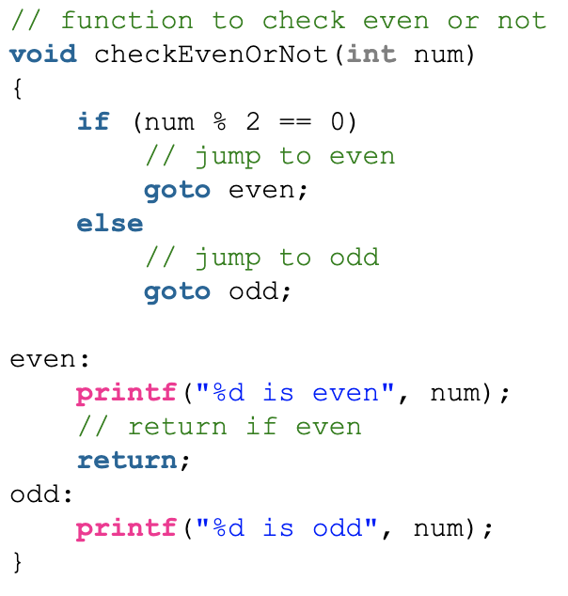
Branch is ”if ( … ) goto ” of high-level code
L2: addi x5, x5, 1
add x10, x5, x11
beq x5, x6, L1
add x10, x10, x9
sub ….
…
L1: sub x10, x10, x9
add …
…

Slide 60
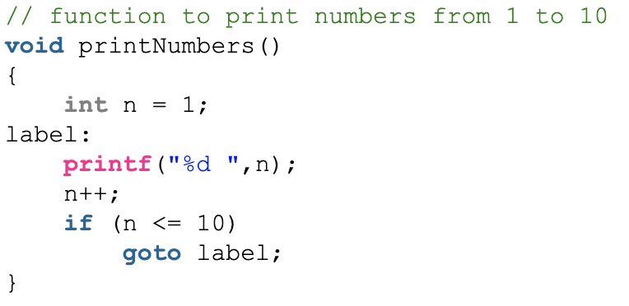
Branch is ”if ( … ) goto ” of high-level code
L2: addi x5, x5, 1
add x10, x5, x11
beq x5, x6, L1
add x10, x10, x9
sub ….
…
L1: sub x10, x10, x9
add …
…
Not directly
  If ( … ) {
  …
  } else {
  …
  }
With branch (if goto), we can implement:
  if … else
  for loop, while loop, do loop
  switch case

Slide 61
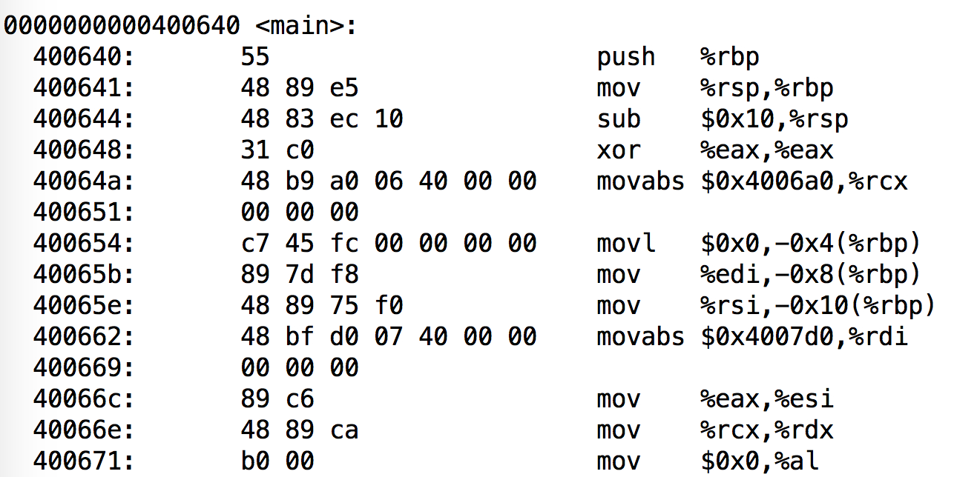
Label in C
Label (a program symbol) is the symbolic representation of the address of the memory that the instruction is stored in.

Slide 62
Compiling Loop Statements 2/3
C code:
while (save[i] == k) i += 1;
  i in x22, k in x24
  address of save in x25
RISC-V code: (save[i] is to be read/loaded)
Loop: slli x10, x22, 3 //x10 has i*8
add x10, x10, x25 //base+offset
ld x9, 0(x10)//newbase in x10
beq x9, x24, Body //True
beq x0, x0, Exit //False
Body: addi x22, x22, 1 //true,the loop body,i=i+1
beq x0, x0, Loop
Exit: …
False
(save[i] == k) ?
True
Exit
i += 1
Using beq for (==) to branch to the true path, which is the loop body
The instruction following beq is the false path, which breaks the loop by jumping to Exit
We need another beq to jumping back to the beginning of the loop, i.e. loop back
Not as elegant as the previous version, one more instruction in the code. But not necessary executing more instructions.

Slide 63
Chapter 2: Instructions: Language of the Computer
2.8 – 2.10 Procedure, String and Addressing for Wide
ITSC 3181 Introduction to Computer Architecture
Spring 2023 https://passlab.github.io/ITSC3181/
Department of Computer Science
Yonghong Yan
yyan7@uncc.edu
https://passlab.github.io/yanyh/

Slide 64
Three Classes of Instructions We Will Focus On:
Arithmetic-logic instructions
  add, sub, addi, and, or, shift left|right, etc
Memory load and store instructions
  lw and sw: Load/store word
  ld and sd: Load/store doubleword
Control transfer instructions (changing sequence of instruction execution)
  Conditional branch: bne, beq
  Unconditional jump: j
  Procedure call and return: jal and jr

Slide 65
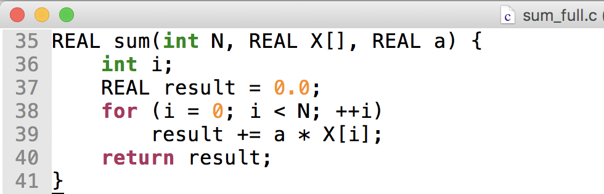
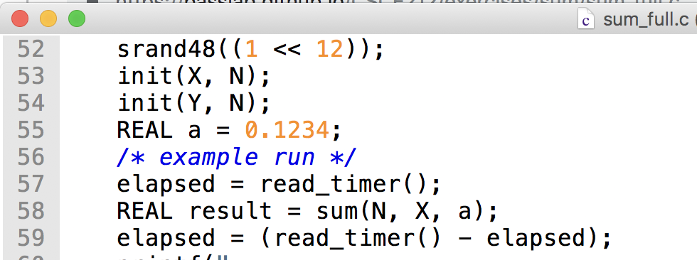
Procedure Call: sum_full.c
§2.8 Supporting Procedures in Computer Hardware
https://passlab.github.io/ITSC3181/exercises/sum

Slide 66
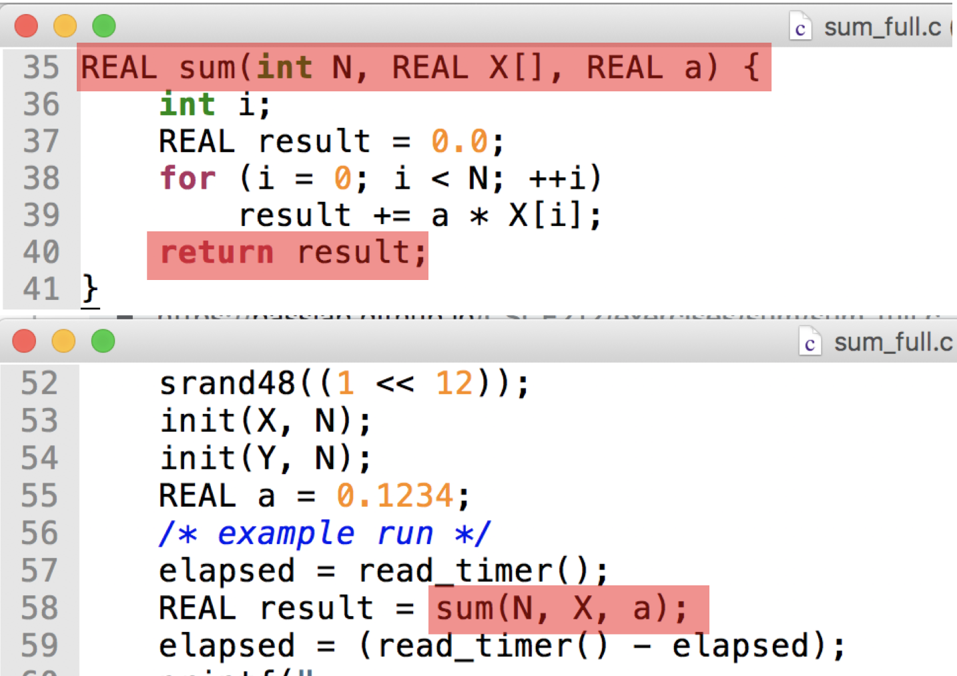
Procedure Call
Control is transferred when there is procedure call and return
Steps required
  Place parameters in registers
  Transfer control to procedure
  Acquire storage for procedure
  Perform procedure’s operations
  Place result in register for caller
  Return to place of call

Slide 67

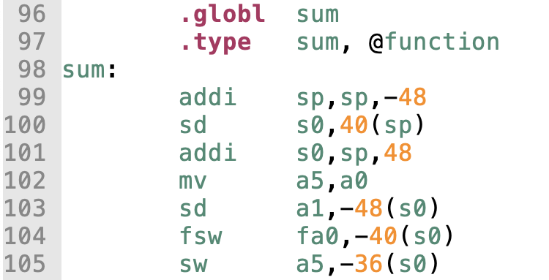
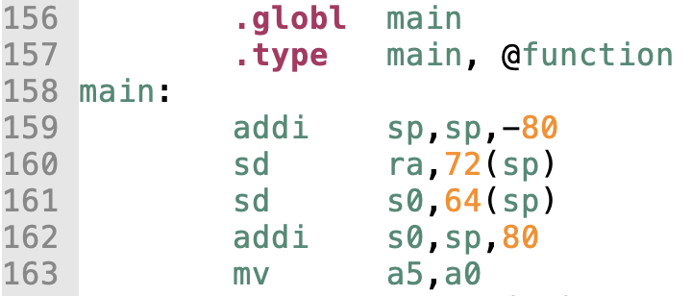
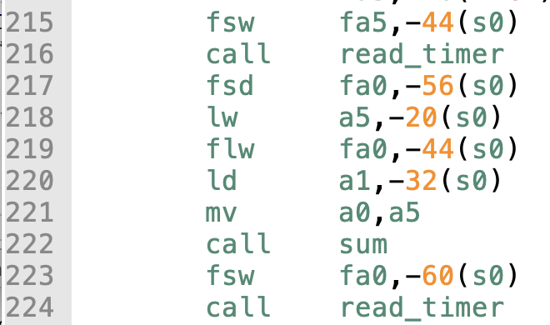
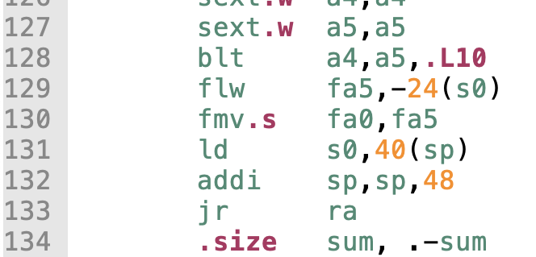
Sum Example, sum_full_riscv.s
Args for sum call
Store return address in reg and call transfer to sum
Return to caller with return value stored in register
https://passlab.github.io/ITSC3181/exercises/sum

Slide 68
Procedure Call Instructions
Procedure call: jump and link
jal x1, ProcedureLabel
  Address of following instruction put in x1
  Jumps to target address
Procedure return: jump and link register
jalr x0, 0(x1)
  Like jal, but jumps to 0 + address in x1
  Use x0 as rd (x0 cannot be changed)
  Can also be used for computed jumps
    e.g., for case/switch statements

Slide 69
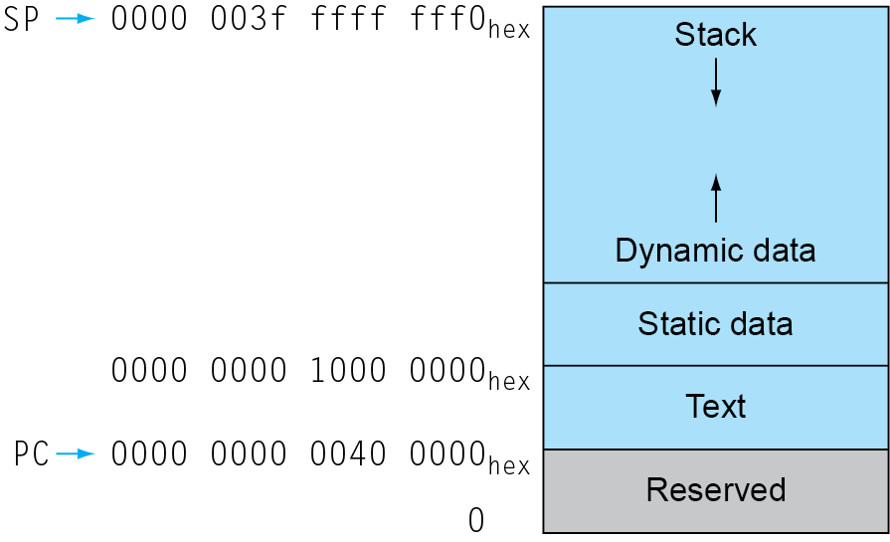
Memory Layout of a Process
Text: program code
Static data: global variables
  e.g., static variables in C, constant arrays and strings
  x3 (global pointer) initialized to address allowing ±offsets into this segment
Dynamic data: heap
  E.g., malloc in C, new in Java
Stack: automatic storage

Slide 70
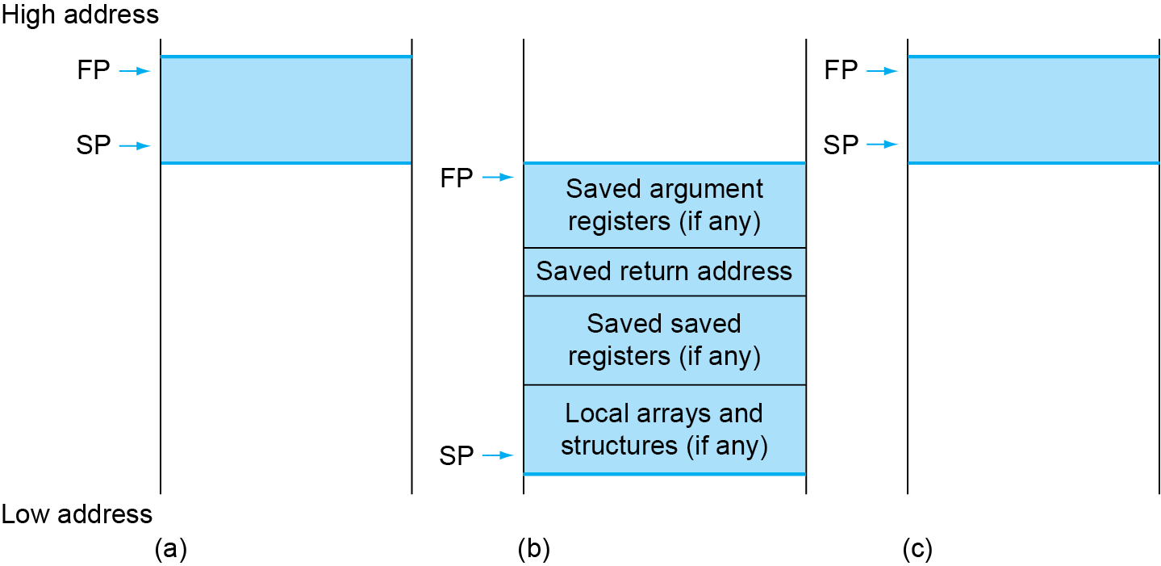
Local Data on the Stack
Local data allocated by callee
  e.g., C automatic variables
Procedure frame (activation record)
  Used by some compilers to manage stack storage

Slide 71
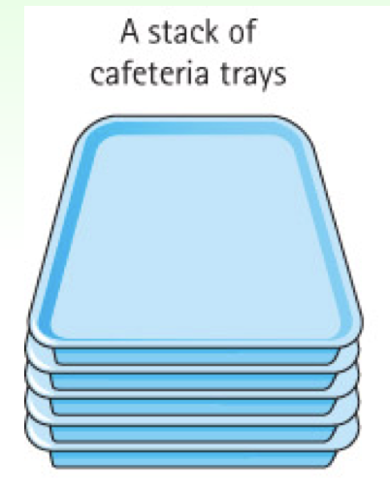
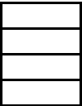
Stack Memory Used for Function Calls
Stack is Last-In-First-Out (LIFO) data structure to store the info of each function of the call path
  Main() calls foo(), foo() calls bar(), bar() calls tar()
  Call in: push function to the stack top
  Return: pop function from the top
Stack frame, function frame, activation record
  The memory and the data of the info for each function call
main()
foo()
bar()
tar()
top
push
pop

Slide 72
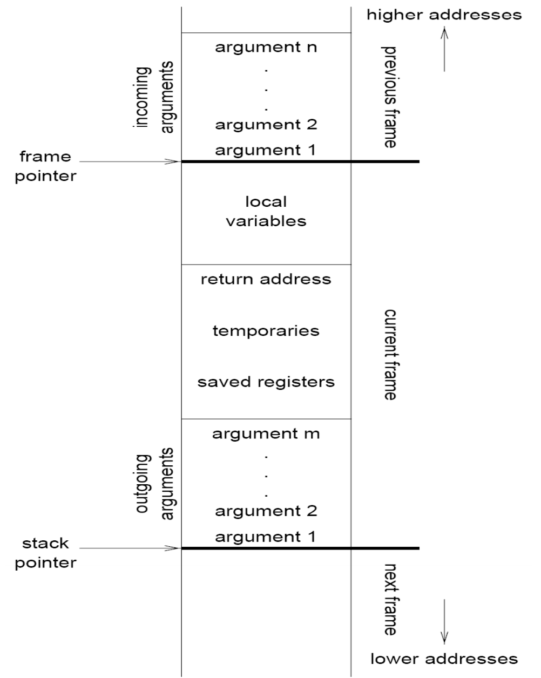
Stack Frame (Activation Record) of a Function Call
Information:
  Parameters
  Local variables
  Return address
  Location to put return value when function exits
  Control link to the caller’s activation record
  Saved registers
  Temporary variables and intermediate results
  (not always) Access link to the function’s static parent
Frame pointer (fp register): the starting address of AR
Stack pointer (sp register): the ending address of AR

Slide 73
Leaf Procedure Example
Leaf procedure
  A procedure does not call other procedures
    Thinking of procedure calls as a tree
C code:
long long int leaf_example (
long long int g, long long int h,
long long int i, long long int j) {
long long int f;
f = (g + h) - (i + j);
return f;
}
  Arguments g, …, j in x10, …, x13
  f in x20
  temporaries x5, x6
  Need to save x5, x6, x20 on stack

Slide 74
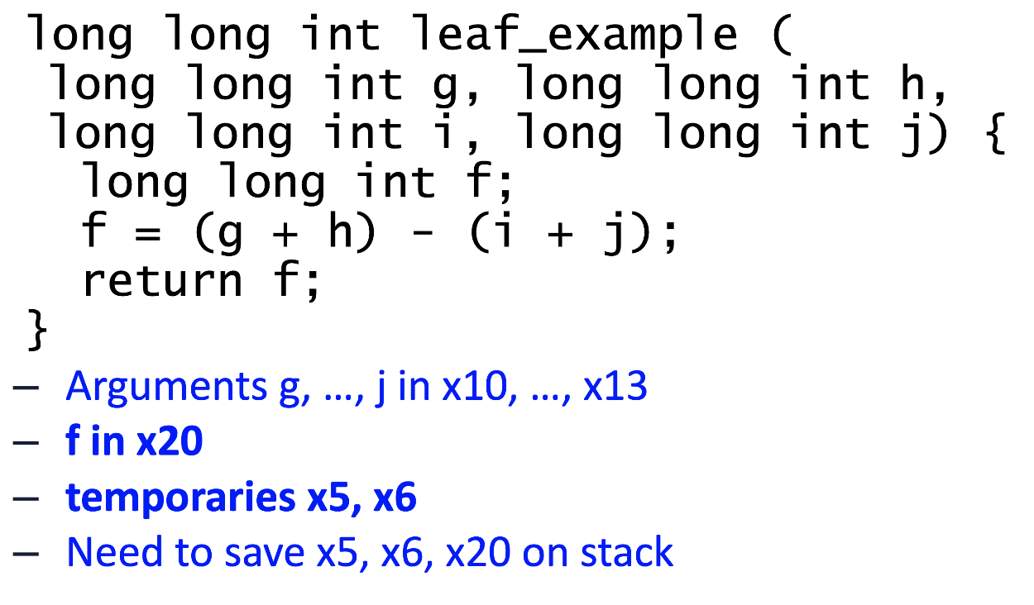
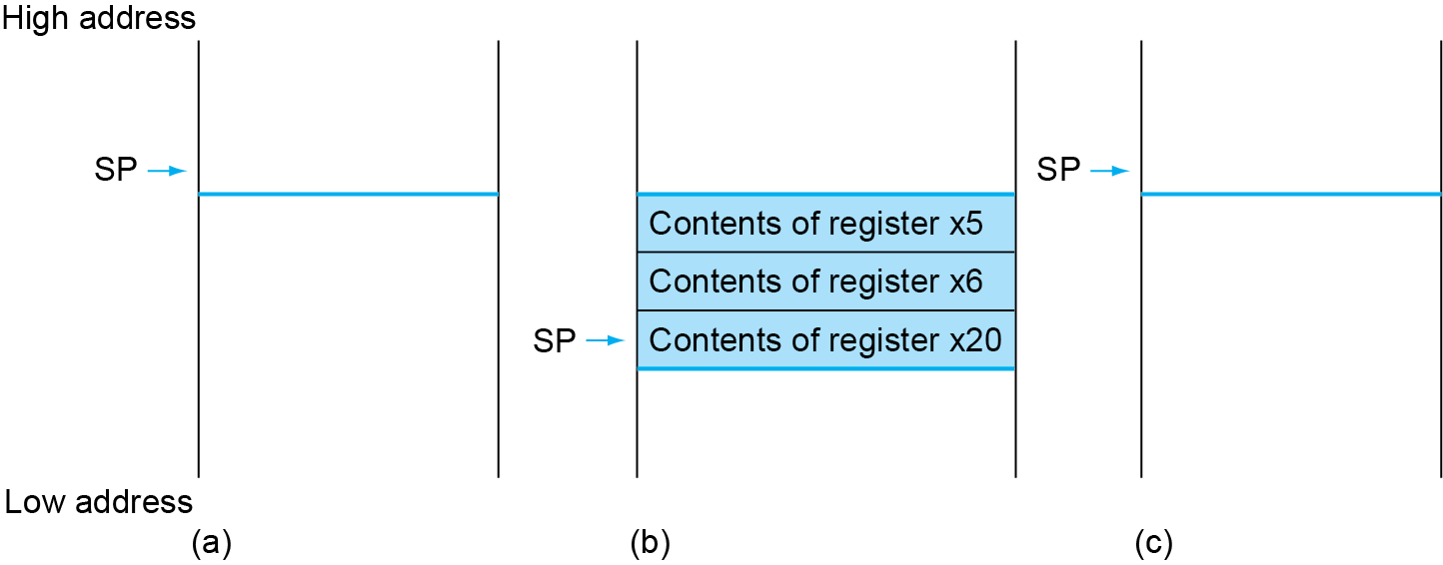
Local Data on the Stack
Stack before, during and after the function call
  SP (stack pointer) is the register that store the address of the current function call
int main ( … ) {
…
long long int result = leaf_example( … );
…
}
If caller uses x5, x6 or x20, we have to preserve them. They are preserved in the callee stack.

Slide 75
Leaf Procedure Example
RISC-V code:
leaf_example:
addi sp,sp,-24
sd x5,16(sp)
sd x6,8(sp)
sd x20,0(sp)
add x5,x10,x11
add x6,x12,x13
sub x20,x5,x6
addi x10,x20,0
ld x20,0(sp)
ld x6,8(sp)
ld x5,16(sp)
addi sp,sp,24
jalr x0,0(x1)
Adjust stack to make room for 3 items
Save x5, x6, x20 on stack
x5 = g + h
x6 = i + j
f = x5 – x6
copy f to return register
Resore x5, x6, x20 from stack
Adjust back to return memory for 3 items
Return to caller

